Slide 1
Introduction to Data Science
Carl Hope Korkpoe, PhD
Academic City University College
Accra, Ghana
carl.korkpoe@acity.edu.gh

Slide 2

Introducing Data Science

Slide 3
What is Data Science?
Data Science is about drawing useful conclusions from large and diverse data sets through exploration, prediction, and inference.
Exploration involves identifying patterns in information.
Prediction involves using information we know to make informed guesses about values we wish we knew.
Inference involves quantifying our degree of certainty: will the patterns that we found in our data also appear in new observations? How accurate are our predictions?

Slide 4
What Skills do Data Scientists Need?
The required skill sets for data scientists are often broken down into three key areas:
Mathematics/statistics to understand what types of analysis is possible and the techniques involved.
Databases/programming to write code that produces the algorithms that do the work.
Domain knowledge/business understanding to optimize the technical work referenced above to the unique conditions of the organization you are working for and the business domain you are operating in.

Slide 5
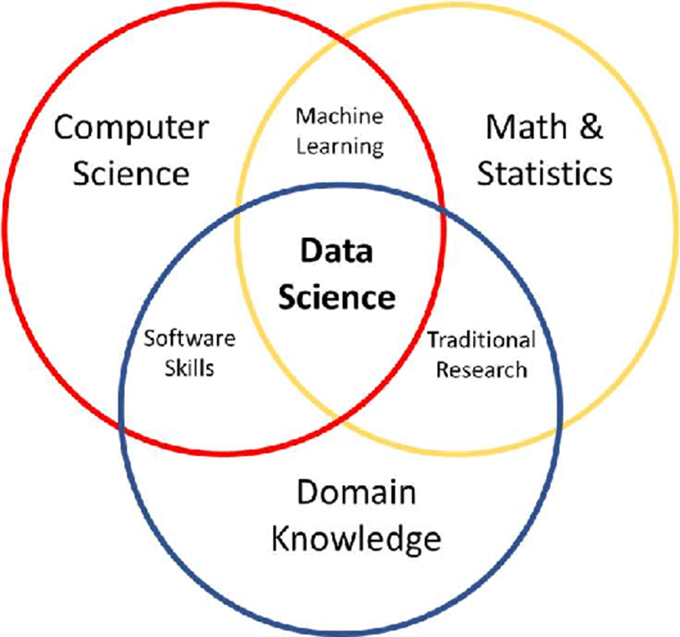

Slide 7
Tools for Data Science
Our primary tools for exploration are visualizations and descriptive statistics, for prediction are machine learning and optimization, and for inference are statistical tests and models.
Statistics is a central component of data science because statistics studies how to make robust conclusions based on incomplete information.

Slide 8
Computing
Computing is a central component because programming allows us to apply analysis techniques to the large and diverse data sets that arise in real-world applications.
Our data will include numbers, text, images, videos, and sensor readings.
Data science is all these things, but it is more than the sum of its parts because of the applications.
Through understanding a particular domain, data scientists learn to ask appropriate questions about their data and correctly interpret the answers provided by our inferential and computational tools.

Slide 9
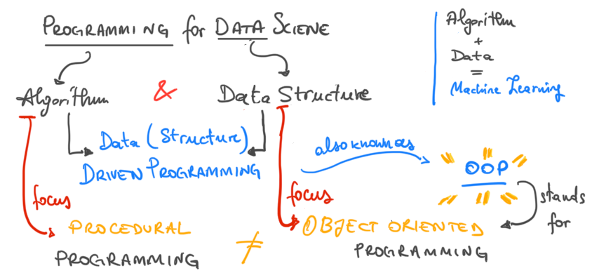
Nature of Programming

Slide 10
Defining Data
Data are descriptions of the world around us, collected through observation and stored on computers.
Data is information that can be interpreted by computers and used by humans in decision-making.
It is a collection of facts, such as numbers, words, measurements, observations or even just descriptions of things.

Slide 11
Sources of Data
In computing, data is typically stored electronically in the form of files or databases.
Data can come from many sources including user input (typed words or images), sensors (temperature readings.) or algorithms (calculations). . .
Computers enable us to infer properties of the world from these descriptions.
GIGO

Slide 12
Data Science formally. . .
Data science is a transdisciplinary field that tries to extract intelligence and conclusions from data using different techniques and models, be they simple or complex.
Data science comprises a range of mathematical and statistical concepts and requires a deep understanding of machine learning algorithms.
The data science process is composed of many steps besides just analyzing data.

Slide 13
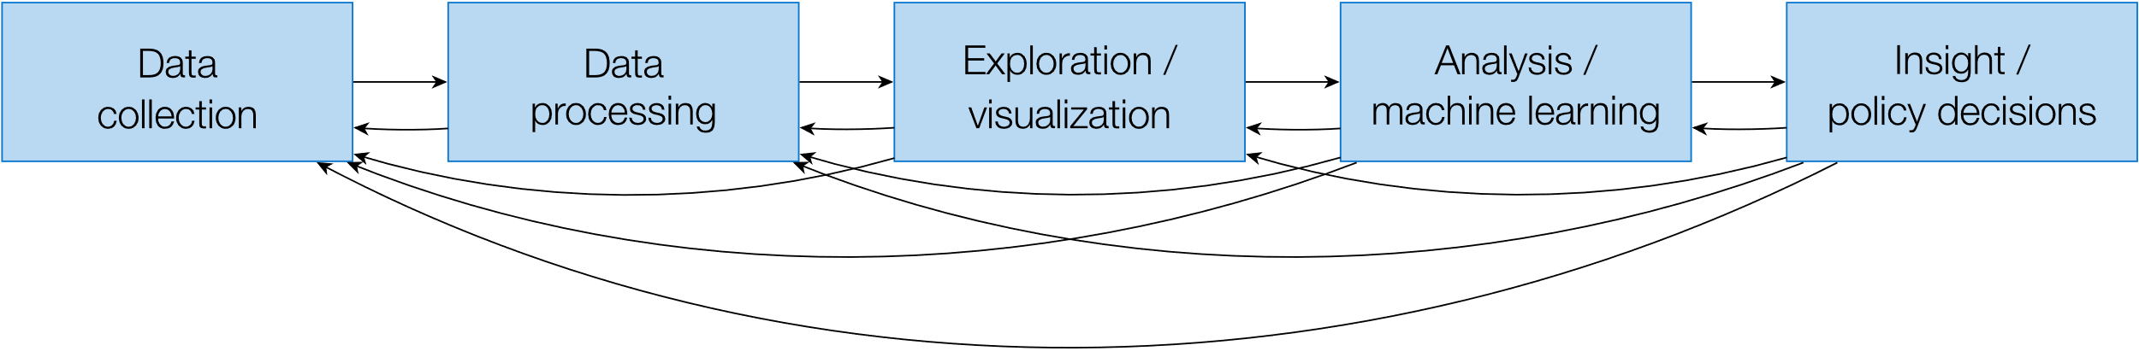
Data Science Pipeline

Slide 14
Challenges in Data Science
For whatever aspect of the world we wish to study—whether it’s the Earth’s weather, the world’s markets, political polls, or the human mind—data we collect typically offer an incomplete description of the subject at hand.
A central challenge of data science is to make reliable conclusions using this partial information.

Slide 15
Statistical Techniques
The discipline of statistics has long addressed the same fundamental challenge as data science: how to draw robust conclusions about the world using incomplete information.
One of the most important contributions of statistics is a consistent and precise vocabulary for describing the relationship between observations and conclusions.
Data science extends the field of statistics by taking full advantage of computing, data visualization, machine learning, optimization, and access to information.
The combination of fast computers and the Internet gives us the ability to access and analyze vast datasets: millions of news articles, full encyclopedias, databases for any domain, and massive repositories of music, photos, and video.

Slide 16
Why Data Science?
Most important decisions are made with only partial information and uncertain outcomes.
However, the degree of uncertainty for many decisions can be reduced sharply by access to large data sets and the computational tools required to analyze them effectively.
Data-driven decision making has already transformed a tremendous breadth of industries, including finance, advertising, manufacturing, and real estate.
At the same time, a wide range of academic disciplines are evolving rapidly to incorporate large-scale data analysis into their theory and practice.

Slide 17
Data Science Terminology
The following terms will have recurrent use throughout the course:
Data Mining: Data mining is the process of identifying patterns and learning information from huge datasets.
Machine Learning: Machine learning is a branch of artificial intelligence that gives computers the ability to learn and predict things without having to be explicitly programmed.
Predictive Modeling: Developing a mathematical model to forecast future results using data from the past is known as predictive modeling.
Big Data: The term used to describe extraordinarily massive and complicated datasets that are difficult to handle or analyze using conventional techniques.
Data visualization: The graphic representation of data to improve comprehension and effectively share insights.

Slide 18
Technical Tools for Data Science
Data science uses various tools to gather, examine, and understand data.
Some of these are:
Python: Data processing, analysis, and modeling are all common uses for Python. Scikit-learn, Pandas, and NumPy are all well-liked libraries.
R: R is mostly used for data visualization and statistical analysis. provides a variety of packages for data science projects.
Julia: About the latest open-sources languages available for data science. Used mainly by scientists and engineering.

Slide 20
Data Science Processes
Data science processes aim at turning a problem into a solution by exploiting data, computational techniques and infrastructures, and analysis techniques.
A data science process includes a set of steps as follows:
(1) Framing the problem;
(2) Collecting the needed data;
(3) Processing the data for analysis;
(4) Exploring the data;
(5) Performing in-depth analysis;
(6) Communicating the results of the analysis.

Slide 21
Data Science Skills
Data science connects strongly with areas such as databases and computer science.
Several different kinds of skills are needed, including non-mathematical ones.
The most relevant are:
learning the application domain;
communicating with data owners/users;
paying attention to data quality;
knowing how data can be represented;
managing data transformation and analysis;
knowing data visualization and presentation;
considering ethical issues.

Slide 22
Applications of Data Science
Data science has many uses in a wide range of businesses.
Some examples:
Healthcare: Patient data are analyzed using data science, and prediction models are created to help with disease diagnosis and treatment.
Finance: Data science enables financial firms to manage risks, spot fraud, and make wise investment choices.
Marketing: Data science gives marketers the ability to examine consumer behavior, customize marketing initiatives, and enhance pricing tactics.
Cybersecurity: Data science is used to analyze network data and spot patterns of harmful behavior to detect and stop cyber threats.

Slide 23
Doing Data Science Ethically
As with any discipline, there is always the potential for unethical behavior and abuse.
Data and the use of it is also at risk of such behaviour and misuse.
This is the reason data science ethics are so important.
There are several basic ethical guidelines for data science to keep in mind.

Slide 24
Entities should aim to collect the data they need, but not more.
They should protect relevant data with the best available technologies.
Furthermore, companies should also promote transparency and guard privacy by keeping data aggregated.

Slide 25
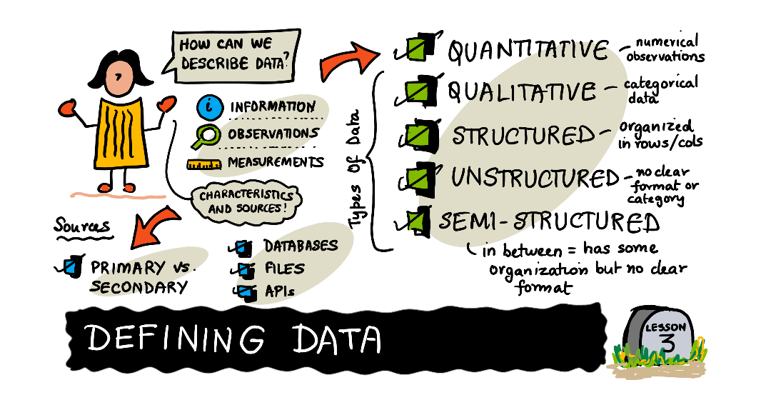
Going into data science. . .

Slide 26
Data Forms
We can identify three basic forms of data.
Structured
Unstructured
Semi-structured

Slide 27
Structured Data
Structured data is organized into rows and columns, where each row will have the same set of columns.
Columns will often have a specific set of rules or restrictions on the values, to ensure that the values accurately represent the column.
For example imagine a spreadsheet of customers where each row must have a phone number and the phone numbers never contain alphabetical characters.
Rules may be applied to the phone number column to ensure it is never empty and only contains numbers.
Examples of structured data: spreadsheets, relational databases, phone numbers, bank statements

Slide 28
Unstructured Data
This type cannot be categorized into rows or columns and doesn't contain a format or set of rules to follow.
Because unstructured data has less restrictions on its structure it's easier to add new information in comparison to a structured dataset.
If a sensor capturing data on barometric pressure every 2 minutes has received an update allowing it to measure and record temperature, it doesn't require altering the existing data if it's unstructured.
However, this may make analyzing or investigating this type of data challenging.
Examples of unstructured data: text files, text messages, video files

Slide 29
Semi-structured
Semi-structured data has features that make it a combination of structured and unstructured data.
It doesn't typically conform to a format of rows and columns but is organized in a way that is considered structured and may follow a fixed format or set of rules.
The structure will vary between sources, such as a well defined hierarchy to something more flexible that allows for easy integration of new information.
Metadata are indicators of how data is organized and stored and will have various names, based on the type of data.
Some common names for metadata are tags, elements, entities and attributes.
For example, a typical email message will have a subject, body and a set of recipients and can be organized by whom or when it was sent.
Examples of semi-structured data: HTML, CSV files, JavaScript Object Notation (JSON)

Slide 30
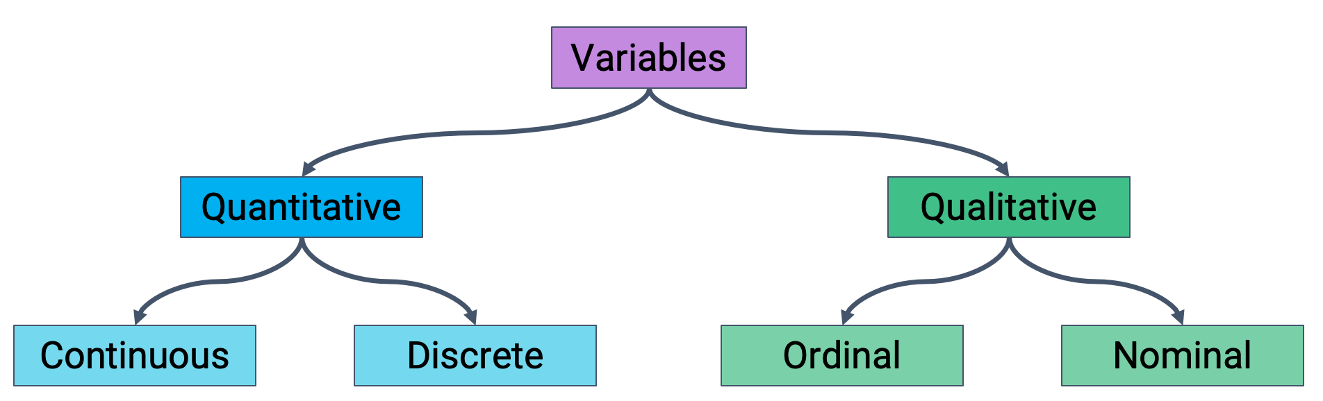
Variables

Slide 31
Quantitative Data
Quantitative data is numerical observations within a dataset and can typically be analyzed, measured and used mathematically.
Some examples of quantitative data are: a country's population, a person's height or a company's quarterly earnings.
With some additional analysis, quantitative data could be used to discover seasonal trends such as the Air Quality Index (AQI) or estimate the probability of rush hour traffic on a typical work day.

Slide 32
Qualitative Data
Qualitative data, also known as categorical data is data that cannot be measured objectively like observations of quantitative data.
It has generally various formats of subjective data that captures the quality of something, such as a product or process.
Sometimes, qualitative data is numerical and wouldn't be typically used mathematically, like phone numbers or timestamps.
Some examples of qualitative data are: video comments, the make and model of a car or your closest friends' favorite color.
Qualitative data could be used to understand which products consumers like best or identifying popular keywords in job application resumes.

Slide 33
Type of Data
The four basic types of data are:
Nominal data: Categorical data with no inherent ordering between the categories.
For example, a “pet type” variable could consist of the classes {dog, cat, rabbit}, and there is no relative ordering between these two types, they are just different discrete values.

Slide 34
Ordinal data: categorical data with an inherent ordering, but where the “differences” between categories has no strict numerical meaning.
The canonical example are survey responses such as: {strongly disagree, slightly disagree, neutral, slightly agree, strongly agree}.
The important character here is that although there is a clear ordering between these types, there is no sense in which the difference between slightly agree and strongly agree is the “same” as the difference between neutral and slightly agree.

Slide 35
Interval data
Interval data is numeric data, eg. data that can be mapped to a “number line”.
A classical example is temperature in Fahrenheit or Celsius.
Here the differences between temperatures have a meaning: 10 and 15 degrees are separated by the same amount as 15 and 20.
However, interval data encompasses instances where the zero point has “no real meaning”.
The ratio between two data points has no meaning.
Twenty degrees Fahrenheit is not “twice as hot” in any meaningful sense than 10 degrees; and certainly not infinitely hotter than zero degrees.

Slide 36
Ratio data is also numeric data.
The ratio between measurements does have some meaning.
The classical example here is temperature Kelvin.
Just like temperature Fahrenheit or Celsius, this describes the basic phenomenon of temperature, but unlike the previous cases, zero Kelvin has a meaning in terms of molecular energy in a substance (i.e., that there is none).
This means that ratios have a real meaning: a substance at 20 degrees Kelvin has twice as much kinetic energy at the molecular level as that substance as 10 degrees Kelvin.

Slide 37
Valid Operations on Data
Operations on two data points of the different types:
Nominal data: =,≠. All we can do with nominal data is compare two data points and test if they are equal or not.
Ordinal data: =,≠,<,>. In addition to checking for equality, we can also compare the ordering of different data points.
Interval data: =,≠,<,>,−. We have all the operations of ordinal data, but can also compute exact numeric differences between two data points.
Ratio data: =,≠,<,0,−,+,÷. We have all the operations of interval data, but addition is now virtually always allowed, and we can additional perform division (to determine ratios) between different data points.

Slide 38
A Dive into Python
Python is an Object-Oriented Programming (OOP) language.
In layman terms, it means that every number, string, data structure, function, class, module, etc., exists in the python interpreter as a python object.
An object may have attributes and methods associated with it.

Slide 39
Student Object
Student
- name
- programme Student Derick = new Student()
- GPA
- Residential Derick.name
writeExam() Derick.shout()
shout()
attendClasses()
goForLunch()

Slide 40
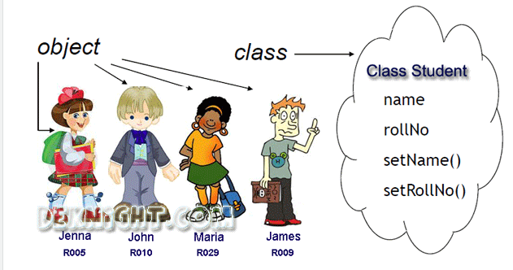
Class ➔ Objects

Slide 41
Hello World!
Let’s start with an example that appears in almost every programming book, which is to write “Hello World!” to the screen/output.
To print output in Python, use the print() function, which is a built-in function in Python.
This is a Python function.
Python functions are called by using the function name with parentheses after it.
Functions can accept arguments, which are variables and values that the function can act on.
The arguments for a function are put inside the parentheses, with commas separating different items.

Slide 42
To output text using print(), put it as an argument inside single or double quotation marks.
We will generally use single quotation marks because they do not require using the shift key to type.
print('Hello World!’)
print(32)
print([1, 4, 9, 16])

Slide 43
To print multiple items, just pass all the items as arguments to the print() function, but separate the items by commas:
print('Hello', 'world!', 10 + 5, [1, 4, 9, 16])
lucky_num = input('Enter your lucky number:')
Enter your lucky number:66
print(lucky_num)
66

Slide 44

The road ahead

Slide 45

When you open something, close it immediately!
()|$←$
{}|
[]|
' '
" "

Slide 46
Arithmetic Operators
Python provides all basic arithmetic operators.
The symbols which are used for mathematical operations are +, –, *, /, **, %, //, and a unary minus sign.

Slide 47
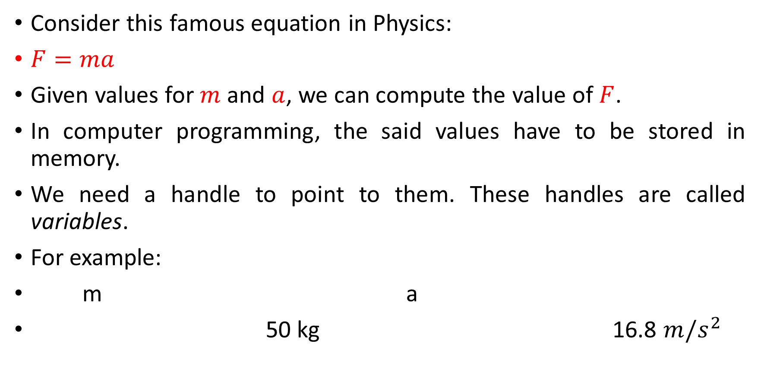
Variables in Python
Consider this famous equation in Physics:
$F=ma$
Given values for $m$ and $a$, we can compute the value of $F$.
In computer programming, the said values have to be stored in memory.
We need a handle to point to them. These handles are called variables.
For example:
m a
50 kg 16.8 $m/s^{2}$

Slide 48
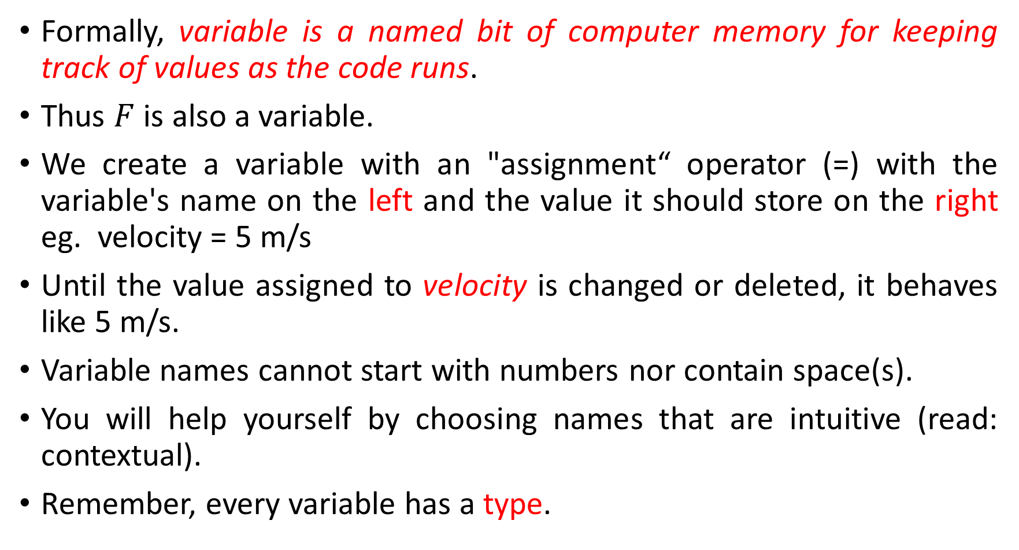
Formally, variable is a named bit of computer memory for keeping track of values as the code runs.
Thus $F$ is also a variable.
We create a variable with an "assignment“ operator (=) with the variable's name on the left and the value it should store on the right eg. velocity = 5 m/s
Until the value assigned to velocity is changed or deleted, it behaves like 5 m/s.
Variable names cannot start with numbers nor contain space(s).
You will help yourself by choosing names that are intuitive (read: contextual).
Remember, every variable has a type.

Slide 49
But. . .
Python has certain words that should never be used for naming out variables.
These are known as keywords or reserved words.
import keyword
keyword.kwlist
In most programming environments, these words will be highlighted in a different color as a warning to the programmer.

Slide 50
Rules for variable names
Variable names can be short (a, x, y, etc.) or descriptive ( my_favorite_color, profit_margin, the_3_musketeers, etc.).
However, use descriptive variable names as it makes it easier to understand the code.
Rules to be followed while naming Python variables:
A variable’s name must start with a letter or the underscore character _. It cannot begin with a number.
A variable name can only contain lowercase (small) or uppercase (capital) letters, digits, or underscores (a-z, A-Z, 0-9, and _).
Variable names are case-sensitive, i.e., a_variable, A_Variable, and A_VARIABLE are all different variables.

Slide 51
Examples
Here are some valid variable names:
a_variable = 23
is_today_Saturday = False
my_favorite_car = "BMW"
the_3_musketeers = ["Athos", "Porthos", "Aramis"]

Slide 52
Invalid variable names
Let’s try creating some variables with invalid names.
Python prints a syntax error if the variable’s name is invalid.
Syntax: The syntax of a programming language refers to the rules that govern the structure of a valid instruction or statement. If a statement does not follow these rules, Python stops execution and informs you that there is a syntax error. Syntax can be thought of as the rules of grammar for a programming language.
Runtime: These errors happen while the program is running and is attempting to execute an operation that it cannot perform. The program crashes or stops unexpectedly during execution. eg. Attempting to divide a number by zero, or trying to access a file that doesn't exist.
Logic: These errors occur when the program's logic is flawed, meaning it runs without crashing but produces an incorrect result.

Slide 53
Invalid variable names
a variable = 23
is_today_$aturday = False
my-favorite-car = "Delorean"
3_musketeers = ["Athos", "Porthos", "Aramis"]

Slide 54
Built-in data types
Variable is created as soon as a value is assigned to it.
average = 26
We don’t have to define the type of variable explicitly as in other programming languages because Python can automatically guess the type of data entered (dynamically typed).
Any data or information stored within a Python variable has a type.
We can view the type of data stored within a variable using the type() function.

Slide 55
a_variable
type(a_variable)
is_today_Saturday
type(is_today_Saturday)
my_favorite_car
type(my_favorite_car)
the_3_musketeers
type(the_3_musketeers)

Slide 56
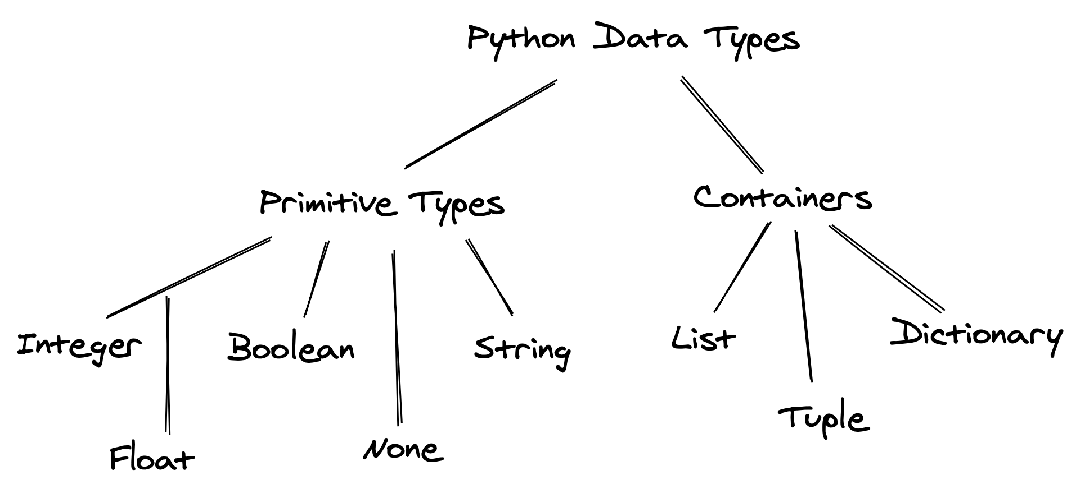
Python has several built-in data types for storing different kinds of information in variables.

Slide 57
Primitive: Integer, float, boolean, None, and string are primitive data types because they represent a single value.
Containers: Other data types like list, tuple, and dictionary are often called data structures or containers because they hold multiple pieces of data together.

Slide 58
The data type of the object can be identified using the in-built python function type().
For example, see the following objects and their types:
type(4)
type(4.4)
type('4')
type(True)

Slide 59
Built-in modules and functions
Built-in functions in Python are a set of predefined functions that are available for use without the need to import any additional libraries or modules.
The Python Standard Library is very extensive.
Besides built-in functions, it also contains many Python scripts (with the . py extension) containing useful utilities and modules written in
Python that provide standardized solutions for many problems that occur in everyday programming.

Slide 60
Examples
range(): The range() function returns a sequence of evenly-spaced integer values.
It is commonly used in for loops to define the sequence of elements over which the iterations are performed.
Below is an example where the range() function is used to create a sequence of whole numbers up to 10:
print(list(range(1,10)))

Slide 61
The advantage of the range type over a regular list or tuple is that a range object will always take the same (small) amount of memory.
No matter the size of the range it represents (as it only stores the start, stop and step values, calculating individual items and subranges as needed).
Date time: Python as a built-in datetime module for handling date/time objects:
import datetime as dt
dt_object = dt.datetime.now()
dt_object.day

Slide 62
dt_object.strftime('%m/%d/%Y’)
dt_object.strftime('%m/%d/%y %H:%M’)
dt_object.strftime('%h-%d-%Y')

Slide 63
Importing libraries
There are several built-in functions in python like print(), abs(), max(), sum() etc., which do not require importing any library.
However, these functions will typically be insufficient for a analyzing data.
Some of the popular libraries are the core of everything in python.

Slide 64
NumPy: NumPy is a fundamental library for numerical computing in Python. It provides support for arrays, matrices, and mathematical functions, making it essential for scientific and data analysis tasks.. It is mostly used for performing numerical operations and efficiently storing numerical data.
Pandas: Pandas is a powerful data manipulation and analysis library. It offers data structures like DataFrames and Series, which facilitate data reading, cleaning, transformation, and analysis, making it indispensable in data science projects.

Slide 65
Matplotlib, Seaborn: Matplotlib is a comprehensive library for creating static, animated, or interactive plots and visualizations.
It is commonly used for data visualization and exploration in data science.
Seaborn is a Python data visualization library based on matplotlib.
It provides a high-level interface for drawing attractive and informative statistical graphics.
SciPy: SciPy is used for performing scientific computing such as solving differential equations, optimization, statistical tests, etc.

Slide 66
Scikit-learn: Scikit-learn is a machine learning library that provides a wide range of tools for data pre-processing, classification, regression, clustering, dimensionality reduction, and more.
It simplifies the implementation of machine learning algorithms and model evaluation.
Statsmodels: Statsmodels is used for developing statistical models with a focus on inference (in contrast to focus on prediction as in scikit-learn).

Slide 67
Package Use
To use libraries like NumPy, pandas, Matplotlib, and scikit-learn in Python, you typically need to follow these steps:
Install the libraries (Anaconda already does this)
Import the libraries in the python script or jupyter notebook
Use the Library Functions and Classes: After importing the libraries, you can use their functions, classes, and methods in your code.

Slide 68
For instance, you can:
create NumPy arrays,
manipulate data with pandas,
create plots with Matplotlib, or
train machine learning models with scikit-learn.

Slide 69
Example. . .
A library can be imported using the import keyword.
For example, a NumPy library can be imported as:
import numpy as np
Here NumPy library has been given the name np.
All the functions and attributes of the library can be called using the ‘np.’ prefix.
For example, let us generate a sequence of whole numbers up to 10 using the NumPy function arange():
np.arange(11)

Slide 70
Different ways to import
There’s different ways to import:
Import the whole module using its original name:
import math, os
Import specific things from the module:
from random import randint
from math import pi
Import the whole library and rename it, usually using a shorter variable name:
import pandas as pd
Import a specific method from the module and rename it as it is imported:
from os.path import join as join_path

Slide 71
Installing a package
Sometimes the package you need isn’t available in your default installation.
You have to install it.
Let’s say you need data on US census and income which is available at: https://archive.ics.uci.edu/dataset/20/census+income.
Someone told you it is available in the package called ucimlrepo.
The way to install it is:
pip install ucimlrepo
To use it, we import
from ucimlrepo import fetch_ucirepo

Slide 72
Let’s fetch the data
census_income = fetch_ucirepo(id=20)
type(census_income)
Out[14]: ucimlrepo.dotdict.dotdict
# data (as pandas dataframes)
X = census_income.data.features
y = census_income.data.targets
type(X)
Out[16]: pandas.core.frame.DataFrame
type(y)
Out[17]: pandas.core.frame.DataFrame

Slide 73
# metadata
print(census_income.metadata)
print(census_income.variables)
name role ... units missing_values
0 age Feature ... None no
1 workclass Feature ... None yes
2 fnlwgt Feature ... None no
3 education Feature ... None no

Slide 74
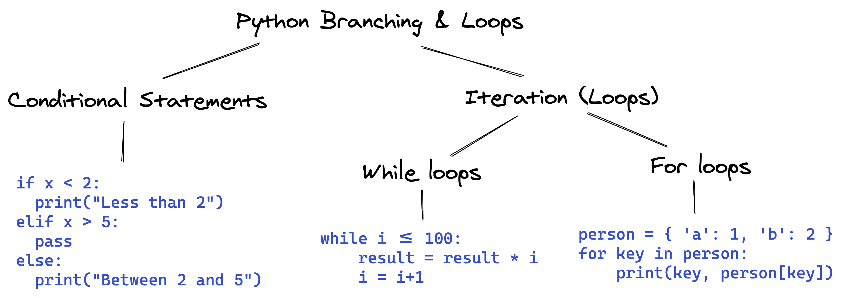
Control Flow
Python has built-in keywords that provide conditional flow of control in the code.

Slide 75
Branching with if, else and elif
One of the most powerful features of programming languages is branching ie. the ability to make decisions and execute a different set of statements based on whether one or more conditions are true.
The three keywords – if, else and elif – are used to examine programming logic to decide which code to execute.

Slide 76
Boolean Expressions
We came across Boolean type: True or False.
By boolean expressions we mean expressions that evaluate to either True or False based on a comparison between two or more values.
You use these expressions in if statements as well as in looping statements.

Slide 77
Relational operators

Slide 78
The if statement
if structure controls the execution of statements based on the results of a Boolean expression.
In Python, branching is implemented using the if statement, which is written as follows:
if condition:
statement1
statement2
The condition can be a value, variable or expression.
If the condition evaluates to True, then the statements within the if block are executed.

Slide 79
Notice the four spaces before statement1, statement2, etc.
The spaces inform Python that these statements are associated with the if statement above.
This technique of structuring code by adding spaces is called indentation.

Slide 80
Indentation
Python relies heavily on indentation (white space before a statement) to define code structure.
This makes Python code easy to read and understand.
You can run into problems if you don’t use indentation properly.
Indent your code by placing the cursor at the start of the line and pressing the Tab key once to add 4 spaces.
Pressing Tab again will indent the code further by 4 more spaces. . .

Slide 81
Let’s write some code to check and print a message if a given number is even.
a_number = 34
if a_number % 2 == 0:
...: print("We're inside an if block")
...: print('The given number {} is even.'.format(a_number))
We're inside an if block
The given number 34 is even.

Slide 82
The else statement
We may want to print a different message if the number is not even in the above example.
This can be done by adding the else statement.
It is written as follows:
if condition:
statement1
statement2
else:
statement4
statement5
If condition evaluates to True, the statements in the if block are executed. If it evaluates to False, the statements in the else block are executed.

Slide 83
a_number = int(input('Enter a number:'))
Enter a number:27
if a_number % 2 == 0:
...: print('The given number {} is even.'.format(a_number))
else:
...: print('The given number {} is odd.'.format(a_number))
...:
The given number 27 is odd.

Slide 84
The elif statement
Python also provides an elif statement (short for “else if”) to chain a series of conditional blocks.
The conditions are evaluated one by one.
For the first condition that evaluates to True, the block of statements below it is executed.
The remaining conditions and statements are not evaluated.
So, in an if, elif, elif… chain, at most one block of statements is executed, the one corresponding to the first condition that evaluates to True.

Slide 85
today = 'Wednesday'
if today == 'Sunday':
...: print("Today is the day of the sun.")
elif today == 'Monday':
...: print("Today is the day of the moon.")
elif today == 'Tuesday':
...: print("Today is the day of Tyr, the god of war.")
elif today == 'Wednesday':
...: print("Today is the day of Odin, the supreme diety.")
elif today == 'Thursday':
...: print("Today is the day of Thor, the god of thunder.")
elif today == 'Friday':
...: print("Today is the day of Frigga, the goddess of beauty.")
elif today == 'Saturday':
...: print("Today is the day of Saturn, the god of fun and feasting.")

Slide 86
Using if, elif, and else together
You can also include an else statement at the end of a chain of if, elif… statements.
This code within the else block is evaluated when none of the conditions hold true.

Slide 87
score = float(input(‘Enter exam score:’))
if score >= 90:
...: grade = 'A'
elif score >= 80:
...: grade = 'B'
elif score >= 70:
...: grade = 'C'
elif score >= 60:
...: grade = 'D'
else:
...: grade = 'F'

Slide 88
print(‘The exam grade for {} is {}’.format(score, grade))

Slide 89
a_number = int(input('Enter a number:'))
Enter a number:49
if a_number % 2 == 0:
...:print('{} is divisible by 2'.format(a_number))
elif a_number % 3 == 0:
...:print('{} is divisible by 3'.format(a_number))
elif a_number % 5 == 0:
...:print('{} is divisible by 5'.format(a_number))
else:
...: print('All checks failed!')
...: print('{} is not divisible by 2, 3 or 5'.format(a_number))

Slide 90
Non-Boolean Conditions
Note that conditions do not necessarily have to be booleans.
In fact, a condition can be any value.
The value is converted into a boolean automatically using the bool operator.
Any value in Python can be converted to a Boolean using the bool function.
Only the following values evaluate to False (they are often called falsy values):

Slide 91
The value False itself
The integer 0
The float 0.0
The empty value None
The empty text ""
The empty list []
The empty tuple ()
The empty dictionary {}
The empty set set()
The empty range range(0)
Everything else evaluates to True (a value that evaluates to True is often called a truthy value).

Slide 92
if '':
print('The condition evaluated to True')
else:
print('The condition evaluated to False')

Slide 93
if 'Hello':
print('The condition evaluated to True')
else:
print('The condition evaluated to False')

Slide 94
if { 'a': 34 }:
print('The condition evaluated to True')
else:
print('The condition evaluated to False')

Slide 95
if None:
print('The condition evaluated to True')
else:
print('The condition evaluated to False')

Slide 96
Nested conditional statements
The code inside an if block can also include an if statement inside it.
This pattern is called nesting and is used to check for another condition after a particular condition holds true.
a_number = 15

Slide 97
if a_number % 2 == 0:
print("{} is even".format(a_number))
if a_number % 3 == 0:
print("{} is also divisible by 3".format(a_number))
else:
print("{} is not divisibule by 3".format(a_number))
else:
print("{} is odd".format(a_number))
if a_number % 5 == 0:
print("{} is also divisible by 5".format(a_number))
else:
print("{} is not divisibule by 5".format(a_number))

Slide 98
Shorthand if conditional expression
A frequent use case of the if statement involves testing a condition and setting a variable’s value based on the condition.
Python provides a shorter syntax, which allows writing such conditions in a single line of code.
It is known as a conditional expression, sometimes also referred to as a ternary operator. It has the following syntax:
x = true_value if condition else false_value

Slide 99
It has the same behavior as the following if-else block:
if condition:
x = true_value
else:
x = false_value

Slide 100
a_number = 15
parity = 'even' if a_number % 2 == 0 else 'odd'
print('The number {} is {}.'.format(a_number, parity))
The number 15 is odd.
if a_number % 2 == 0:
parity = 'even'
else:
parity = 'odd'

Slide 101
The pass statement
if statements cannot be empty, there must be at least one statement in every if and elif block.
We can use the pass statement to do nothing and avoid getting an error.
a_number = 9
if a_number % 2 == 0:
elif a_number % 3 == 0:
print('{} is divisible by 3 but not divisible by 2')

Slide 102
Iteration with while loops
Another powerful feature of programming languages, closely related to branching, is running one or more statements multiple times.
This feature is often referred to as iteration or looping, and there are two ways to do this in Python: using while loops and for loops.
while loops have the following syntax:
while condition:
statement(s)

Slide 103
Statements in the code block under while are executed repeatedly as long as the condition evaluates to True.
Generally, one of the statements under while makes some change to a variable that causes the condition to evaluate to False after a certain number of iterations.
Let’s try to calculate the factorial of 10 using a while loop.
The factorial of a number n is the product (multiplication) of all the numbers from 1 to n, i.e., 1*2*3*...*(n-2)*(n-1)*n.

Slide 104
Code
result = 1
i = 1
while i <= 10:
result = result * i
i = i+1
print('The factorial of 10 is: {}'.format(result))

Slide 105
Infinite Loops
Suppose the condition in a while loop always holds true.
In that case, Python repeatedly executes the code within the loop forever, and the execution of the code never completes.
This situation is called an infinite loop.
It generally indicates that you’ve made a mistake in your code.
For example, you may have provided the wrong condition or forgotten to update a variable within the loop, eventually falsifying the condition.

Slide 106
**Don’t run this code
# INFINITE LOOP - INTERRUPT THIS CELL
result = 1
i = 1
while i <= 100:
result = result * i
# forgot to increment i

Slide 107
**Don’t run this code
# INFINITE LOOP - INTERRUPT THIS CELL
result = 1
i = 1
while i > 0 : # wrong condition
result *= i
i += 1

Slide 108
break and continue statements
In Python, break and continue statements can alter the flow of a normal loop.

Slide 109
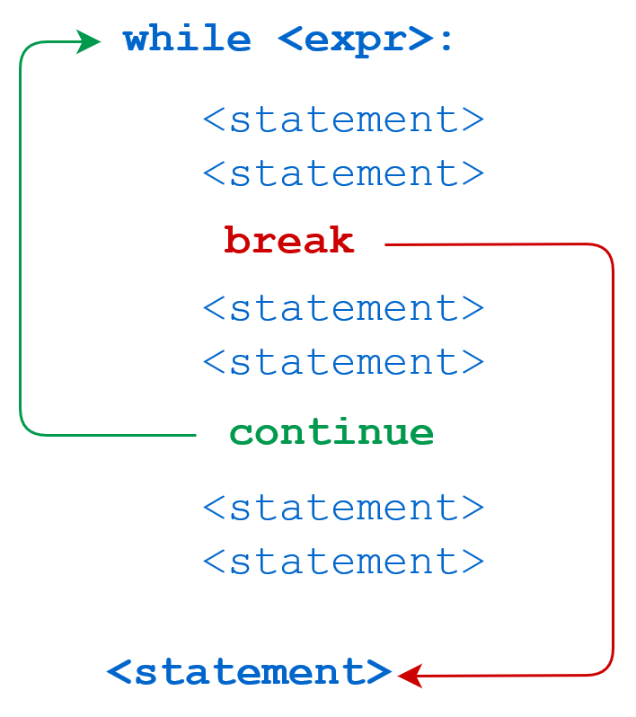

Slide 110
We can use the break statement within the loop’s body to immediately stop the execution and break out of the loop.
With the continue statement, if the condition evaluates to True, then the loop will move to the next iteration.

Slide 111
Example - break
i = 1
result = 1
while i <= 100:
result *= i
if i == 42:
print('Magic number 42 reached! Stopping execution..')
break
i += 1
print('i:', i)
print('result:', result)

Slide 112
Example - continue
i = 1
result = 1
while i < 8:
i += 1
if i % 2 == 0:
print('Skipping {}'.format(i))
continue
print('Multiplying with {}'.format(i))
result = result * i
print('i:', i)
print('result:', result)

Slide 113
Exercise
# Use of break statement inside the loop
for val in "string":
if val == "i":
break
print(val)
print("The end")

Slide 114
Exercise
# Program to show the use of continue statement inside loops
for val in "string":
if val == "i":
continue
print(val)
print("The end")

Slide 115
Iteration with for loops
A for loop is used for iterating or looping over sequences, i.e., lists, tuples, dictionaries, strings, and ranges.
for loops have the following syntax:
for value in sequence:
statement(s)
The statements within the loop are executed once for each element in sequence.
The sequence is anything iterable. [3, 4, 12, 8, -5]

Slide 116
Here’s an example that prints all the elements of a list.
days = ['Monday', 'Tuesday', 'Wednesday', 'Thursday', 'Friday']
for day in days:
print(day)

Slide 117
# Looping over a string
for char in 'Monday':
print(char)

Slide 118
# Looping over a dictionary
person = {
'name': 'John Doe',
'sex': 'Male',
'age': 32,
'married': True
}
for key, value in person.items():
print("Key:", key, ",", "Value:", value)

Slide 119
Iterating using range and enumerate
The range function is used to create a sequence of numbers that can be iterated over using a for loop.
It can be used in 3 ways:
range(n) - Creates a sequence of numbers from 0 to n-1
range(a, b) - Creates a sequence of numbers from a to b-1
range(a, b, step) - Creates a sequence of numbers from a to b-1 with increments of step

Slide 120
Let’s try it out
for i in range(4):
print(i)
for i in range(3, 8):
print(i)
for i in range(3, 14, 4):
print(i)

Slide 121
Ranges are used for iterating over lists when you need to track the index of elements while iterating.
a_list = ['Monday', 'Tuesday', 'Wednesday', 'Thursday', 'Friday']
for i in range(len(a_list)):
print('The value at position {} is {}.'.format(i, a_list[i]))

Slide 122
Another way to achieve the same result is by using the enumerate function with a_list as an input, which returns a tuple containing the index and the corresponding element.
for i, val in enumerate(a_list):
print('The value at position {} is {}.'.format(i, val))

Slide 123
Pandas
“An analyst is not as good as the tools he can use, but as good as his understanding of the data”

Slide 124
Tabular Data
Data scientists work with data stored in a variety of formats.
Understanding the data is key in order to be a successful data scientist.
Tabular data is one of the most common systems that data scientists use to organize data.
This is in large part due to the simplicity and flexibility of tables.
Tables allow us to represent each observation, or instance of collecting data from an individual, as its own row.
We can record distinct characteristics, or features, of each observation in separate columns.

Slide 125
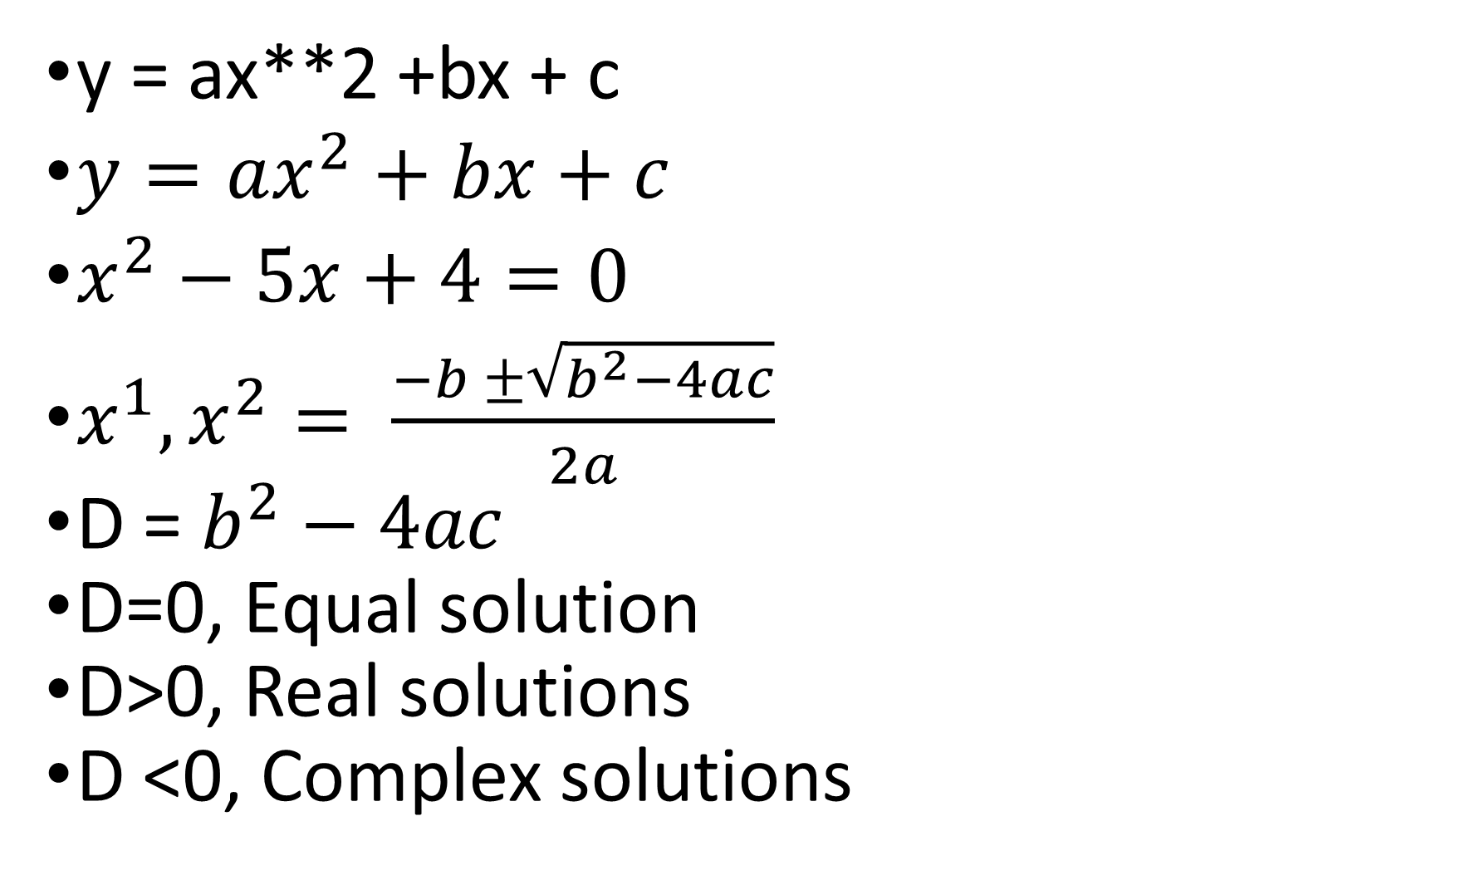
y = ax**2 +bx + c
$y=ax^{2}+bx+c$
$x^{2}−5x+4=0$
$x^{1},x^{2}= \frac{−b ±\sqrt{b^{2}−4ac}}{2a}$
D = $b^{2}−4ac$
D=0, Equal solution
D>0, Real solutions
D <0, Complex solutions

Slide 126

$\sqrt{−4}= \sqrt{−1∗4}= \sqrt{−1}∗\sqrt{4}=2i$
$\sqrt{−32}= \sqrt{−1∗32}=\sqrt{−1}∗\sqrt{32}=\sqrt{−1}∗\sqrt{16∗2}= 4\sqrt{2}i$

Slide 127
Code
Let’s explore the elections dataset, which stores information about political candidates who ran for president of the United States in various years.
import os # os package provides facilities for interaction with os
os.chdir(‘C:/ACity')
import pandas as pd
df = pd.read_csv('elections.csv')

Slide 128
Election Data
In the elections dataset, each row represents one instance of a candidate running for president in a particular year.
For example, the first row represents Andrew Jackson running for president in the year 1824.
Each column represents one characteristic piece of information about each presidential candidate.
For example, the column named “Result” stores whether or not the candidate won the election.

Slide 129
DataFrames, Series, and Indices
There are three fundamental data structures in pandas:
Series: 1D labeled array data; best thought of as columnar data
DataFrame: 2D tabular data with rows and columns
Index: A sequence of row/column labels
DataFrames, Series, and Indices can be represented visually in the following diagram, which considers the first few rows of the elections dataset.

Slide 130
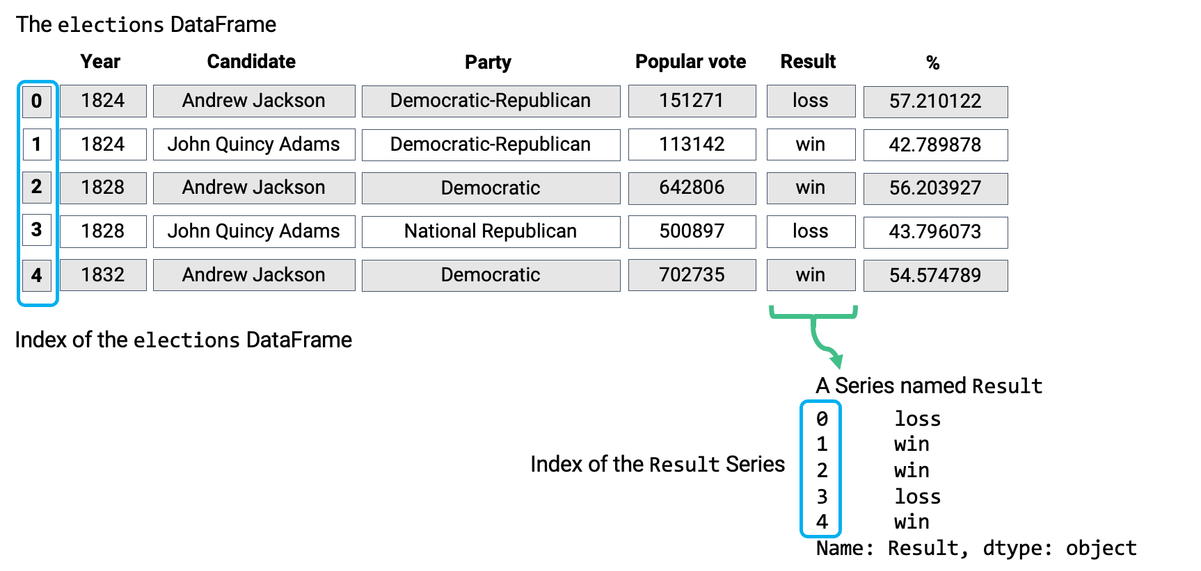

Slide 131
DataFrame is a two-dimensional object – it contains both rows and columns.
The Series above is a singular column of this DataFrame, namely, the Result column.
Both contain an Index, or a shared list of row labels (here, the integers from 0 to 4, inclusive).

Slide 132
Series
A Series represents a column of a DataFrame.
It can be any 1-dimensional array-like object containing values of the same type with associated data labels, called its index.
Let’s create a Series named s.
s = pd.Series([-1, 10, 2])
s
s.values
array([-1, 10, 2], dtype=int64)
s.index
Out[14]: RangeIndex(start=0, stop=3, step=1)

Slide 133
By default, the Index of a Series is a sequential list of integers beginning from 0.
Optionally, a manually-specified list of desired indices can be passed to the index argument.
s = pd.Series([-1, 10, 2], index = [‘a’, ‘b’, ‘c’])
s
Indices can also be changed after initialization.
s.index = [‘first’, ‘second’, ‘third’]
s

Slide 134
Selection in Series
There are 3 primary methods of selecting data.
A single index label
A list of index labels
A filtering condition
To demonstrate this, let’s define the Series ser.
ser = pd.Series([4, -2, 0, 6], index = ["a", "b", "c", "d"])
ser

Slide 135
A Single Index Label
ser[‘a’] # We return the value stored at the Index label "a“
A List of Index Labels
ser[[‘a’, ‘c’]] # We return a *Series* of the values stored at labels "a" and "c“
A Filtering Condition
Perhaps the most interesting (and useful) method of selecting data from a Series is with a filtering condition.
First, we apply a boolean condition to the Series. This create a new Series of boolean values.

Slide 136
ser > 0 # Filter condition: select all elements greater than 0
Out[22]:
a True
b False
c False
d True
dtype: bool
We then use this boolean condition to index into our original Series.
pandas will select only the entries in the original Series that satisfy the condition.
ser[ser > 0]

Slide 137
DataFrames
With our new understanding of pandas series in hand, let’s return to the elections dataset from before.
Now, we recognize that it is represented as a pandas DataFrame.
elections = pd.read_csv(‘elections.csv’)
elections
Out[25]:
Year Candidate Party Popular vote Result %
0 1824 Andrew Jackson Democratic-Republican 151271 loss 57.210122
1 1824 John Quincy Adams Democratic-Republican 113142 win 42.789878
2 1828 Andrew Jackson Democratic 642806 win 56.203927

Slide 138
We see that our elections DataFrame has 182 rows and 6 columns (Year, Candidate, Party, Popular Vote, Result, %).
Each row represents a single record – in our example, a presedential candidate from some particular year.
Each column represents a single attribute, or feature of the record.

Slide 139
Creating a DataFrame
There are many ways to create a DataFrame.
Here are the most popular approaches.
Using a list and column names
From a dictionary
From a Series

Slide 140
Using a List and Column Names
df_list_1 = pd.DataFrame([1, 2, 3], columns=['Numbers'])
In [33]: df_list_1
Numbers
0 1
1 2
2 3

Slide 141
df_list_2 = pd.DataFrame([[1, ‘one’], [2, ‘two’]], columns = [‘Number’, ‘Description’])
df_list_2
Number Description
0 1 one
1 2 two

Slide 142
From a Dictionary
A second (and more common) way to create a DataFrame is with a dictionary.
The dictionary keys represent the column names, and the dictionary values represent the column values.
df_dict = pd.DataFrame({‘Fruit’: [‘Strawberry’, ‘Orange’], ‘Price’: [5.49, 3.99]})
df_dict
Out[35]:
Fruit Price
0 Strawberry 5.49
1 Orange 3.99

Slide 143
From a Series
We noted earlier that a Series is usually thought of as a column in a DataFrame.
It follows then, that a DataFrame is equivalent to a collection of Series, which all share the same index.
In fact, we can initialize a DataFrame by merging two or more Series.

Slide 144
s_a = pd.Series(["a1", "a2", "a3"], index = ["r1", "r2", "r3"])
s_b = pd.Series(["b1", "b2", "b3"], index = ["r1", "r2", "r3"])
pd.DataFrame({"A-column": s_a, "B-column": s_b})
Out[36]:
A-column B-column
r1 a1 b1
r2 a2 b2
r3 a3 b3

Slide 145
Indices
We saw how a DataFrame as a collection of Series that all share the same Index.
On a more technical note, an Index doesn’t have to be an integer, nor does it have to be unique.
For example, we can set the index of the elections Dataframe to be the name of presidential candidates.
elections.set_index("Candidate", inplace=True)
elections.index

Slide 146
And, if we’d like, we can revert the index back to the default list of integers.
elections.reset_index(inplace=True)
elections.index

Slide 147
Slicing in DataFrames
Now that we’ve learned how to create DataFrames, let’s dive more deeply into their capabilities.
The API (application programming interface) for the DataFrame class is enormous.
The simplest way to manipulate a DataFrame is to extract a subset of rows and columns, known as slicing.

Slide 148
We will do so with four primary methods of the DataFrame class:
.head and .tail
.loc
.iloc
[]

Slide 149
Extracting data with .head and .tail
The simplest scenario in which we want to extract data is when we simply want to select the first or last few rows of the DataFrame.
To extract the first n rows of a DataFrame df, we use the syntax df.head(n).
elections.head(5)
Candidate Year Party Popular vote Result %
0 Andrew Jackson 1824 Democratic-Republican 151271 loss 57.210122
1 John Quincy Adams 1824 Democratic-Republican 113142 win 42.789878
2 Andrew Jackson 1828 Democratic 642806 win 56.203927
3 John Quincy Adams 1828 National Republican 500897 loss 43.796073
4 Andrew Jackson 1832 Democratic 702735 win 54.574789

Slide 150
Similarly, calling df.tail(n) allows us to extract the last n rows of the DataFrame.
elections.tail(5)
Out[40]:
Candidate Year Party Popular vote Result %
177 Jill Stein 2016 Green 1457226 loss 1.073699
178 Joseph Biden 2020 Democratic 81268924 win 51.311515
179 Donald Trump 2020 Republican 74216154 loss 46.858542
180 Jo Jorgensen 2020 Libertarian 1865724 loss 1.177979
181 Howard Hawkins 2020 Green 405035 loss 0.255731

Slide 151
Say, you want to randomly select cases. .. use sample(n)
elections.sample(5)
Out[41]:
Candidate Year Party Popular vote Result %
133 Ronald Reagan 1984 Republican 54455472 win 59.023326
91 Franklin Roosevelt 1936 Democratic 27752648 win 60.978107
171 Mitt Romney 2012 Republican 60933504 loss 47.384076
110 T. Coleman Andrews 1956 States' Rights 107929 loss 0.174883
35 James B. Weaver 1880 Greenback 308649 loss 3.352344

Slide 152
Indexing with .loc
The .loc operator selects rows and columns in a DataFrame by their row and column label(s), respectively.
The row labels (commonly referred to as the indices) are the bold text on the far left of a DataFrame, while the column labels are the column names found at the top of a DataFrame.
To grab data with .loc, we must specify the row and column label(s) where the data exists.
The row labels are the first argument to the .loc function; the column labels are the second.

Slide 153
For example, we can select the the row labeled 0 and the column labeled Candidate from the elections DataFrame.
elections.loc[0, 'Candidate']
Out[42]: 'Andrew Jackson’
To select multiple rows and columns, we can use Python slice notation.
Here, we select the rows from labels 0 to 3 and the columns from labels "Year" to "Popular vote".

Slide 154
elections.loc[0:3, 'Year':'Popular vote']
Out[43]:
Year Party Popular vote
0 1824 Democratic-Republican 151271
1 1824 Democratic-Republican 113142
2 1828 Democratic 642806
3 1828 National Republican 500897

Slide 155
Suppose that instead, we wanted every column value for the first four rows in the elections DataFrame.
The shorthand : is useful for this.
elections.loc[0:3, :]
Out[44]:
Candidate Year Party Popular vote Result %
0 Andrew Jackson 1824 Democratic-Republican 151271 loss 57.210122
1 John Quincy Adams 1824 Democratic-Republican 113142 win 42.789878
2 Andrew Jackson 1828 Democratic 642806 win 56.203927
3 John Quincy Adams 1828 National Republican 500897 loss 43.796073

Slide 156
Note carefully
There are a couple of things we should note.
Firstly, unlike conventional Python, Pandas allows us to slice string values (in our example, the column labels).
Secondly, slicing with .loc is inclusive.
Notice how our resulting DataFrame includes every row and column between and including the slice labels we specified.
Equivalently, we can use a list to obtain multiple rows and columns in our elections DataFrame.

Slide 157
elections.loc[[0, 1, 2, 3], ['Year', 'Candidate', 'Party', 'Popular vote']]
Out[45]:
Year Candidate Party Popular vote
0 1824 Andrew Jackson Democratic-Republican 151271
1 1824 John Quincy Adams Democratic-Republican 113142
2 1828 Andrew Jackson Democratic 642806
3 1828 John Quincy Adams National Republican 500897

Slide 158
Lastly, we can interchange list and slicing notation.
elections.loc[[0, 1, 2, 3], :]
Out[46]:
Candidate Year Party Popular vote Result %
0 Andrew Jackson 1824 Democratic-Republican 151271 loss 57.210122
1 John Quincy Adams 1824 Democratic-Republican 113142 win 42.789878
2 Andrew Jackson 1828 Democratic 642806 win 56.203927
3 John Quincy Adams 1828 National Republican 500897 loss 43.796073

Slide 159
Indexing with .iloc
Slicing with .iloc works similarily to .loc.
However, .iloc uses the index positions of rows and columns rather the labels (think to yourself: loc uses labels; iloc uses indices).
The arguments to the .iloc function also behave similarly -– single values, lists, indices, and any combination of these are permitted.

Slide 160
Let’s begin reproducing our results from above.
We’ll begin by selecting for the first presidential candidate in our elections DataFrame:
elections.loc[0, "Candidate"] #- Previous approach
'Andrew Jackson’
elections.iloc[0, 0]
Out[50]: 'Andrew Jackson'

Slide 161
elections.iloc[0:4, 0:4]
Out[51]:
Candidate Year Party Popular vote
0 Andrew Jackson 1824 Democratic-Republican 151271
1 John Quincy Adams 1824 Democratic-Republican 113142
2 Andrew Jackson 1828 Democratic 642806
3 John Quincy Adams 1828 National Republican 500897

Slide 162
Slicing is no longer inclusive in .iloc -– it’s exclusive.
In other words, the right-end of a slice is not included when using .iloc.
This is one of the subtleties of pandas syntax; you will get used to it with practice.
When should we use .loc vs .iloc?
In most cases, .loc is generally safer to use.
You can imagine .iloc may return incorrect values when applied to a dataset where the ordering of data can change.

Slide 163
Indexing with []
The [] selection operator is the most baffling of all, yet the most commonly used.
It only takes a single argument, which may be one of the following:
A slice of row numbers
A list of column labels
A single column label
That is, [] is context dependent. Let’s see some examples.

Slide 164
A slice of row numbers
Say we wanted the first four rows of our elections DataFrame.
elections[0:4]
Out[52]:
Candidate Year Party Popular vote Result %
0 Andrew Jackson 1824 Democratic-Republican 151271 loss 57.210122
1 John Quincy Adams 1824 Democratic-Republican 113142 win 42.789878
2 Andrew Jackson 1828 Democratic 642806 win 56.203927
3 John Quincy Adams 1828 National Republican 500897 loss 43.796073

Slide 165
A list of column labels
Suppose we now want the first four columns.
elections[["Year", "Candidate", "Party", "Popular vote"]]
Out[53]:
Year Candidate Party Popular vote
0 1824 Andrew Jackson Democratic-Republican 151271
1 1824 John Quincy Adams Democratic-Republican 113142
2 1828 Andrew Jackson Democratic 642806

Slide 166
A single column label
Lastly, [ ] allows us to extract only the Candidate column.
elections["Candidate"]
Out[54]:
0 Andrew Jackson
1 John Quincy Adams
2 Andrew Jackson
3 John Quincy Adams
4 Andrew Jackson
...
177 Jill Stein

Slide 167
Pandas II
We have learned about the pandas library as a framework for processing data.
We came across the DataFrame and Series data structures, familiarized ourselves with the basic syntax for manipulating tabular data, and began writing our first lines of pandas code.
Presently, let’s dive into some advanced pandas syntax that we would use going forward.

Slide 168
Loading the data
babynames = pd.read_csv('https://dlsun.github.io/pods/data/names/yob2000.txt')
babynames.head()
Out[16]:
Emily F 25953
0 Hannah F 23075
1 Madison F 19967
2 Ashley F 17997
3 Sarah F 17689
4 Alexis F 17627

Slide 169
babynames.columns = 'Name', 'Sex', 'Number'
In [18]: babynames.head()
Out[18]:
Name Sex Number
0 Hannah F 23075
1 Madison F 19967
2 Ashley F 17997
3 Sarah F 17689
4 Alexis F 17627
type(babynames)

Slide 170
Conditional Selection
Conditional selection allows us to select a subset of rows in a DataFrame if they follow some specified condition.
We came across .loc and [] methods – a boolean array, which is simply an array or Series where each element is either True or False.
This boolean array must have a length equal to the number of rows in the DataFrame.
It will return all rows that correspond to a value of True in the array.
We used a very similar technique when performing conditional extraction from a Series in the last lecture.

Slide 171
To see this, let’s select all even-indexed rows in the first 10 rows of our DataFrame.
babynames_first_10_rows = babynames.loc[:9, :]
babynames_first_10_rows
Name Sex Number
0 Hannah F 23075
1 Madison F 19967
2 Ashley F 17997
3 Sarah F 17689
4 Alexis F 17627
5 Samantha F 17264
6 Jessica F 15705
7 Elizabeth F 15089
8 Taylor F 15077
9 Lauren F 14173

Slide 172
Conditional selection is based on our selection meeting a given criteria.
We can instead provide a logical condition as an input to .loc or [] that returns a boolean array with the necessary length.
For example, to return all names associated with F sex:
# First, use a logical condition to generate a boolean array
logical_operator = (babynames[“Sex"] == "F")
# Then, use this boolean array to filter the DataFrame
babynames[logical_operator].head()

Slide 173
Out[62]:
Name Sex Number
0 Hannah F 23075
1 Madison F 19967
2 Ashley F 17997
3 Sarah F 17689
4 Alexis F 17627

Slide 174
Recall from the previous lecture that .head() will return only the first few rows in the DataFrame.
In reality, babynames[logical operator] contains as many rows as there are entries in the original babynames DataFrame with sex "F".
Here, logical_operator evaluates to a Series of boolean values with length 29763.
print("There are a total of {} values in 'logical_operator'".format(len(logical_operator)))
There are a total of 29763 values in 'logical_operator'

Slide 175
Rows starting at row 0 and ending at row 29762 evaluate to True and are thus returned in the DataFrame.
Rows from 29763 onwards evaluate to False and are omitted from the output.

Slide 176
Passing a Series as an argument to babynames[] has the same affect as using a boolean array.
In fact, the [] selection operator can take a boolean Series, array, and list as arguments.
These three are used interchangeably thoughout the course.
We can also use .loc to achieve similar results.
babynames.loc[babynames[‘Sex’] == ‘F’].head()

Slide 177
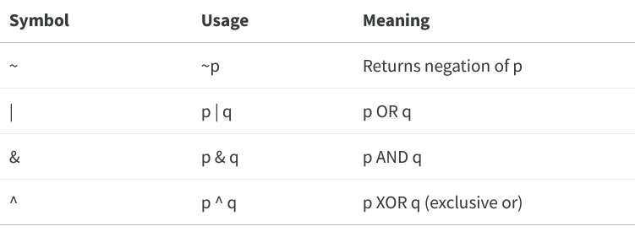
Combining Bools
Boolean conditions can be combined using various bitwise operators that allow us to filter results by multiple conditions.

Slide 178
Syntax
When combining multiple conditions with logical operators, we surround each individual condition with a set of parenthesis ().
This imposes an order of operations on pandas evaluating your logic, and can avoid code erroring.
For example, if we want to return data on all names with sex "F" and the number being less that 20000, we can write:
babynames[(babynames['Sex'] == 'F') & (babynames['Number'] < 20000)].head()
Out[28]:
Name Sex Number
1 Madison F 19967
2 Ashley F 17997
3 Sarah F 17689
4 Alexis F 17627
5 Samantha F 17264

Slide 179
Boolean array selection is a useful tool, but can lead to overly verbose code for complex conditions.
In this example, our boolean condition is long enough to extend for several lines of code.
# Note: The parentheses surrounding the code make it possible to break the code on to multiple lines for readability
(
babynames[(babynames["Name"] == "Bella") |
(babynames["Name"] == "Alex") |
(babynames["Name"] == "Ani") |
(babynames["Name"] == "Lisa")]
).head()

Slide 180
Fortunately, pandas provides many alternative methods for constructing boolean filters.
The .isin function is one such example.
This method evaluates if the values in a Series are contained in a different sequence (list, array, or Series) of values.
The code below achieves equivalent result to the DataFrame above with far more concise code.
names = [‘Bella’, ‘Alex’, ‘Ani’, ‘Lisa’]
babynames[babynames[‘Name’].isin(names)].head()

Slide 181
The function str.startswith can be used to define a filter based on string values in a Series object.
It checks to see if string values in a Series start with a particular character.
# Find the names that begin with the letter "N"
babynames[babynames["Name"].str.startswith("N")].head()

Slide 182
Adding, Removing, and Modifying Columns
In many data science tasks, we may need to change the columns contained in our DataFrame in some way.
Fortunately, the syntax to do so is fairly straightforward.
To add a new column to a DataFrame, we use a syntax similar to that used when accessing an existing column.
Specify the name of the new column by writing df["column"], then assign this to a Series or array containing the values that will populate this column.

Slide 183
# Create a Series of the length of each name.
babynames_lengths = babynames[‘Name’].str.len()
# Add a column named "name_lengths" that includes the length of each name
babynames[‘names_lengths’] = babynames_lengths
babynames.head(5)

Slide 184
If we need to later modify an existing column, we can do so by referencing this column again with the syntax df[‘column’], then re-assigning it to a new Series or array.
# Modify the “name_lengths” column to be one less than its original value
babynames[‘name_lengths’] = babynames[‘name_lengths’]-1
babynames.head()

Slide 185
Renaming a columns
We can rename a column using the .rename() method.
.rename() takes in a dictionary that maps old column names to their new ones.
# Rename “name_lengths” to “Length”
babynames = babynames.rename(columns = {‘name_lengths’:’Length’})
babynames.head()

Slide 186
Removing a column
If we want to remove a column or row of a DataFrame, we can call the .drop method.
Use the axis parameter to specify whether a column or row should be dropped.
Unless otherwise specified, pandas will assume that we are dropping a row by default.
# Drop our new "Length" column from the DataFrame
babynames = babynames.drop(‘Length’, axis = ‘columns’)
babynames.head(5)

Slide 187
Notice that we reassigned babynames to the result of babynames.drop(...).
This is a subtle, but important point: pandas table operations do not occur in-place.
Calling df.drop(...) will output a copy of df with the row/column of interest removed, without modifying the original df table.

Slide 188
In other words, if we simply call:
# This creates a copy of `babynames` and removes the column "Name"...
babynames.drop(‘Name’, axis = ‘columns’)
# ...but the original `babynames` is unchanged!
# Notice that the "Name" column is still present
babynames.head(5)

Slide 189
Handy Utility Functions
pandas contains an extensive library of functions that can help shorten the process of setting and getting information from its data structures.
Here is an overview of each of the main utility functions that will help us in the course.

Slide 190
You are encouraged to explore and experiment on your own.
NumPy and built-in function support
.shape
.size
.describe()
.sample()
.value_counts()
.unique()
.sort_values()

Slide 191
Working with Tabular Data
Tabular data is any collection of data that can be organized into rows and columns, essentially a two-dimensional matrix.
On the hand, we have unstructured text, network data, geospatial data, image data, and video data, each of which have distinct methods and file formats for the data.

Slide 192
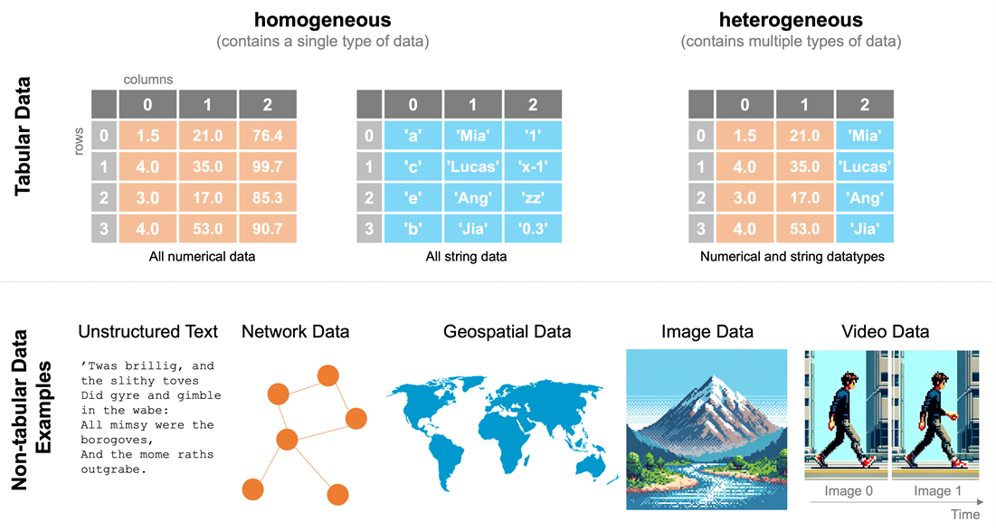

Slide 193
In the data above, we have not only numerical data, but also text, images, geometric objects, or any other type of data (i.e., your data are heterogeneous).
In these situations, numpy may not be appropriate, while pandas can easily organize, manipulate, and analyze this kind of “mixed data.”
If you have tabular data — that is, data organized into rows and columns, as in a spreadsheet — it is often easier in pandas to describe, summarize, query, and visualize the data than the equivalent processes with numpy.

Slide 194
Effectively working with tabular data
Let’s walk through some examples of what you can do easily with pandas that can be rather complicated without it:
Quickly reading your data into a structured tabular form
Quickly describe/summarize your data
Quickly querying your dataset
Quickly plotting your data

Slide 195
Reading Data Structured in Tabular Form
Let’s load in a dataset to demonstrate how we work with tabular data.
#Change to where the data is stored
import os
os.chdir(‘C:/ACity’)
pwd

Slide 196
smallworld = pd.read_csv('world-very-small.csv')
smallworld
country region gdp_per_capita_2008
0 Brazil S. America 10296
1 Germany W. Europe 35613
2 Mexico N. America 14495
3 Mozambique Africa 855
4 Russia C&E Europe 16139
5 Ukraine C&E Europe 7271

Slide 197
Describe / summarize your data
With the use of a single pandas method, we can summarize the statistics of any fully-numerical columns of data:
smallworld.describe()
gdp_per_capita_2008
count 6.000000
mean 14111.500000
std 11863.031683
min 855.000000
25% 8027.250000
50% 12395.500000
75% 15728.000000
max 35613.000000

Slide 198
Querying the data
Not only can we load and describe our data quickly, but we can query our data quickly, too.
Let’s say we wanted to find the countries on the list with per-capita GDP below $10,000.
This is simply:
smallworld.loc[smallworld.gdp_per_capita_2008 < 10000]
country region gdp_per_capita_2008
3 Mozambique Africa 855
5 Ukraine C&E Europe 7271

Slide 199
Plotting the data
If you want/need a quick look at your data, we plot with matplotlib ecosystem for plotting. . . more on that later.
Let’s create a bar plot of the GDP per capita for each of the countries in our list:
%matplotlib
Using matplotlib backend: qtagg
smallworld.plot.bar(x="country", y="gdp_per_capita_2008")

Slide 200
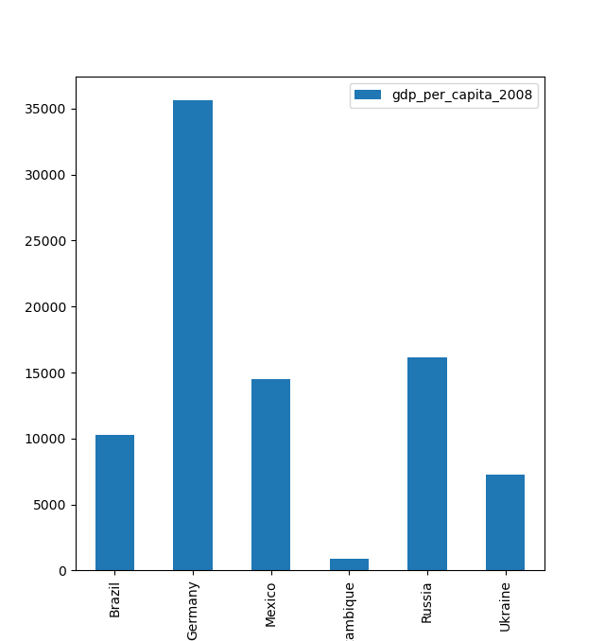

Slide 201
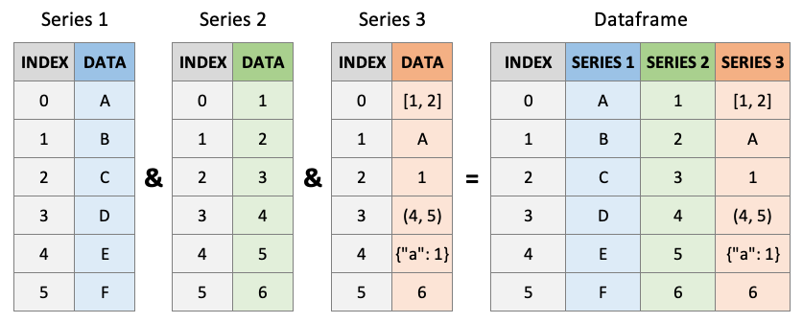
Deeper with Tabular Data using DataFrames
Remember, we mentioned that pandas is made up of Series and DataFrames.

Slide 202
Format of DataFrames
Pandas offers lots of tools for reading data in different formats.
Here are few important methods to know about:
pd.read_csv: Read in a comma-separated-value file
pd.read_excel: Read in an Excel (.xls and .xlsx) spreadsheet
pd.read_stata: Read Stata (.dta) datasets
pd.read_hdf: Read HDF (.hdf) datasets
pd.read_sql: Read from a SQL database

Slide 203
Similarly, if we have an existing DataFrame (let’s call it df) we want to output to a file or database, we can use complimentary methods of df to do so such as:
df.to_csv: Write to a comma-separated-value file
df.to_excel: Write to an Excel (.xls and .xlsx) spreadsheet
df.to_stata: Write to a stata (.dta) dataset
df.to_hdf: Write to an HDF (.hdf) dataset
df.to_sql: Write to a SQL database

Slide 204
Writing DataFrames by hand
We can construct DataFrames by hand.
The easiest (and most common) way is by passing in a Dictionary, where the keys will become column names and the values are column values:
df = pd.DataFrame(
...: {
...: "animals": ["dog", "cat", "bird", "fish"],
...: "can_swim": [True, False, False, True],
...: "has_fur": [True, True, False, False],
...: }
...: )
df

Slide 205
Out[16]:
animals can_swim has_fur
0 dog True True
1 cat False True
2 bird False False
3 fish True False

Slide 206
Usually, unless that data size is small, we would rather prefer to load the data in the form of a DataFrame into Python.
Let’s load the smallworld dataset where we have all countries of the world into Python instead of the 6 we had earlier.

Slide 207
world = pd.read_csv('world-small.csv')
country region gdppcap08 polityIV
0 Albania C&E Europe 7715 17.8
1 Algeria Africa 8033 10.0
2 Angola Africa 5899 8.0
3 Argentina S. America 14333 18.0
4 Armenia C&E Europe 6070 15.0
.. ... ... ... ...
140 Venezuela S. America 12804 16.0
141 Vietnam Asia-Pacific 2785 3.0
142 Yemen Middle East 2400 8.0
143 Zambia Africa 1356 15.0
144 Zimbabwe Africa 188 6.0

Slide 208
As you can see, pandas prints out a bunch of the rows, but not all the rows (note the ... in the middle) in an effort to not take over your monitor.
This DataFrame could theoretically be printed out in its entirety but in the real world, we often work with datasets with hundreds of thousands or millions of rows where printing just isn’t possible.
So here are some methods for “getting to know your data”:
Let’s look at the first 5 rows using .head():

Slide 209
world.head(5)
Out[19]:
country region gdppcap08 polityIV
0 Albania C&E Europe 7715 17.8
1 Algeria Africa 8033 10.0
2 Angola Africa 5899 8.0
3 Argentina S. America 14333 18.0
4 Armenia C&E Europe 6070 15.0

Slide 210
And look at the last 5 rows with .tail():
world.tail(5)
Out[20]:
country region gdppcap08 polityIV
140 Venezuela S. America 12804 16.0
141 Vietnam Asia-Pacific 2785 3.0
142 Yemen Middle East 2400 8.0
143 Zambia Africa 1356 15.0
144 Zimbabwe Africa 188 6.0

Slide 211
world.sample(5)
Out[21]:
country region gdppcap08 polityIV
64 Italy W. Europe 30756 20.0
141 Vietnam Asia-Pacific 2785 3.0
114 Singapore Asia-Pacific 49284 8.0
51 Guatemala S. America 4760 18.0
0 Albania C&E Europe 7715 17.8

Slide 212
We can use len() to get the number of rows:
len(world)
Out[22]: 145
Or len() and .columns to get the number of columns:
len(world.columns)
4
We can also check the data type of each column with .dtypes (note the s):
world.dtypes
Out[24]:
country object
region object
gdppcap08 int64
polityIV float64
dtype: object

Slide 213
We could have used a slightly more nicely formatted summary with .info():
world.info()
# Column Non-Null Count Dtype
--- ------ -------------- -----
0 country 145 non-null object
1 region 145 non-null object
2 gdppcap08 145 non-null int64
3 polityIV 145 non-null float64
dtypes: float64(1), int64(1), object(2)
memory usage: 4.7+ KB

Slide 214
We can also summary statistics for each numeric column (objects are ignored) with .describe():
world.describe()
Out[26]:
gdppcap08 polityIV
count 145.000000 145.000000
mean 13251.993103 13.407816
std 14802.581676 6.587626
min 188.000000 0.000000
25% 2153.000000 7.666667
50% 7271.000000 16.000000
75% 19330.000000 19.000000
max 85868.000000 20.000000

Slide 215
Finally, we can list out all the column names.
world.columns
Out[27]: Index(['country', 'region', 'gdppcap08', 'polityIV'], dtype='object')

Slide 216
Subsetting a DataFrame
.iloc
To subset a DataFrame using iloc, we now have to pass two arguments into iloc separated by a comma (the first entry subsets rows, the second columns, just like in numpy).
For example, if we wanted the entry in the fourth row of the first column, we would use:
world.iloc[3, 0]
Out[28]: 'Argentina’
Again, Series and numpy, iloc supports slices.

Slide 217
Here are the first two rows of the first three columns:
world.iloc[0:2, 0:3]
Out[29]:
country region gdppcap08
0 Albania C&E Europe 7715
1 Algeria Africa 8033
If you want to get a subset on one dimension, but all the entries on the other, just pass : for the dimension on which you want all the data (just like in numpy).
Here are the first two rows and all the columns:

Slide 218
world.iloc[0:2, :]
Out[30]:
country region gdppcap08 polityIV
0 Albania C&E Europe 7715 17.8
1 Algeria Africa 8033 10.0
If we ONLY pass one set of arguments, though, those will be applied to the first dimension (rows).
Thus .iloc[0:2] is the same as .iloc[0:2, :].
world.iloc[0:2]
Out[31]:
country region gdppcap08 polityIV
0 Albania C&E Europe 7715 17.8
1 Algeria Africa 8033 10.0

Slide 219
loc
.loc generalized from Series to DataFrames using the same tricks as .iloc:
- if you pass two arguments, the first will subset rows (though for .loc, the subsetting is on index values, not row numbers), and
- the second will subset columns (again, on column names, not column order).
world.loc[1, "country"]
Out[32]: 'Algeria’
And just like in Series, if you pass a range to .loc, the end points will be included (unlike with most Python functions)

Slide 220
world.loc[0:1, "country"]
Out[33]:
0 Albania
1 Algeria
Name: country, dtype: object

Slide 221
As with .iloc, if you pass a single argument to .loc, it will subset on the first dimension (rows):
world.loc[0:3]
Out[34]:
country region gdppcap08 polityIV
0 Albania C&E Europe 7715 17.8
1 Algeria Africa 8033 10.0
2 Angola Africa 5899 8.0
3 Argentina S. America 14333 18.0

Slide 222
Logical Tests on DataFrames
Subsetting with logical tests also works in a familiar manner for DataFrames:
If you pass a single boolean array to .loc, it will subset on rows.
If the Boolean array has an Index (i.e. if it’s a Series), then alignment will take place on index values.
If the Boolean array does NOT have an index (i.e. it’s a list of Booleans), then alignment will take place on row order.
To subset columns based on a test, you have to use .loc[:, YOUR_TEST_HERE].

Slide 223
world = world.sort_values("gdppcap08")
world.head()
Out[35]:
country region gdppcap08 polityIV
144 Zimbabwe Africa 188 6.0
29 Congo Kinshasa Africa 321 15.0
76 Liberia Africa 388 10.0
53 Guinea-Bissau Africa 538 11.0
40 Eritrea Africa 632 3.0

Slide 224
# Test with an index -> subset rows, align on index
relatively_democratic = world.loc[world["polityIV"] > 10]
relatively_democratic.head()
Out[36]:
country region gdppcap08 polityIV
29 Congo Kinshasa Africa 321 15.000000
53 Guinea-Bissau Africa 538 11.000000
96 Niger Africa 684 15.333333
22 Central African Republic Africa 736 10.200000
113 Sierra Leone Africa 766 15.000000

Slide 225
[] Square brackets
Single square brackets in pandas change their behavior depending on the values you pass them.
There is nothing that one can do with square brackets that you can’t do with .loc and .iloc.
# Select one column
world["country"].head()
Out[37]:
144 Zimbabwe
29 Congo Kinshasa
76 Liberia
53 Guinea-Bissau
40 Eritrea
Name: country, dtype: object

Slide 226
# Select multiple columns
world[["country", "gdppcap08"]].head()
Out[38]:
country gdppcap08
144 Zimbabwe 188
29 Congo Kinshasa 321
76 Liberia 388
53 Guinea-Bissau 538
40 Eritrea 632

Slide 227
# Boolean test
world[world["gdppcap08"] > 10000].head()
Out[40]:
country region gdppcap08 polityIV
79 Macedonia C&E Europe 10041 19.0
118 South Africa Africa 10109 19.0
16 Brazil S. America 10296 18.0
30 Costa Rica S. America 11241 20.0
68 Kazakhstan C&E Europe 11315 4.0

Slide 228
# Slice of rows
world[0:3]
Out[41]:
country region gdppcap08 polityIV
144 Zimbabwe Africa 188 6.0
29 Congo Kinshasa Africa 321 15.0
76 Liberia Africa 388 10.0

Slide 229
Note
# Slice of rows
type(world['country'])
Out[42]: pandas.core.series.Series
# Slice of rows
type(world[['country']])
Out[43]: pandas.core.frame.DataFrame

Slide 230
Data Wrangling
One of the foundational pillars of data science is data wrangling.
Data wrangling (often known as data munging) is the process of transforming raw data into a more digestible and usable format for analysis.
In the context of Python, data wrangling becomes an essential skill for any data enthusiast.
It is a ‘must-have’ skill imparting practical knowledge on various data manipulation, import, and summarization techniques.
At the end of it all, you will be equipped with the tools and techniques to handle, transform, and visualize data efficiently.

Slide 231
Identifying Data Problems
In a totally perfect world, our datasets would all arrive containing only accurate data formatted in exactly the way we need.
Unfortunately, that is not the case we would meet in our career.
Data is going to be ‘dirty’ because of clumsy data entry, bad translation between data formats, survey participants no particularly careful, the coding errors of other data scientists, etc.
Messy data is a fact of life.
As a result, a key part of being a data scientist is to learn to (a) seek out and identify data cleanliness problems, and (b) learn to correct them.

Slide 232
Some facts . . .
A recent survey by Anaconda found that the average data scientists reported data that wrangling took up about 45% of their time.
Being familiar with data wrangling is important to being a successful data scientist.
It is often said that “data scientists spend 80% of their time cleaning data and only 20% doing analyses”.
pandas is a powerful tool for identifying problems and cleaning data before we turn to modeling.

Slide 233
Exercise
Suppose you have been asked to calculate the overall employment rate and average incomes for men and women, as well as the employment rate and average income of people in their 30s and 40s.
To accomplish this task, we’ve have been handed a 0.1% sample of the US American Community Survey—a representative survey of residents of the United States published by the US Census Bureau.
Now, this is real data, and like all real data comes with lots of quirks and oddities we’ll need to navigate.
Suppose, we’ve even been told that the variable for gender in the dataset is sex, the variable for age is age, the variable for income is inctot, and the variable for whether someone is employed is empstat.
Let’s do it!

Slide 234
Code
import pandas as pd
import numpy as np
acs = pd.read_csv(‘US_ACS_2017_10pct_sample.csv’)
acs.head()
acs = acs[[‘year’, ‘sex’, ‘age’, ‘inctot’, ‘empstat’]]
acs.head()

Slide 235
Now let’s start to analyze our data.
For starters, let’s get warmed up by just getting the average income in our data:
acs[‘inctot’].mean()
Out[54]: 1723646.2703978634
# Made pretty and better formatted:
print(f"The average income of Americans is ${acs['inctot'].mean():,.2f}")
The average income of Americans is $1,723,646.27
Let’s look at the mean of the employed.
(acs["empstat"] == "employed").mean()
Out[56]: 0.46632017153389926

Slide 236
Introspection Methods
Some methods are .value_counts() and .describe().
These are methods to tell you about all the values in a single variable.
.value_counts(), shows all the unique values a variable takes on and the number of occurrences of each value.
For example, using value_counts() we can see that empstat takes on 4 values:
acs.empstat.value_counts()
Out[57]:
empstat
employed 148758
not in labor force 104676
n/a 57843
unemployed 7727

Slide 237
To see proportions instead of counts, we pass the keyword normalize=True.
acs.empstat.value_counts(normalize=True)
Out[58]:
empstat
employed 0.466320
not in labor force 0.328134
n/a 0.181324
unemployed 0.024222

Slide 238
.describe()
For continuous numeric variables, we use .describe() to provide summary statistics for a variable.
acs["inctot"].describe()
Out[59]:
count 3.190040e+05
mean 1.723646e+06
std 3.732326e+06
min -9.000000e+03
25% 1.050000e+04
50% 3.370000e+04
75% 9.140000e+04
max 9.999999e+06

Slide 239
Cleaning Data Types
It is very common to load data that you think should be numeric (say, float64), only to discover that pandas has loaded it as Categorical or Object type.
There are restricted operations on some types of data (e.g., mean, median, etc.).
There are two main reasons that this can happen:
There are observations that are accidentally being parsed as non-numeric, or
There are observations that are deliberately non-numeric you didn’t realize were there.

Slide 240

Visualization

Slide 241
Plotting Best Practices
Plotting effectively is more than just displaying data accurately.
It’s communicating effectively.
This is a learned skill and likely does not come intuitively to most.

Slide 242
Principles of Visualization
Focus on your goal
Every plot should have a communicative purpose, and that purpose is typically either to inform or to persuade (although NEVER to mislead) through evidence.
This means that every plot should have a message that it communicates.
Be sure you know what message you want to convey and keep your focus on that message.
If you’re not able to identify your plot’s message, neither will a viewer.

Slide 243
Know your audience
You’re communicating to people with lived experiences.
These experiences may or may not include what you plan to show them with your plot.
Target what you plot and how you plot it, annotate it, and caption it to reach your intended audience and accomplish your goal.

Slide 244
Make it professional
Not every plot needs to be beautiful; but every plot that is shared with others should be sufficiently professional for that audience.
If you’re sharing some quick results with colleagues, the plot likely needs to be clean and readable.
If you’re sharing a plot publicly, you want that plot to be a reflection of the level of professionalism that went into the data within it.
This also helps to build trust and credibility.

Slide 245
Plotting with matplotlib
We came across the basic plotting features of matplotlib.
However, advanced plotting and customization requires a deeper knowledge of this plotting tool.
Becoming proficient with using matplotlib is well-worth it, since many Python data science tools and APIs use matplotlib as a native plotting tool, including pandas and xarray.

Slide 246
Basic Plotting
# Create some data to plot
x = [1, 2, 3, 4, 5]
y = [1, -2, 3, -4, 5]
We start by importing the pyplot module from the matplotlib package.
As a convention we import it as plt with the command
import matplotlib.pyplot as plt
You’ll want to start every plotting session with this command.
The next step is to create our canvas on which we’ll add out plots.
We can use plt.subplots() to create a figure that contains a set of axes on which to place the plot through the command
fig, ax = plt.subplots()

Slide 247
Then, we can create a line plot of the data on the specified axes using
ax.plot(x,y)
Lastly, we specify that the plot be rendered on the screen using
plt.show()
In place of the above, we can use %matplotlib in ipython and %matplotlib inline in Jupyter.
This last item is not always required in an interactive terminal or in Jupyter notebooks, but is generally required to guarantee the plot is displayed.

Slide 248
Example
import matplotlib.pyplot as plt
fig, ax = plt.subplots()
ax.plot(x, y)
plt.show()

Slide 249
Following the same approach, we can create a simple bar plot and a scatter plot of the same data.
fig, ax = plt.subplots()
ax.bar(x, y)
plt.show()
For a scatter plot. . .
fig, ax = plt.subplots()
ax.scatter(x, y)
plt.show()

Slide 250
Customization of matplotlib
The power of matplotlib comes from customization of its plots for visualization.
There is so much that can be customized, but most customizations require adding additional code, and additional code means additional time.
Understanding all of the pieces of a plot and how to adjust them takes time.

Slide 251
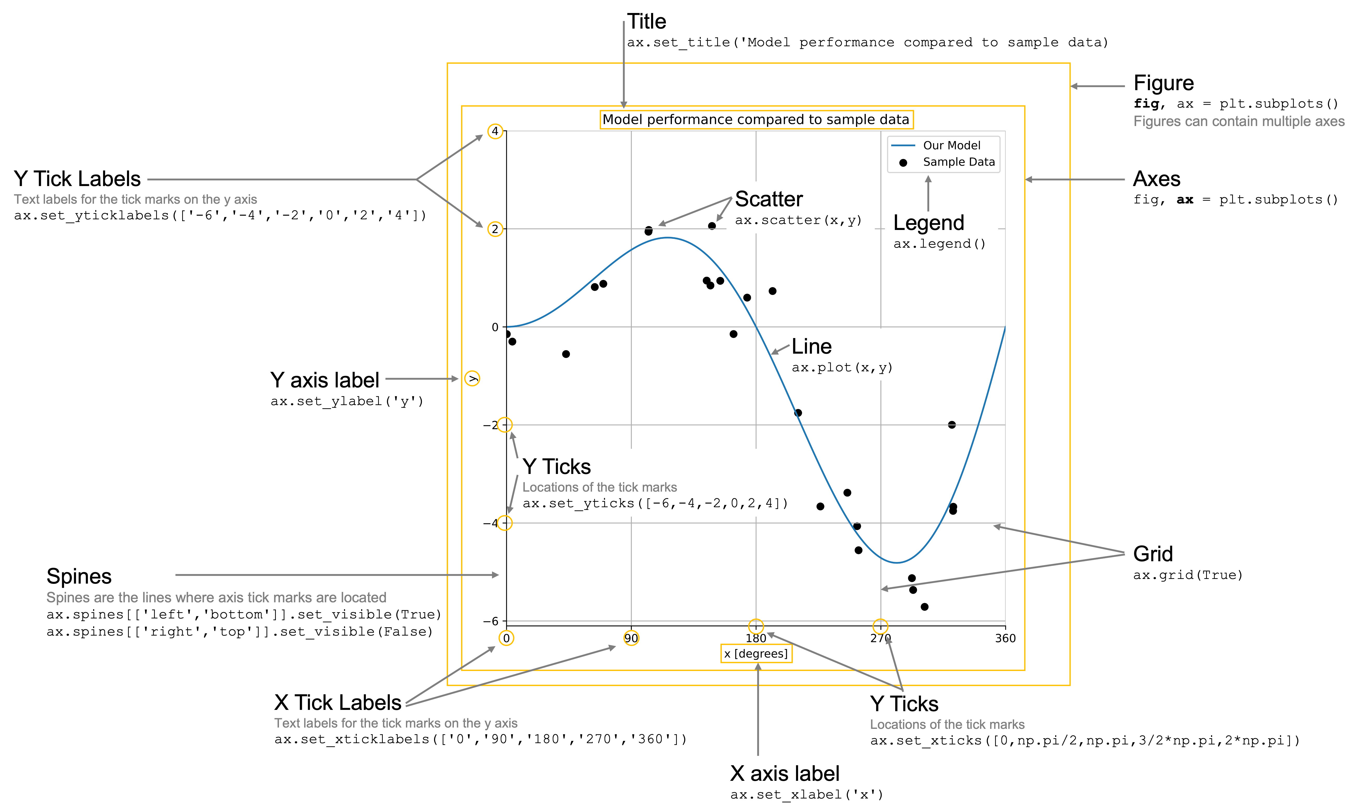
Here is the final product with every item included in a customized plot.

Slide 252
Some Code
Let’s create some toy data for us to work with.
We’ll create variables y_model and y_data which represent some data and a model for those data.

Slide 253
import numpy as np
# Create noise-free data
maxval = 2 * np.pi
x_model = np.linspace(0, maxval, 1000)
f = lambda x: np.sin(x) * x
y_model = f(x_model)
# Create noisy data
x_data = np.random.rand(25) * maxval
y_data = f(x_data) + np.random.randn(*x_data.shape) * 0.5

Slide 254
Figures and axes
Every plot is composed of a few key pieces: the figure, which contains one or more axes, and the axes themselves, onto which you can add plots that share the same axes.
This is created for you with the
fig, ax = plt.subplots()
command, where fig is your figure object and ax is your axes object.
We have the optional command to make the figures high resolution.

Slide 255
import matplotlib_inline
matplotlib_inline.backend_inline.set_matplotlib_formats("retina")
# You can also use:
# %config InlineBackend.figure_format = 'retina’
import matplotlib.pyplot as plt
fig, ax = plt.subplots(figsize=(7, 7))
%matplotlib

Slide 256
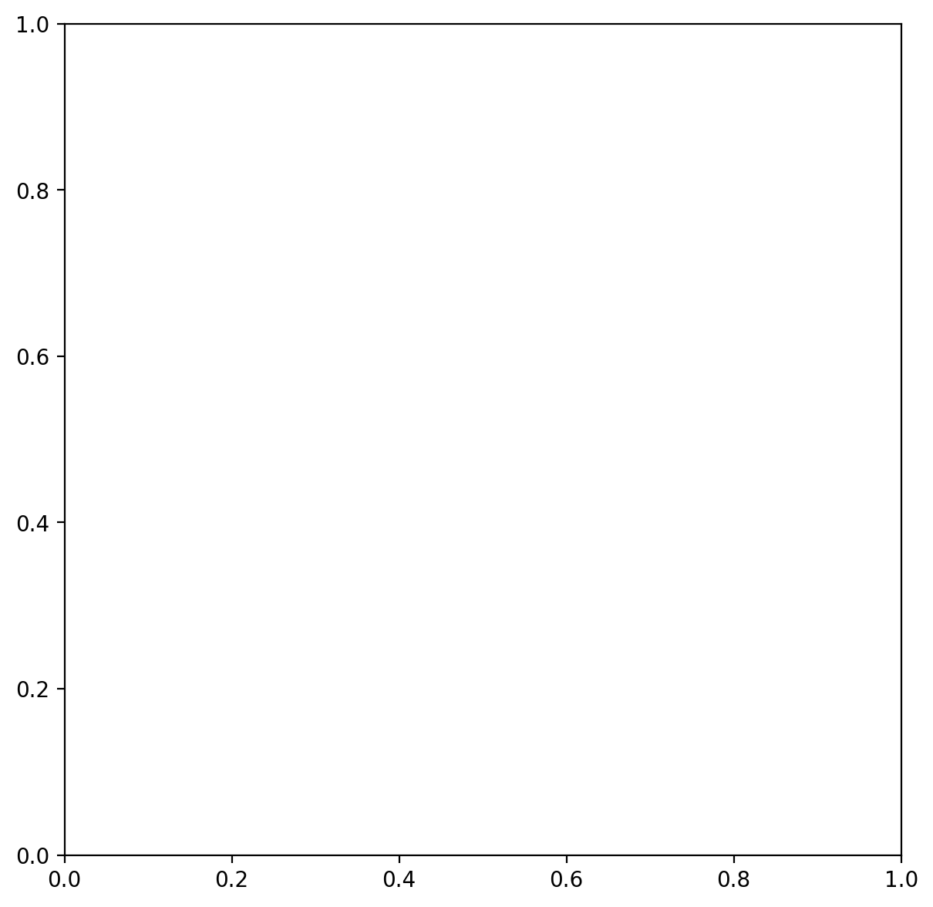

Slide 257
Line and scatter plots
Plotting lines in matplotlib allows for significant amounts of customizations.
Let’s simply create a line plot of y_model and a scatter plot of y_data.
We’ll adjust the scatter plot color to be black to make sure it’s distinguishable from the blue line of y_model.
fig, ax = plt.subplots(figsize=(7, 7))
ax.plot(x_model, y_model)
ax.scatter(x_data, y_data, color="black")

Slide 258
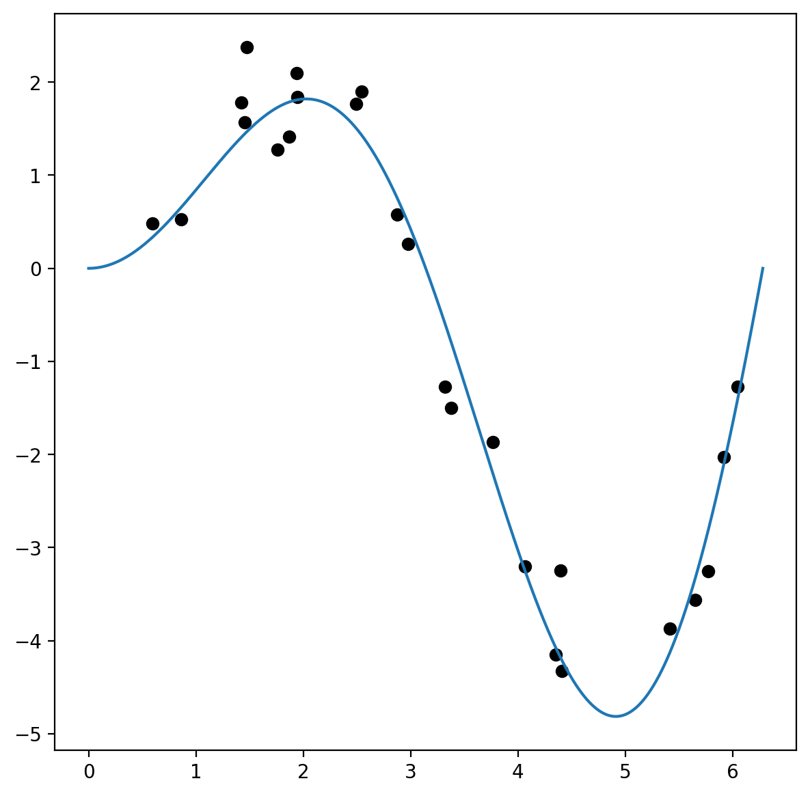

Slide 259
Axis labels
The next things to add to any good plot are the axis labels so we know the content we’re plotting.
Let’s label these simply x and y.
fig, ax = plt.subplots(figsize=(7, 7))
ax.plot(x_model, y_model)
ax.scatter(x_data, y_data, color = "black")
ax.set_xlabel("x")
ax.set_ylabel("y")

Slide 260
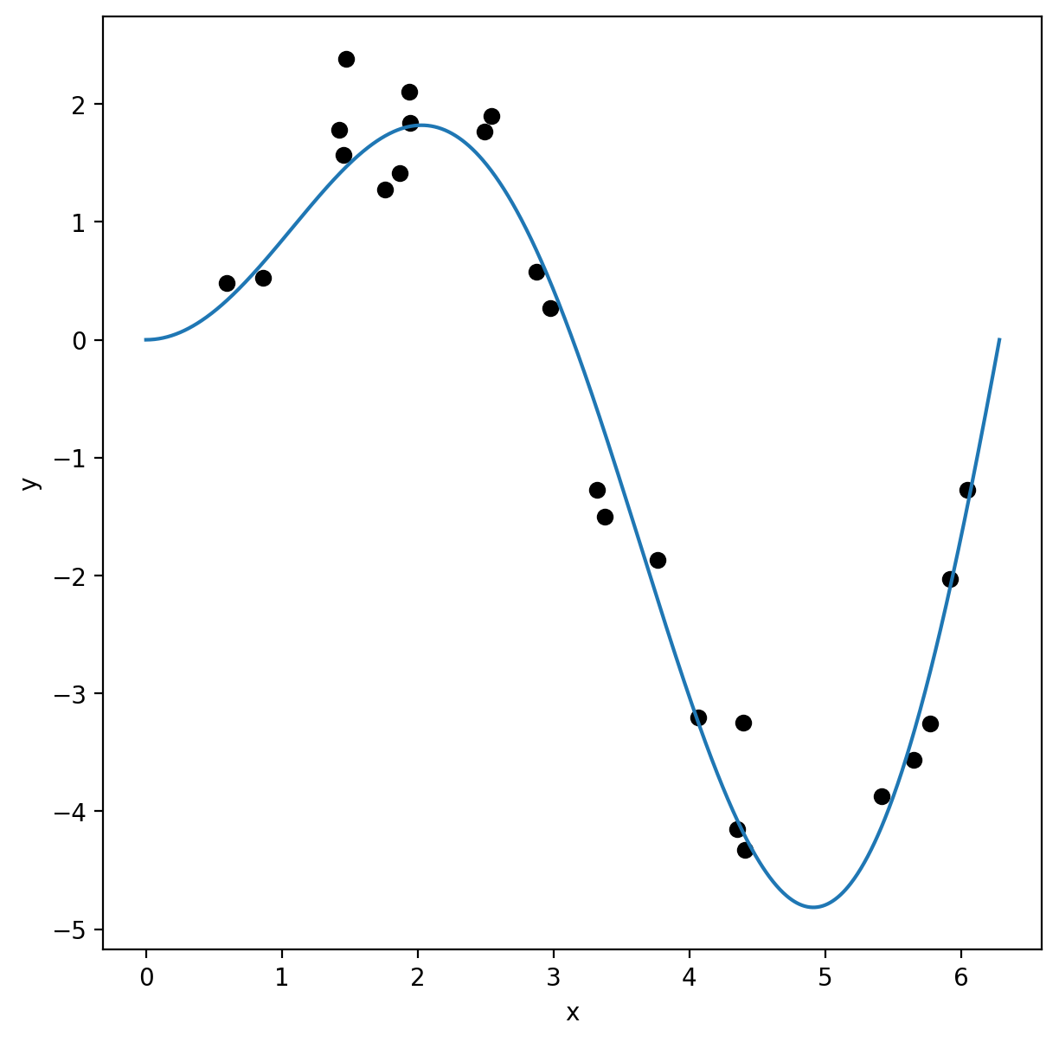

Slide 261
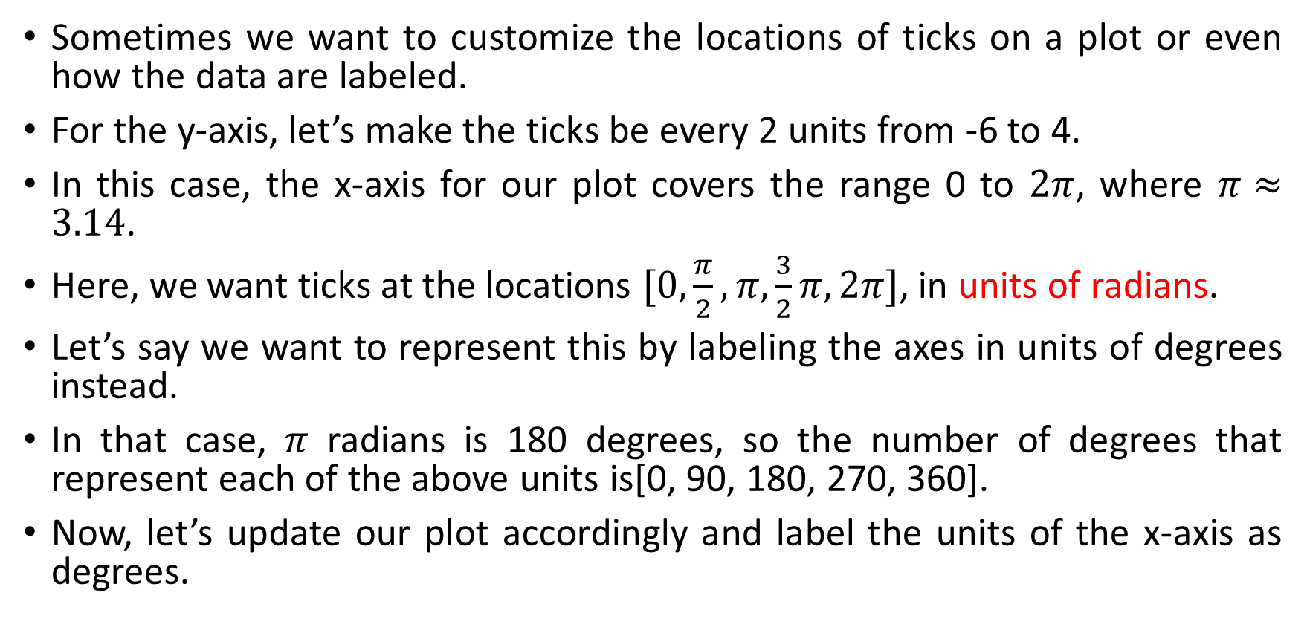
Ticks and tick labels
Sometimes we want to customize the locations of ticks on a plot or even how the data are labeled.
For the y-axis, let’s make the ticks be every 2 units from -6 to 4.
In this case, the x-axis for our plot covers the range 0 to $2π$, where $π≈3.14$.
Here, we want ticks at the locations $[0,\frac{π}{2},π,\frac{3}{2}π,2π]$, in units of radians.
Let’s say we want to represent this by labeling the axes in units of degrees instead.
In that case, $π$ radians is 180 degrees, so the number of degrees that represent each of the above units is[0, 90, 180, 270, 360].
Now, let’s update our plot accordingly and label the units of the x-axis as degrees.

Slide 262
fig, ax = plt.subplots(figsize=(7, 7))
ax.plot(x_model, y_model)
ax.scatter(x_data, y_data, color = 'black')
ax.set_xlabel('x [degrees]')
ax.set_ylabel('y')
ax.set_xticks([0, np.pi / 2, np.pi, 3 / 2 * np.pi, 2 * np.pi])
ax.set_xticklabels([0, 90, 180, 270, 360])
ax.set_yticks([-6, -4, -2, 0, 2, 4])

Slide 263
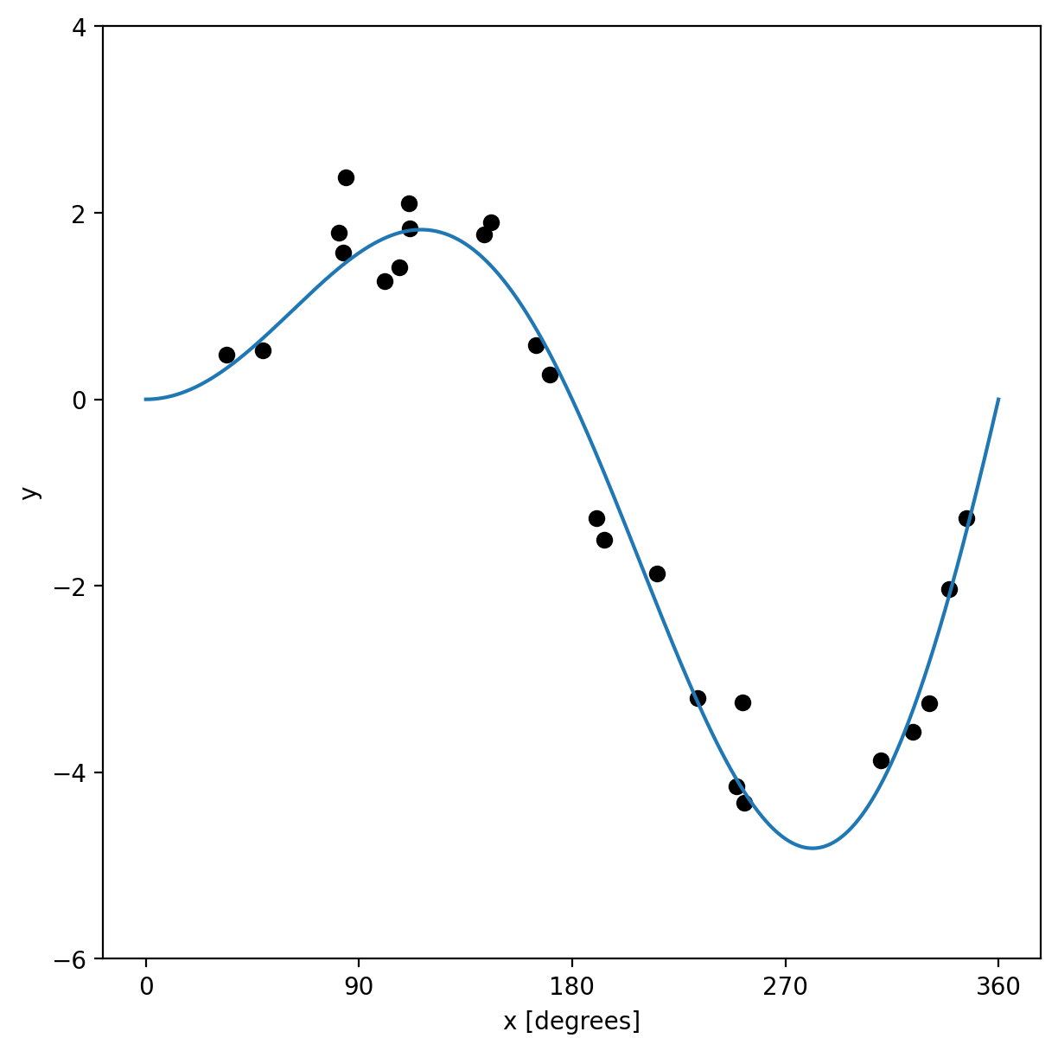

Slide 264
Axis limits
Sometimes a plot’s automatically chosen limits don’t align with what you want.
For example, in the above plot, the plot includes values below 0 degrees and above 360.
Let’s place a limit on the x-values (in the original units of radians since those match the values being input into the plot).

Slide 265
fig, ax = plt.subplots(figsize=(7, 7))
ax.plot(x_model, y_model)
ax.scatter(x_data, y_data, color='black')
ax.set_xlabel('x [degrees]')
ax.set_ylabel('y')
ax.set_xticks([0, np.pi / 2, np.pi, 3 / 2 * np.pi, 2 * np.pi])
ax.set_xticklabels([0, 90, 180, 270, 360])
ax.set_yticks([-6, -4, -2, 0, 2, 4])
ax.set_xlim([0, 2 * np.pi])

Slide 266
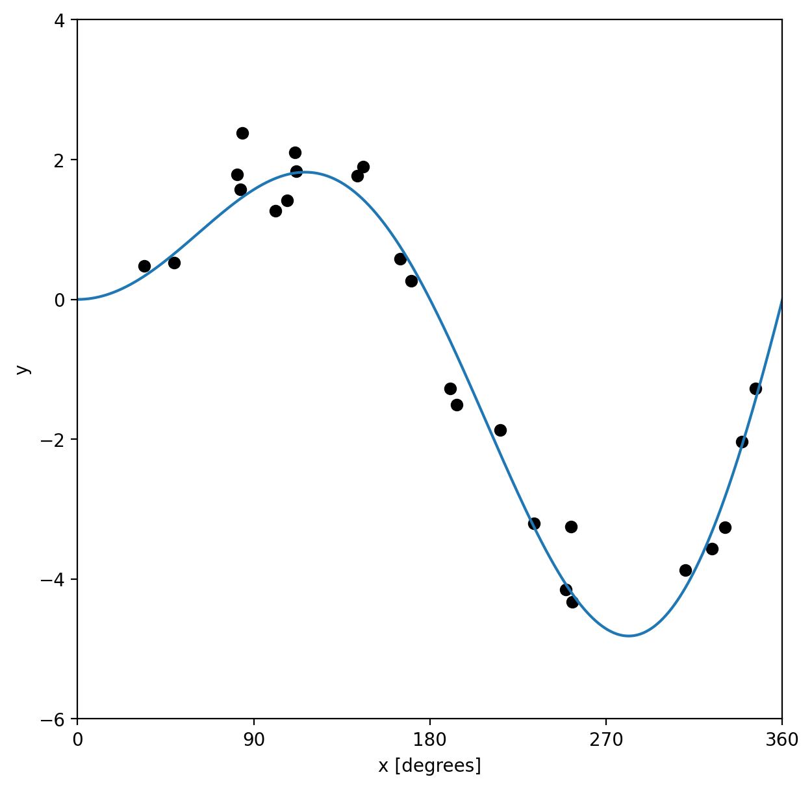

Slide 267
Grid lines
Adding a grid can often allow the plot to be more easily read.
It’s not necessary, but can be helpful for effective interpretation of the data.

Slide 268
fig, ax = plt.subplots(figsize=(7, 7))
ax.plot(x_model, y_model)
ax.scatter(x_data, y_data, color = 'black')
ax.set_xlabel('x [degrees]')
ax.set_ylabel('y')
ax.set_xticks([0, np.pi / 2, np.pi, 3 / 2 * np.pi, 2 * np.pi])
ax.set_xticklabels([0, 90, 180, 270, 360])
ax.set_yticks([-6, -4, -2, 0, 2, 4])
ax.set_xlim([0, 2 * np.pi])
ax.grid(True)

Slide 269
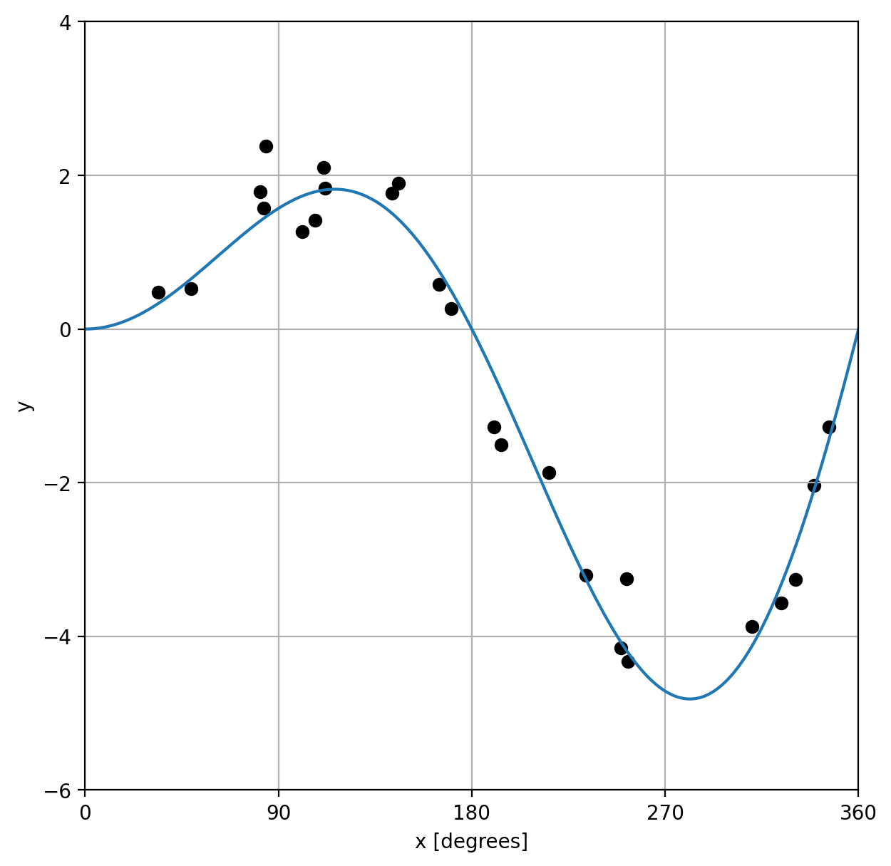

Slide 270
Legend
Our understanding our data is among the most important aspects of any plot and a legend is key to making that happen.
To add a legend, we have to label each of the items that we’re plotting, which is done most easily by adding a label keyword argument to the plotting method call.
We’ll call the line plot “Our Model” and the scatter plot data “Sample data”.

Slide 271
fig, ax = plt.subplots(figsize=(7, 7))
ax.plot(x_model, y_model, label = 'Our Model')
ax.scatter(x_data, y_data, color ='blue', label = 'Sample Data')
ax.set_xlabel('x [degrees]')
ax.set_ylabel('y')
ax.set_xticks([0, np.pi / 2, np.pi, 3 / 2 * np.pi, 2 * np.pi])
ax.set_xticklabels([0, 90, 180, 270, 360])
ax.set_yticks([-6, -4, -2, 0, 2, 4])
ax.set_xlim([0, 2 * np.pi])
ax.grid(True)
ax.legend()

Slide 272
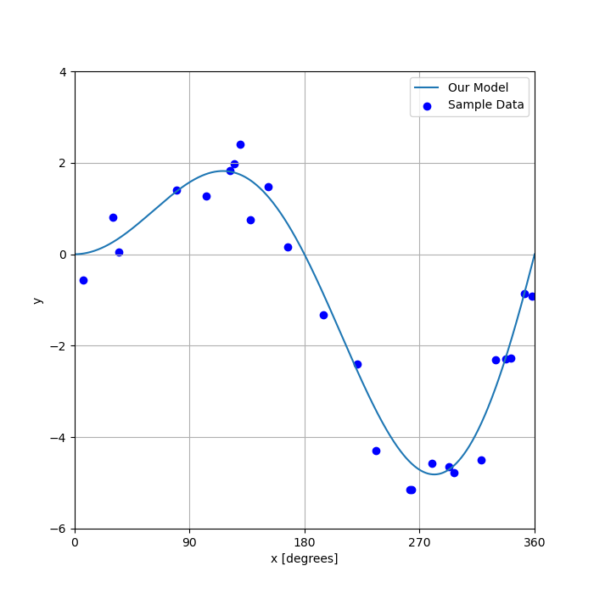

Slide 273
Title
While a title can be added to any plot, it can be especially useful in subplots when you need to label each of the subplots to make sure it’s clear what they represent.
Let’s add a title to our plot.

Slide 274
fig, ax = plt.subplots(figsize=(7, 7))
ax.plot(x_model, y_model, label = 'Our Model')
ax.scatter(x_data, y_data, color ='blue', label = 'Sample Data')
ax.set_xlabel('x [degrees]')
ax.set_ylabel('y')
ax.set_xticks([0, np.pi / 2, np.pi, 3 / 2 * np.pi, 2 * np.pi])
ax.set_xticklabels([0, 90, 180, 270, 360])
ax.set_yticks([-6, -4, -2, 0, 2, 4])
ax.set_xlim([0, 2 * np.pi])
ax.grid(True)
ax.set_title('Model performance compared to sample data')
ax.legend()

Slide 275
Spines
Spines are the lines that form the border of a set of axes.
You can customize these by turning them on or off or adjusting their color pattern and other aspects of their style.
Let’s turn off the top and right spines to see this in action.

Slide 276
fig, ax = plt.subplots(figsize=(7, 7))
ax.plot(x_model, y_model, label = 'Our Model')
ax.scatter(x_data, y_data, color ='blue', label = 'Sample Data')
ax.set_xlabel('x [degrees]')
ax.set_ylabel('y')
ax.set_xticks([0, np.pi / 2, np.pi, 3 / 2 * np.pi, 2 * np.pi])
ax.set_xticklabels([0, 90, 180, 270, 360])
ax.set_yticks([-6, -4, -2, 0, 2, 4])
ax.set_xlim([0, 2 * np.pi])
ax.grid(True)
ax.set_title('Model performance compared to sample data’)
ax.spines[['right', 'top']].set_visible(False)
ax.legend()

Slide 277
Another way to set properties
In the above examples, we used the individual set method for each property of the Axes object we wanted to change.
For example ax.set_ylabel('y’).
However, an alternative to this structure is to use the ax.set() method and set each property as a keyword property.
For the y label example, this would be ax.set(ylabel='y’).
And we can include multiple parameters that we wish to set.
This notation can be more compact and easier to read.

Slide 278
fig, ax = plt.subplots(figsize=(7, 7))
ax.plot(x_model, y_model, label= "Our Model")
ax.scatter(x_data, y_data, color= "black", label="Sample Data")
ax.legend()
ax.spines[["right", "top"]].set_visible(False)
ax.grid(True)
ax.set(
xlabel="x [degrees]",
ylabel="y",
xticks=[0, np.pi / 2, np.pi, 3 / 2 * np.pi, 2 * np.pi],
xticklabels=[0, 90, 180, 270, 360],
yticks=[-6, -4, -2, 0, 2, 4],
xlim=[0, 2 * np.pi],
)
ax.set_title("Model performance compared to sample data")
plt.show()

Slide 279
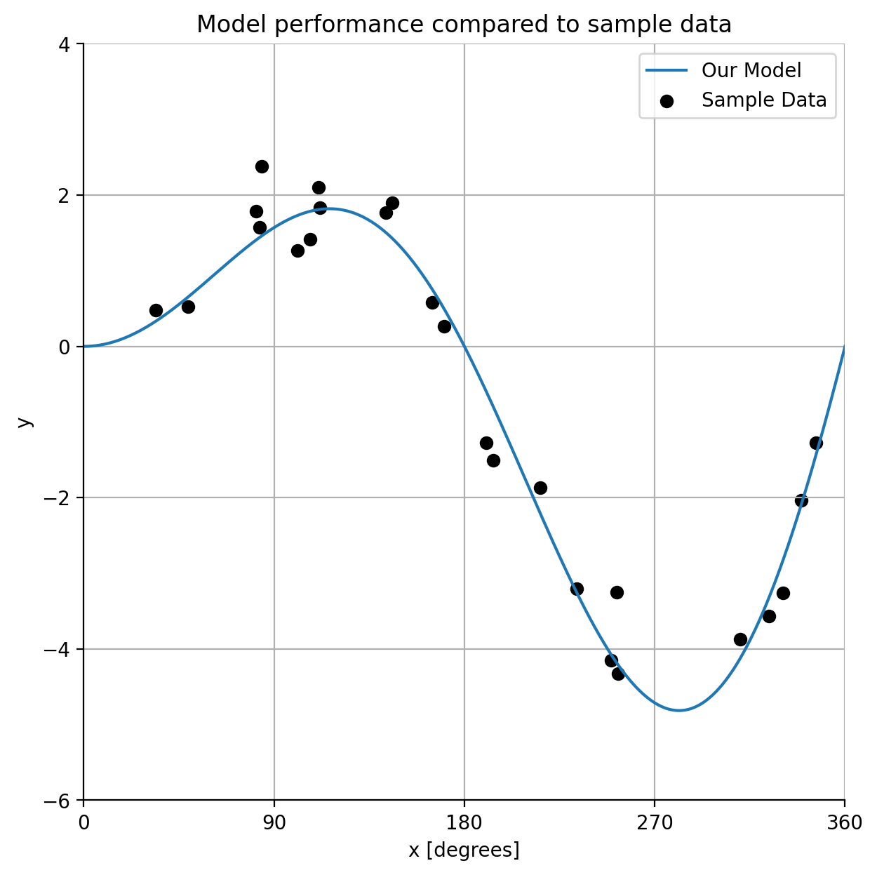

Slide 280
Data Visualization with Seaborn
seaborn is built on top of matplotlib so you can also mix code for the two packages.

Slide 281
import matplotlib as mpl
import matplotlib.pyplot as plt
import numpy as np
import pandas as pd
import seaborn as sns
import seaborn.objects as so
# Set seed for random numbers
seed_for_prng = 78557
prng = np.random.default_rng(seed_for_prng)

Slide 282
Datasets in Seaborn
There are quite a few of the datasets built into seaborn used for teaching.
Let’s explore the tips, penguins, diamonds and healthexp datasets for our work in seaborn.
tips = sns.load_dataset('tips')
penguins = sns.load_dataset('penguins').dropna()
diamonds = sns.load_dataset('diamonds’)
healthexp = (sns.load_dataset('healthexp').sort_values(['Country', 'Year']).query('Year <= 2020'))

Slide 283
tips.columns
penguins.columns
diamonds.columns
healthexp.columns

Slide 284
type(penguins)
Out[125]: pandas.core.frame.DataFrame
penguins.head()
Out[126]:
species island bill_length_mm bill_depth_mm flipper_length_mm body_mass_g sex
0 Adelie Torgersen 39.1 18.7 181.0 3750.0 Male
1 Adelie Torgersen 39.5 17.4 186.0 3800.0 Female
2 Adelie Torgersen 40.3 18.0 195.0 3250.0 Female
4 Adelie Torgersen 36.7 19.3 193.0 3450.0 Female
5 Adelie Torgersen 39.3 20.6 190.0 3650.0 Male

Slide 285
Specifying a plot and mapping data
The most important command in seaborn is Plot().
You specify plots by instantiating a Plot() object and calling its methods.
Let’s see a simple example:
plotter = so.Plot(penguins, x = ‘bill_length_mm’, y = ‘bill_depth_mm’).add(so.Dot())
fig, ax = plt.subplots()
plotter.on(ax).plot()

Slide 286
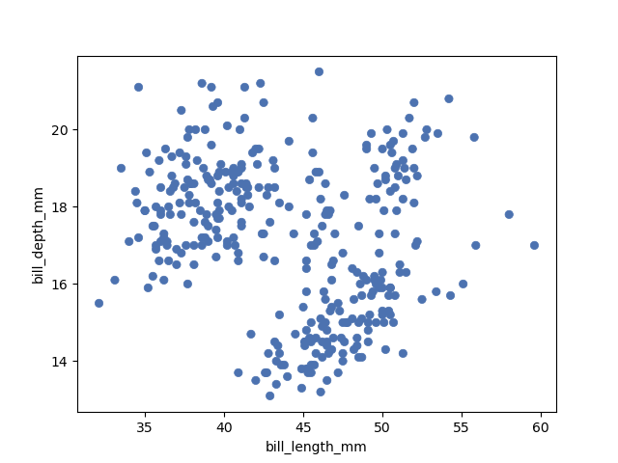

Slide 287
This can be achieved as a scatter plot by calling seaborn.scatterplot() and passing the dataframe (penguins) and assigned two of its columns to the x and y coordinates of the plot.
sns.scatterplot(penguins, x = 'bill_length_mm', y = 'bill_depth_mm')

Slide 288
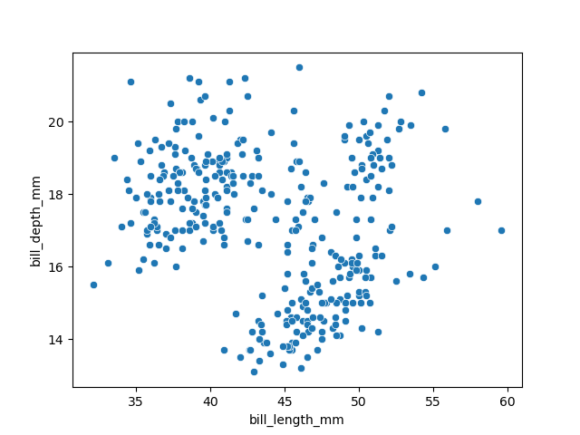

Slide 289
Setting properties
The Dot class is an example of a Mark: an object that graphically represents data values.
Each mark will have a number of properties that can be set to change its appearance.
plotter = so.Plot(penguins, x='bill_length_mm', y='bill_depth_mm').add(so.Dot(color='g', pointsize=4))
fig, ax = plt.subplots()
plotter.on(ax).plot()

Slide 290
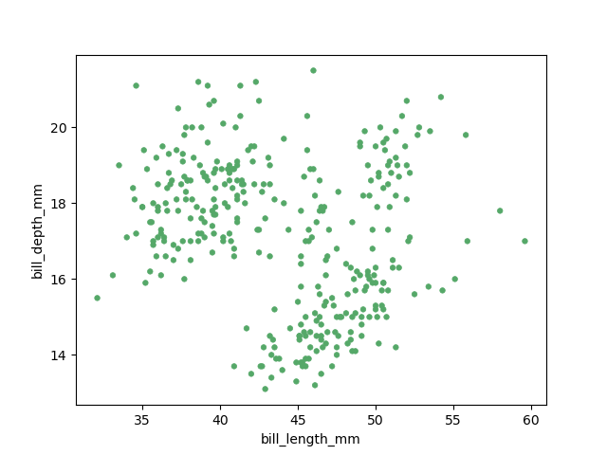

Slide 291
Mapping properties
As with seaborn’s functions, it is also possible to map data values to various graphical properties.
(so.Plot(penguins,
x="bill_length_mm",
y="bill_depth_mm",
color="species",
pointsize="body_mass_g",
).add(so.Dot()).show()

Slide 292
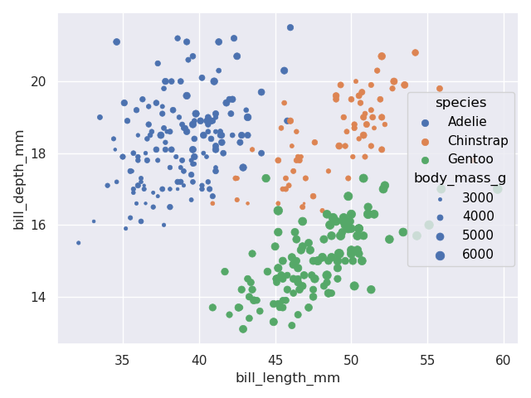

Slide 293
Defining groups
The Dot mark represents each data point independently, so the assignment of a variable to a property only has the effect of changing each dot’s appearance.
For marks that group or connect observations, such as Line, it also determines the number of distinct graphical elements:
(so.Plot(healthexp, x="Year", y="Life_Expectancy", color="Country").add(so.Line()))

Slide 294
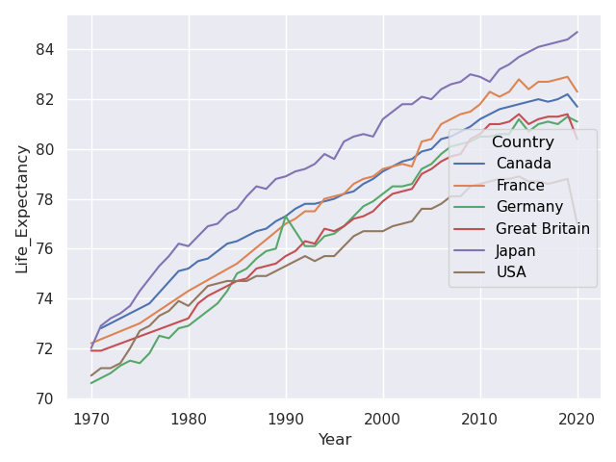

Slide 295
Transforming data before plotting

Slide 296
Statistical Transformation
As with many seaborn functions, the objects interface supports statistical transformations.
These are performed by Stat objects, such as Agg().
(so.Plot(penguins, x="species", y="body_mass_g").add(so.Bar(), so.Agg())).show()

Slide 297
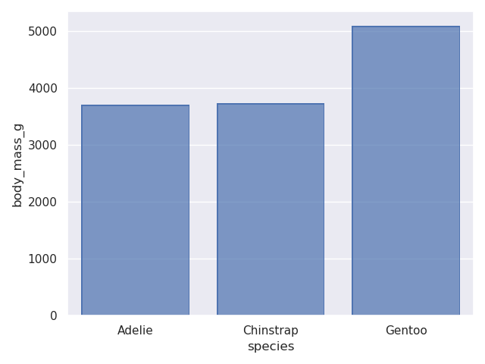

Slide 298
(so.Plot(penguins, x="species", y="body_mass_g").add(so.Bar(), so.Agg('median'))).show()

Slide 299
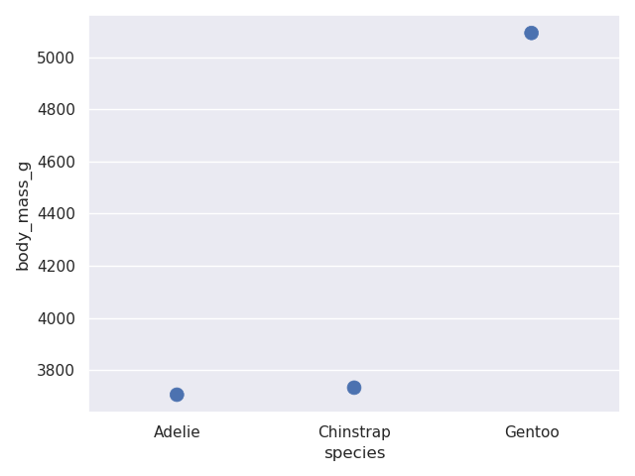
(so.Plot(penguins, x=‘species’, y = ‘body_mass_g’).add(so.Dot(pointsize=10), so.Agg())).show()

Slide 300
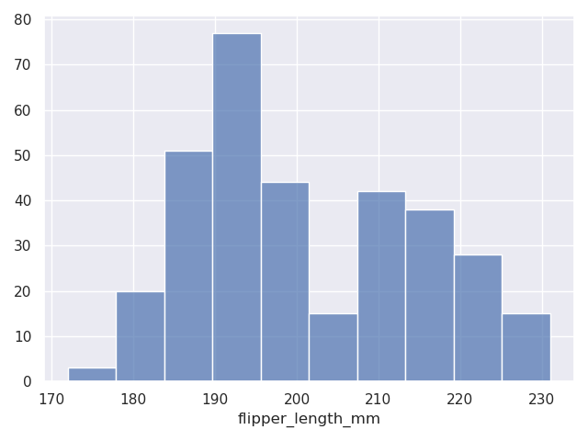
For numeric data, we can have a histogram.
(so.Plot(penguins, x ='flipper_length_mm').add(so.Bars(), so.Hist())).show()

Slide 301
Adding Multiple Layers
More complex single-subplot graphics can be created by calling Plot.add() repeatedly.
Each time it is called, it defines a layer in the plot.
For example, we may want to add a scatterplot (now using Dots) and then a regression fit:
(so.Plot(tips, x = 'total_bill', y = 'tip').add(so.Dots()).add(so.Line(), so.PolyFit())).show()

Slide 302
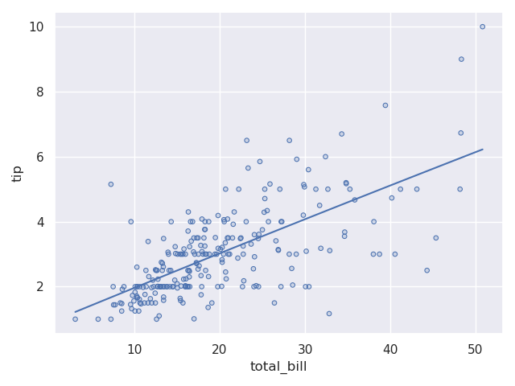

Slide 303
Variable mappings that are defined in the Plot() constructor will be used for all layers.
(
...: so.Plot(tips, x = 'total_bill', y = 'tip', color = 'time')
...: .add(so.Dots())
...: .add(so.Line(), so.PolyFit())
...: ).show()

Slide 304
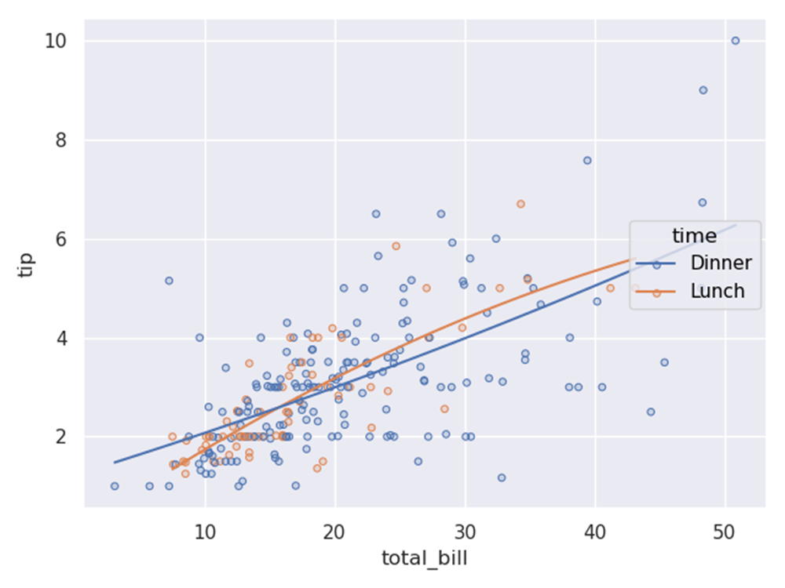

Slide 305
(
so.Plot(healthexp, x="Year", y="Life_Expectancy")
facet("Country", wrap = 3)
.add(so.Line(alpha=0.3), group="Country", col=None)
.add(so.Line(linewidth=3))
).show()

Slide 306
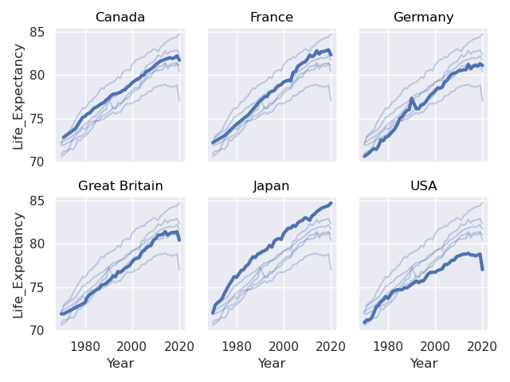

Slide 307
Package information
https://seaborn.pydata.org/tutorial/introduction.html

Slide 308
Data Value Problems
Data can be dirty and unsuitable to be fed to models.
Now let’s turn to what we can do once we’ve found a problem in our data.
In pandas, there are, broadly, two ways to deal with these problems:
using a general cleaning function, or
directly modifying problematic values.

Slide 309
Let’s use the world-very-small.csv dataset.
We are going to use .replace() to fix “bad” values in our data.
As the name suggests, replace finds specific values in a Series and replaces them with other values.
For example, let’s begin with this little dataset of with countries, their regions, GDP per capita, and Polity IV scores (a measure of how close countries are to being liberal democracies).

Slide 310
Code
import pandas as pd
smallworld = pd.read_csv(‘world-very-small.csv’)
smallworld
Out[69]:
country region gdppcap08 polityIV
0 Brazil S. America 10296 18
1 Germany W. Europe 35613 20
2 Mexico N. America 14495 18
3 Mozambique Africa 855 16
4 Russia C&E Europe 16139 17
5 Ukraine C&E Europe 7271 16

Slide 311
Now suppose that we want to change country names from their anglicized names to what their own citizens would call them.
Starting by replacing “Germany” with “Deutschland”:
smallworld[‘country’] = smallworld[‘country’].replace(‘Germany’, ‘Deutschland’)
smallworld
Out[70]:
country region gdppcap08 polityIV
0 Brazil S. America 10296 18
1 Deutschland W. Europe 35613 20
2 Mexico N. America 14495 18
3 Mozambique Africa 855 16
4 Russia C&E Europe 16139 17
5 Ukraine C&E Europe 7271 16

Slide 312
Replace works for numbers too—suppose we learned that the Polity organization had mis-coded all scores of 15 as 16, so we wanted to change all 16s to 15s:
smallworld[‘polityIV’] = smallworld[‘polityIV’].replace(16, 15)
smallworld
Out[71]:
country region gdppcap08 polityIV
0 Brazil S. America 10296 18
1 Deutschland W. Europe 35613 20
2 Mexico N. America 14495 18
3 Mozambique Africa 855 15
4 Russia C&E Europe 16139 17
5 Ukraine C&E Europe 7271 15

Slide 313
Note here that .replace() replaces all entries with a given value, here, the values for both Mozambique and Ukraine).
If we wanted to, say, just change Mozambique’s score because of a recent coup, you’d need a different tool.

Slide 314
.replace() with Dictionaries
If we need to make lots of changes at once, .replace() will also accept a dictionary instead of a pair of distinct values.
When you pass a dictionary, .replace() will replace each occurrence of each key in the dictionary with the associated values.
For example, if we could continue changing our country names to their native spellings this way:

Slide 315
changes = {
'Mexico': 'México',
'Russia': 'Российская Федерация',
'Ukraine': 'Україна',
'Brazil': 'Brasil',
}
smallworld['country'] = smallworld['country'].replace(changes)
smallworld

Slide 316
The .str. String Methods
String are problematics in data.
There are just SO MANY ways to get problems in strings – capitalization issues, differences in spellings, differences in accents, etc.
As a result, pandas comes with a special set of methods for manipulating strings.
These can be accessed through the .str. methods (e.g. smallworld[‘country’].str.upper() will capitalize your country names).

Slide 317
Here’s a short list of available string methods.
.str.lower() / .str.upper(): Change the case of strings (there are lots of these formatting methods…)
.str.contains(): Look for a substring, return True if found
.str.isnumeric(): True if value could be converted to a number easily (e.g. “10”), returns False if not (e.g. “Nick”).
.str.strip(): Removes whitespaces at start or end of strings (a common cleanliness problem)

Slide 318
Let’s illustrate by capitalizing all of our country names.
smallworld['country'].str.upper()
Out[73]:
0 BRASIL
1 DEUTSCHLAND
2 MÉXICO
3 MOZAMBIQUE
4 РОССИЙСКАЯ ФЕДЕРАЦИЯ
5 УКРАЇНА

Slide 319
Or make them all lowercase.
smallworld['country'].str.lower()
Out[74]:
0 brasil
1 deutschland
2 méxico
3 mozambique
4 российская федерация
5 україна

Slide 320
Cleaning Data Types
An extremely common data cleanliness problem pertains to managing data types.
For example, it is very common to load data that you think should be numeric (say, float64).
It turns out pandas has loaded it as Categorical or Object type, which means you can’t do numeric computations on the data (e.g., mean, median, etc.).
24, 16, 55, 12, me, 17

Slide 321
There are two main reasons that this can happen:
There are observations that are accidentally being parsed as non-numeric, or
There are observations that are deliberately non-numeric you didn’t realize were there.
It is so common in data. . .

Slide 322
world = pd.read_csv('world-very-small-type-errors.csv')
world
Out[75]:
country region gdppcap08 polityIV
0 Brazil S. America 10296 18
1 Germany W. Europe 35613 20 or higher
2 Mexico N. America na 18
3 Mozambique Africa 855 16
4 Russia C&E Europe 16139 17
5 Ukraine C&E Europe 7271 16

Slide 323
Obviously we can see there are going to be issues with gdppcap08 and polityIV.
If this were a real (big) dataset where this wasn’t evident and you tried to calculate the average GDP of countries in the data. . .
You would get a very weird ValueError / TypeError. . .
world['gdppcap08'].mean()
So the first thing we can do, as a sanity check, is check the dtypes of our dataframe to confirm that what we thought was a numeric column is in fact an object or Categorical column:

Slide 324
world.dtypes
Out[77]:
country object
region object
gdppcap08 object
polityIV object

Slide 325
We can see that gdppcap08 and polityIV are object.
it is such a common problem that pandas has a tool to deal with it: .str.isnumeric().
This method returns True if an observation can be converted to a number without issues, and False otherwise.
By using its logical negation, we can find all observations that aren’t convertible (which we may then need to fix).
world.loc[~world['gdppcap08'].str.isnumeric(),gdppcap08'].value_counts()
Out[78]:
gdppcap08
na 1

Slide 326
In this case, it seems like na is probably just short for np.nan, so we can replace it with np.nan, which is a number.
world.loc[world['gdppcap08'] == 'na', 'gdppcap08'] = np.nan
Then we can either cast gdppcap08 to a numeric type directly with world["gdppcap08"] = world["gdppcap08"].astype("float"), or
let pandas do it implicitly when we run world["gdppcap08"].mean().
In general the former is probably better practice, so let’s do that:
world['gdppcap08'] = world['gdppcap08'].astype('float')
world['gdppcap08'].mean()
Out[82]: 14034.8

Slide 327
A stress-free way. . .
There’s one other option in these situations.
If na is appearing in lots of places in the data as a representation for missing data, we can also communicate this fact to read_csv.
We can parse na_values, where you can specify how missing data is represented in a dataset.
If we use that to tell read_csv that "na" means data is missing, it’ll make this correction on the fly.

Slide 328
world = pd.read_csv('world-very-small-type-errors.csv', na_values = 'na')
world
Out[83]:
country region gdppcap08 polityIV
0 Brazil S. America 10296.0 18
1 Germany W. Europe 35613.0 20 or higher
2 Mexico N. America NaN 18
3 Mozambique Africa 855.0 16
4 Russia C&E Europe 16139.0 17
5 Ukraine C&E Europe 7271.0 16

Slide 329
world.dtypes
Out[84]:
country object
region object
gdppcap08 float64
polityIV object

Slide 330
Deliberate Non-Numerics
In the example above "na" wasn’t really meant to be interpreted as a string.
Sometimes non-numeric values are inserted into datasets to communicate something important to the user.
For example, in this example, polityIV has a non-numeric value.
world.loc[~world['polityIV'].str.isnumeric()]
Out[85]:
country region gdppcap08 polityIV
1 Germany W. Europe 35613.0 20 or higher

Slide 331
Here, the value is to indicate that the value of polityIV could be 20 or any value above 20.
Why might this occur?
In many surveys, there will be a maximum value allowed (e.g., some surveys have a top income value they can record).
These are called “top-codes”, and they are different from the case above because it’s not immediately clear what value you should put into the field.
You could put in 20, but… the value might not be 20, it could be 21!
So when you find a top-code like this, you need to think carefully about what to do with it, as the answer will depend on the type of analysis you want to do.

Slide 332
Combining, grouping, and querying data

Slide 333
Combining data
Up until this point, we’ve assumed our data comes as a single table or file.
While the data may need some cleaning up, they we’ve it into one table or DataFrame.
This is not always the case, since we frequently want to combined data from multiple sources.

Slide 334
Concatenate
Concatenate allows us to add rows or columns from one DataFrame to another.
This could be useful if we have two datasets with medical patient data and we want to combine the two sets of patient datasets into one.

Slide 335
Merge
Merge allows us to combine the contents of two DataFrames.
If we had two sets of patient data:
one with data on recent vital signs records like heart rate, blood pressure, and temperature and
a second set that contains past medical diagnoses (does the patient have asthma, anemia, etc.), and perhaps only some of the patients are contained in both.
Merging is how we combine these datasets together into one.

Slide 336
Grouping data
With the groupby(), we split the dataset based on the contents of particular columns.
We then perform calculations on those groups of data within the dataset, reporting summary values back for each group.
For example, if we had the dataset mentioned above with patients’ vital signs, perhaps we want to see what the typical heart rate was for patients with high blood pressure vs those with lower blood pressure.
This can be efficiently accomplished through grouping our data appropriately.

Slide 337
Querying data
Queries allow us to efficiently ask questions of our data.
We came across the idea of asking questions of our data when we discussed subsetting in previous slides.
Those were queries of the data that allowed us to select subsets of data meeting specific criteria (e.g. what fraction of patients with high blood pressure also have high cholesterol?
What fraction of patients with low cholesterol have high blood pressure?).
While this is not a new concept, it is typically our end goal in combining or grouping data.

Slide 338
Examples
Merging data is a nearly ubiquitous task in data science. Imagine that you are a financial analyst, and you’re trying to estimate the risk of default on a loan. You have one dataset that contains a list of loan applicants’ credit history and another that contains their income. To make an informed decision, the analyst would need to merge the records of these two sets of data together.
As another example, imagine you are a business analyst trying to evaluate trends throughout the year in sales, but the data on those transactions is divided up into monthly datasets. In this case, you would need to concatenate the data together into a single dataset before those trends could be evaluated. If that analyst wishes to then estimate the average sales by the seniority of each salesperson, they would need to group the data first by seniority to then calculate those group-specific sales values.

Slide 339
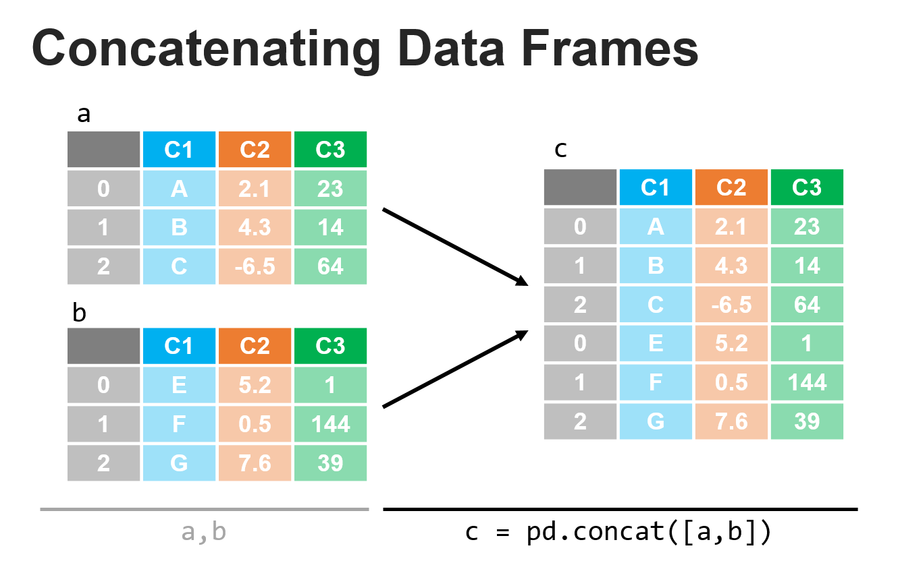
Combining datasets: concatenating

Slide 340
df1 = pd.DataFrame(
...: {
...: 'animals': ['dog', 'cat', 'bird', 'fish'],
...: 'location': ['land', 'land', 'air', 'water'],
...: 'has_fur': [True, True, False, False],
...: 'avg_weight': [40, 10, 0.1, 4],
...: }
...: )
...: df1

Slide 341
Out[86]:
animals location has_fur avg_weight
0 dog land True 40.0
1 cat land True 10.0
2 bird air False 0.1
3 fish water False 4.0

Slide 342
df2 = pd.DataFrame(
...: {
...: 'animals': ['giraffe', 'elephant', 'blue whale'],
...: 'location': ['land', 'land','water'],
...: 'has_fur': [True, False, False],
...: 'avg_weight': [3000, 12000, 300000],
...: }
...: )
...: df2

Slide 343
Out[87]:
animals location has_fur avg_weight
0 giraffe land True 3000
1 elephant land False 12000
2 blue whale water False 300000

Slide 344
df_concat = pd.concat([df1, df2])
df_concat
Out[88]:
animals location has_fur avg_weight
0 dog land True 40.0
1 cat land True 10.0
2 bird air False 0.1
3 fish water False 4.0
0 giraffe land True 3000.0
1 elephant land False 12000.0
2 blue whale water False 300000.0

Slide 345
Reindexing
Note that the index labels were retained from the original datasets, so we see the labels as: [0, 1, 2, 3, 0, 1, 2].
Sometimes if these were id’s associated with each row entry, we may want to keep them as is, but if instead we wanted them as row numbers, we could apply the reset_index method to create a fresh index that increments via the row count.

Slide 346
df_concat_reindexed = df_concat.reset_index()
df_concat_reindexed
Out[89]:
index animals location has_fur avg_weight
0 0 dog land True 40.0
1 1 cat land True 10.0
2 2 bird air False 0.1
3 3 fish water False 4.0
4 0 giraffe land True 3000.0
5 1 elephant land False 12000.0
6 2 blue whale water False 300000.0

Slide 347
If we wanted to drop the old index, we could add the drop=True key/value pair to the call as shown below.
df_concat_reindexed = df_concat.reset_index(drop=True)^M
df_concat_reindexed
Out[90]:
animals location has_fur avg_weight
0 dog land True 40.0
1 cat land True 10.0
2 bird air False 0.1
3 fish water False 4.0
4 giraffe land True 3000.0
5 elephant land False 12000.0
6 blue whale water False 300000.0

Slide 348
Concatenating along different axes
The example we showed above applied concatenate along the default axis (0):
df_concat = pd.concat([df1, df2], axis=0)^M
df_concat
Out[91]:
animals location has_fur avg_weight
0 dog land True 40.0
1 cat land True 10.0
2 bird air False 0.1
3 fish water False 4.0
0 giraffe land True 3000.0
1 elephant land False 12000.0
2 blue whale water False 300000.0

Slide 349
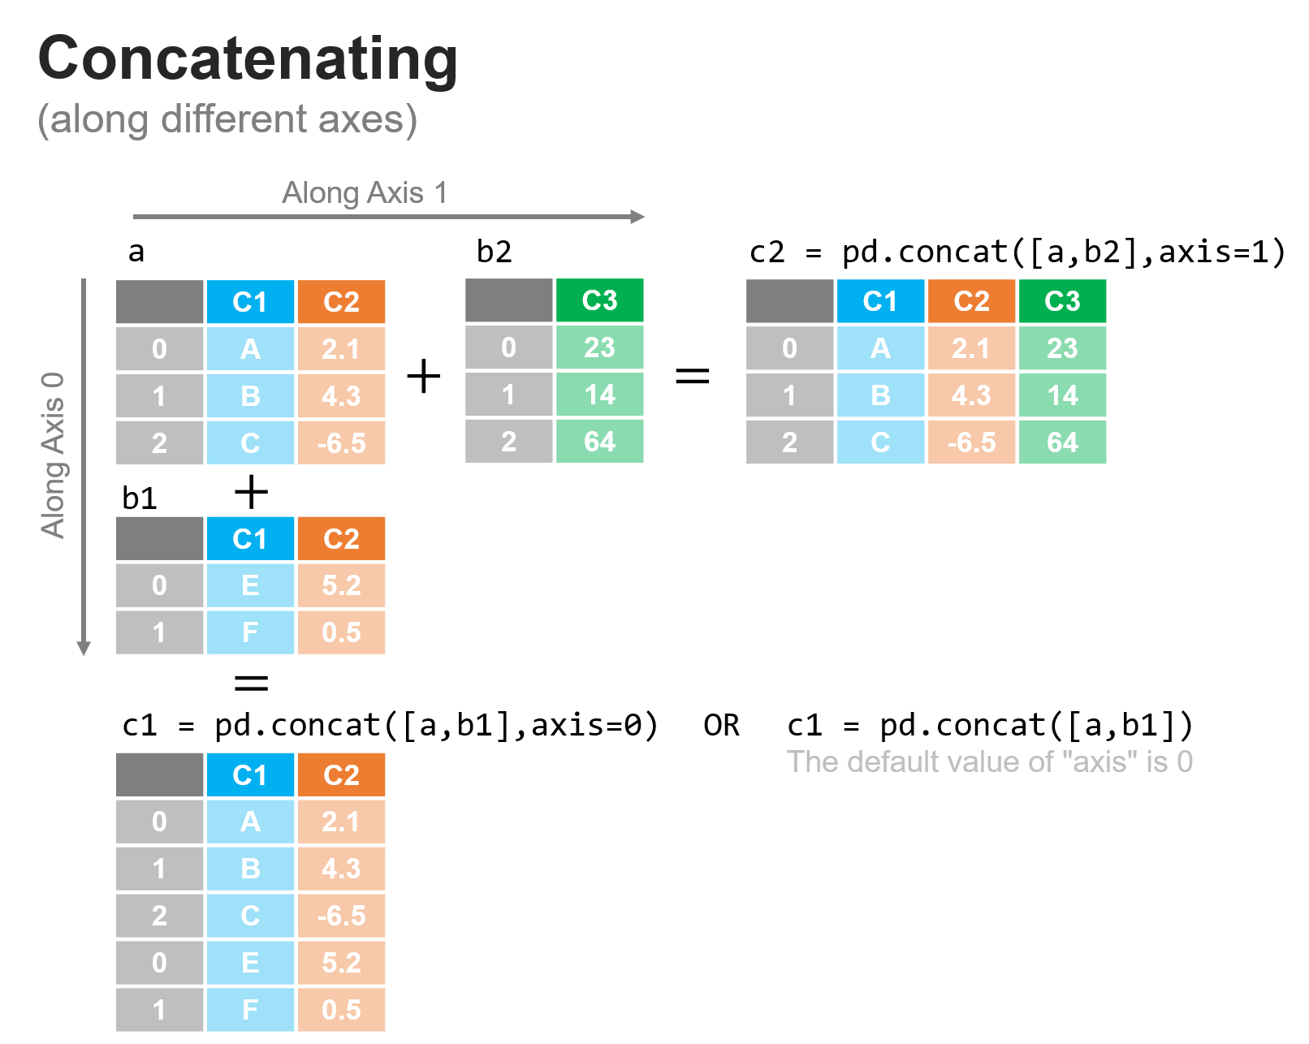

Slide 350
Let’s say we wanted to add additional information about each animal about its average lifespan in years and its length (along the longest dimension) in meters. . .
df3 = pd.DataFrame({'life': [12, 13, 4, 3], 'height': [0.6, 0.45, 0.2, 0.05]})
df3
Out[92]:
life height
0 12 0.60
1 13 0.45
2 4 0.20
3 3 0.05

Slide 351
Recall df1
df1
Out[93]:
animals location has_fur avg_weight
0 dog land True 40.0
1 cat land True 10.0
2 bird air False 0.1
3 fish water False 4.0

Slide 352
We notice the data in df3 are nicely lined up and we just need to add the additional columns to df1 along axis 1.
df_concat_axis1 = pd.concat([df1, df3], axis=1)
df_concat_axis1
Out[94]:
animals location has_fur avg_weight life height
0 dog land True 40.0 12 0.60
1 cat land True 10.0 13 0.45
2 bird air False 0.1 4 0.20
3 fish water False 4.0 3 0.05

Slide 353
Concatenating with mismatched datasets
In all of the cases we’ve looked at so far, everything has been very nice and clean.
We concatenated rows, there were the same number of columns and we concatenated columns there were the same number of rows: an ideal situation.
We have to be careful when concatenating, because we’ll still get a result if these assumptions are not true, with any blanks filled in with NaN values.

Slide 354
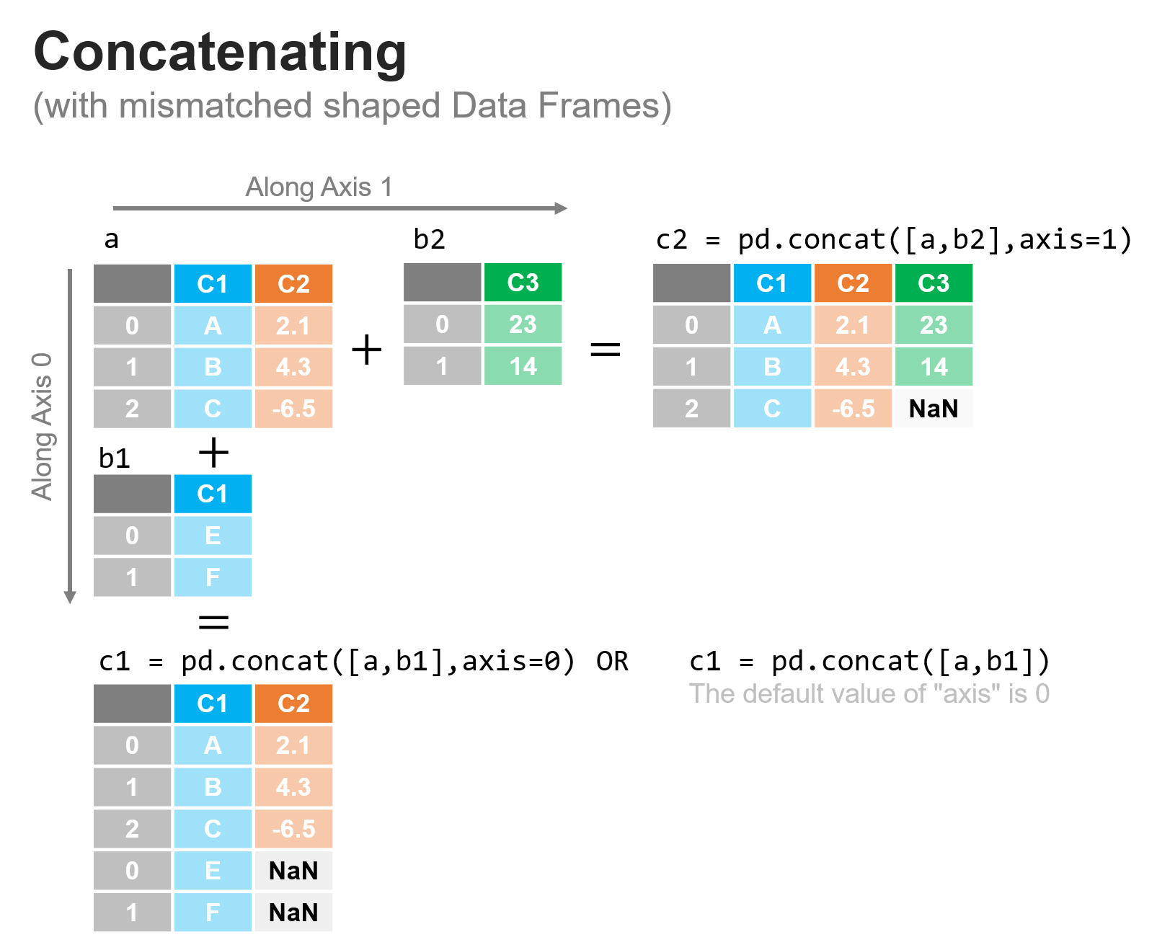

Slide 355
a = pd.DataFrame(data={'C1': ['A', 'B', 'C'], 'C2': [2.1, 4.3, -6.5]})
a
Out[95]:
C1 C2
0 A 2.1
1 B 4.3
2 C -6.5

Slide 356
b1 = pd.DataFrame(data={'C1': ['E', 'F']})
b1
Out[96]:
C1
0 E
1 F

Slide 357
b2 = pd.DataFrame(data={'C3': [23, 14]})
b2
Out[97]:
C3
0 23
1 14

Slide 358
Now let’s concatenate them together as shown above:
c1 = pd.concat([a, b1], axis=0)
c1
Out[98]:
C1 C2
0 A 2.1
1 B 4.3
2 C -6.5
0 E NaN
1 F NaN

Slide 359
c2 = pd.concat([a, b2], axis=1)
c2
Out[99]:
C1 C2 C3
0 A 2.1 23.0
1 B 4.3 14.0
2 C -6.5 NaN

Slide 360
In each case, when concatenating along the rows, concatenate placed the data in the row or column by matching the row index or column header.
We do need to take care when applying this since improper use may still combine your DataFrames but in ways you may not want or expect.

Slide 361
Let’s recall df1.
df1
Out[100]:
animals location has_fur avg_weight
0 dog land True 40.0
1 cat land True 10.0
2 bird air False 0.1
3 fish water False 4.0

Slide 362
df4 = pd.DataFrame({'student_id': [623, 29, 294], 'grade': ['A-', 'B+', 'B']})
df4
Out[101]:
student_id grade
0 623 A-
1 29 B+
2 294 B

Slide 363
df1 and df4 clearly have no relationship to one another and are not the same dimension along either axis.
If we concate them together, they will certainly combine:

Slide 364
df_ax0 = pd.concat([df1, df4], axis=0)^M
df_ax0
Out[102]:
animals location has_fur avg_weight student_id grade
0 dog land True 40.0 NaN NaN
1 cat land True 10.0 NaN NaN
2 bird air False 0.1 NaN NaN
3 fish water False 4.0 NaN NaN
0 NaN NaN NaN NaN 623.0 A-
1 NaN NaN NaN NaN 29.0 B+
2 NaN NaN NaN NaN 294.0 B

Slide 365
In this first case, since there are no shared column headers, this essentially creates two separate tables within one.
In practice, you rarely would want something like this.
If we combine along axis 1, the story is equally problematic, since concat does combine the data, but nonsensically so since the animals are not the students, they just shared the same index values, so the columns were added where those indices matched:

Slide 366
df_ax1 = pd.concat([df1, df4], axis=1)
df_ax1
Out[103]:
animals location has_fur avg_weight student_id grade
0 dog land True 40.0 623.0 A-
1 cat land True 10.0 29.0 B+
2 bird air False 0.1 294.0 B
3 fish water False 4.0 NaN NaN

Slide 367
Warning
We must take care in how we apply these techniques and always check the resulting data to make sure that the process accomplished what we were hoping for.

Slide 368
Combining datasets: joins
You are analyzing the accounts of a firm and were given one dataset with that contained transactions with the corresponding dollar amounts and vendor ID number and a second dataset that contained the vendor ID and the name and industry of the vendor.
How could you determine which vendor corresponds to each transaction?

Slide 369
You are developing a system to compute the credits that each student received from taking classes. You have one dataset that has the students and the name of the class they’re taking, and a separate dataset that list the classes and the number of credits each class provides.
How do you determine the number of credits each student is taking?

Slide 370
You are on the marketing team where each employee is signed to one of the clients of the firm. In most cases, multiple employees are signed to a single client (forming the client team) and those employees may, themselves work with multiple clients (they are part of multiple teams). Each client has one or more products. How do we get a list of each product that each employee is working on?

Slide 371
Addressing the questions. . .
We can address each of the above issues by combining datasets using merge.
In fact, the above examples represents a different type of merge (one-to-one, one-to-many, many-to-many, respectively).

Slide 372
dfa = pd.DataFrame(
...: {
...: 'animals': ['dog', 'cat', 'bird', 'fish'],
...: 'location': ['land', 'land', 'air', 'water'],
...: 'has_fur': [True, True, False, False],^M
...: }
...: )
...: dfa

Slide 373
Out[104]:
animals location has_fur
0 dog land True
1 cat land True
2 bird air False
3 fish water False

Slide 374
dfb = pd.DataFrame(
...: {'animals': ['fish', 'elephant', 'blue whale'], 'avg_weight': [4, 12000, 3000
...: 00]}
...: )
dfb
Out[105]:
animals avg_weight
0 fish 4
1 elephant 12000
2 blue whale 300000

Slide 375
Noteworthy
There are a few differences to note here.
First, there is one shared column in each DataFrame and that is ‘animals’; the rest are unique.
Also, most of the animals are distinct between these two datasets.
To that end, there are 3 ways in which we could merge these DataFrames together referring to the uniqueness of the matches between one dataset and the other:

Slide 376
One-to-one
Each entry in a column of one dataset matches to at most one entry in the column of the second dataset (also, the merge keys are unique in both datasets).
This is the simplest case to encounter.

Slide 377
One-to-many
For the column to merge on, there may only be one row with each unique value in that column in one of the datasets, while there may be multiple values in the corresponding column in the other dataset.

Slide 378
Many-to-many
There may be multiple rows containing the same value in the merge column for each of the datasets.
Each of these above situations can be handled with the merge method.

Slide 379
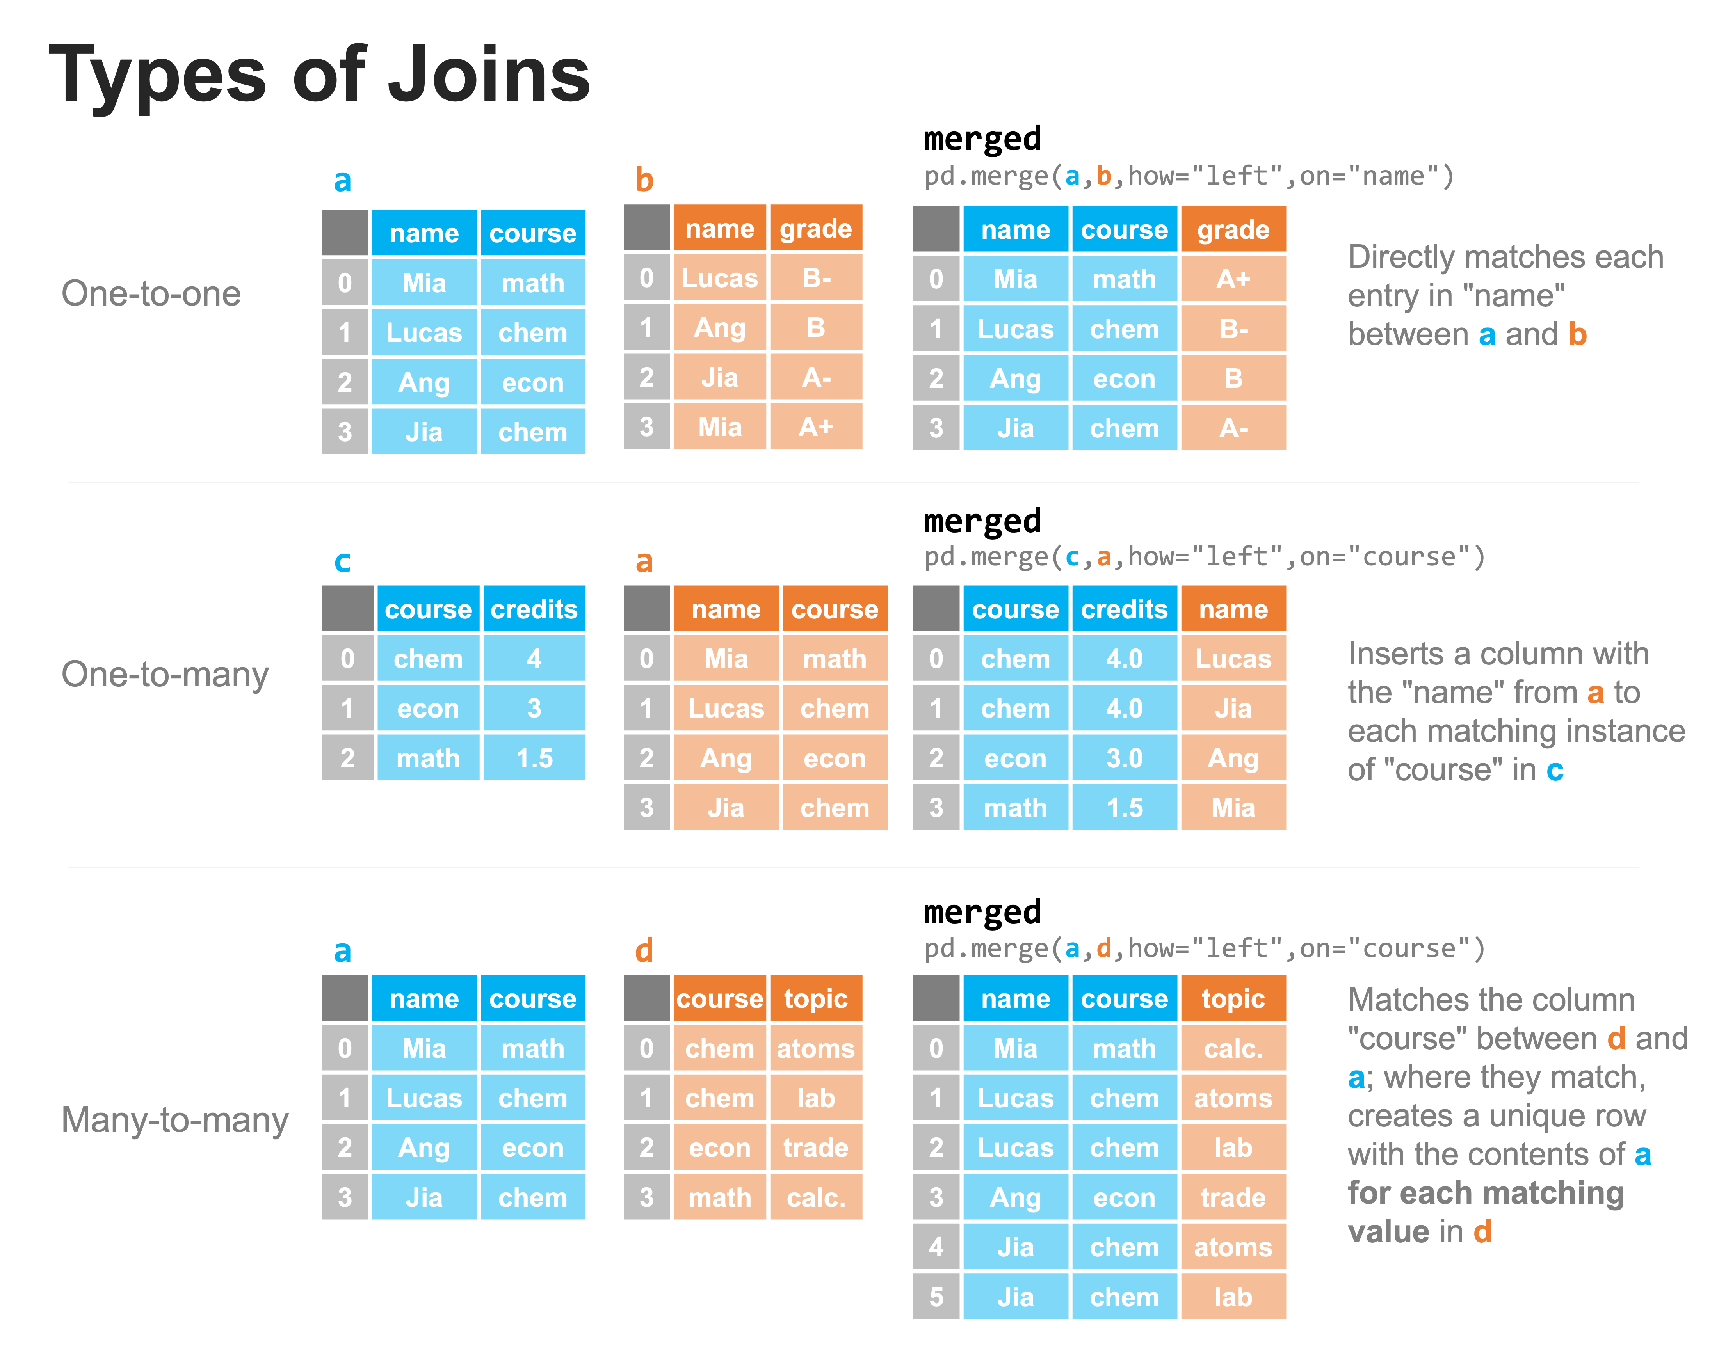

Slide 380
a = pd.DataFrame(
...: data={
...: 'name': ['Mia', 'Lucas', 'Ang', 'Jia'],
...: 'course': ['math', 'chem', 'econ', 'chem'],
...: }
...: )
...: a

Slide 381
Out[106]:
name course
0 Mia math
1 Lucas chem
2 Ang econ

Slide 382
b = pd.DataFrame(
...: data={'name': ['Lucas', 'Ang', 'Jia', 'Mia'], 'grade': ['B-', 'B', 'A-', 'B+'
...: ]}
...: )
...: b
Out[107]:
name grade
0 Lucas B-
1 Ang B
2 Jia A-
3 Mia B+

Slide 383
merged = pd.merge(a, b, how ='left', on = 'name')
merged
Out[108]:
name course grade
0 Mia math B+
1 Lucas chem B-
2 Ang econ B
3 Jia chem A-

Slide 384
Next the one-to-many
c = pd.DataFrame(data={'course': ['chem', 'econ', 'math'], 'credits': [4, 3, 1.5]
})
c
Out[109]:
course credits
0 chem 4.0
1 econ 3.0
2 math 1.5

Slide 385
merged = pd.merge(c, a, how = 'left', on = 'course')
merged
Out[112]:
course credits name
0 chem 4.0 Lucas
1 chem 4.0 Jia
2 econ 3.0 Ang
3 math 1.5 Mia

Slide 386
And finally, the many-to-many
d = pd.DataFrame(
...: data={
...: 'course': ['chem', 'chem', 'econ', 'math'],
...: 'topic': ['atoms', 'lab', 'trade', 'calc.'],
...: }
...: )
...: d
Out[113]:
course topic
0 chem atoms
1 chem lab
2 econ trade
3 math calc.

Slide 387
merged = pd.merge(a, d, how = 'left', on = 'course')
merged
Out[114]:
name course topic
0 Mia math calc.
1 Lucas chem atoms
2 Lucas chem lab
3 Ang econ trade
4 Jia chem atoms
5 Jia chem lab

Slide 388
Combining datasets: merging
Types of merging
The merge method for pandas DataFrames has numerous parameters, but to accomplish the majority of common merges, there are four types of merges to consider:
left, right, inner, and outer.
This is shown in the figure below, and through which we specify using the “how” parameter.

Slide 389
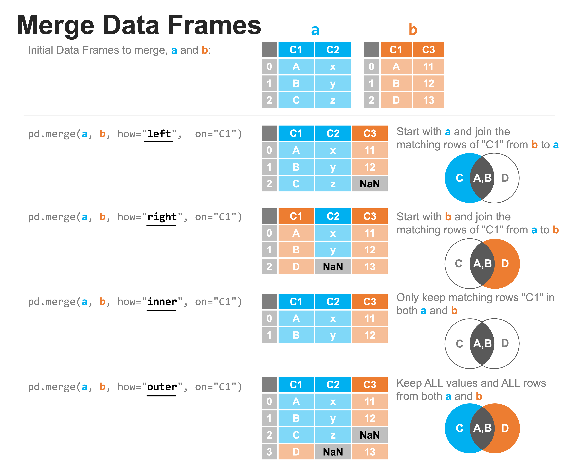

Slide 390
Order of parameters. ..
The order of entering the parameters is very important.
Assume that we’re using the command pd.merge(a, b, ...) with a coming before b and that we’re merging on the data in column “C1”. .
A left merge starts with the contents of a (the DataFrame on the “left”) and joins the rows of “C1” in b that match something in a.
In the example, we can see that the entries A and B in C1 match, but there is no C in b, therefore, there is a NaN in its place.

Slide 391
A right merge performs the same operation, but starts with the contents of b (the DataFrame on the “right”).
In this case we see that there is no match for the value D in column C1 of DataFrame a, so that entry has a NaN value inserted.
An inner merge only keeps rows that have content that matches from both a and b.
An outer merge keeps all value and all rows from both a and b.

Slide 392
Examples
import pandas as pd
a = pd.DataFrame(data={'C1': ['A', 'B', 'C'], 'C2': ['x', 'y', 'z']})
a
Out[18]:
C1 C2
0 A x
1 B y
2 C z

Slide 393
b = pd.DataFrame(data={'C1': ['A', 'B', 'D'], 'C2': [11, 12, 13]})
In [22]: b
Out[22]:
C1 C2
0 A 11
1 B 12
2 D 13

Slide 394
merged = pd.merge(a, b, how = 'left', on = 'C1')
merged
Out[23]:
C1 C2_x C2_y
0 A x 11.0
1 B y 12.0
2 C z NaN

Slide 395
merged = pd.merge(a, b, how = 'right', on = 'C1')
merged
Out[24]:
C1 C2_x C2_y
0 A x 11
1 B y 12
2 D NaN 13

Slide 396
merged = pd.merge(a, b, how = 'inner', on = 'C1')
merged
Out[25]:
C1 C2_x C2_y
0 A x 11
1 B y 12

Slide 397
merged = pd.merge(a, b, how = 'outer', on = 'C1')
merged
Out[26]:
C1 C2_x C2_y
0 A x 11.0
1 B y 12.0
2 C z NaN
3 D NaN 13.0

Slide 398
Grouping datasets
We’ve been able to effectively combined our data into a single DataFrame, we can explore a common set of operations for summarizing data based on shared characteristics.
Let’s say we have the following dataset that describes the number of car sales at a dealership over three years.
In that time, there were 9 employees who each worked there for a year, and different years had different numbers of employees.

Slide 399
sales = pd.read_csv('dealership.csv')
sales
Out[34]:
employee sales year
0 Katrina 14 2018
1 Guanyu 17 2019
2 Jan 6 2020
3 Roman 12 2018
4 Jacqueline 8 2020
5 Paola 3 2019
6 Esperanza 7 2019
7 Alaina 15 2020
8 Egweyn 5 2020

Slide 400
Questions
We want to answer two questions:
What year was the best for the number of sales?
Which year was the best for the number of sales per employee?

Slide 401
To answer Q1, we need to know how many sales there were in each year.
We could do this manually, summing the values of sales for each year and reporting the results.
Unfortunately, we couldn’t do this by hand practically if this list had 1 million entries in it.
This is where the groupby method shines.

Slide 402
Groupby
We can use a process that is facilitated by groupby to
(a) split the data into groups
(b) apply a function to the contents of each group independently, and then
(c) combine the data back into a single DataFrame.
The figure shows how we can group by ‘year’, and sum the data from the ‘sales’ column, all in one simple expression.

Slide 403
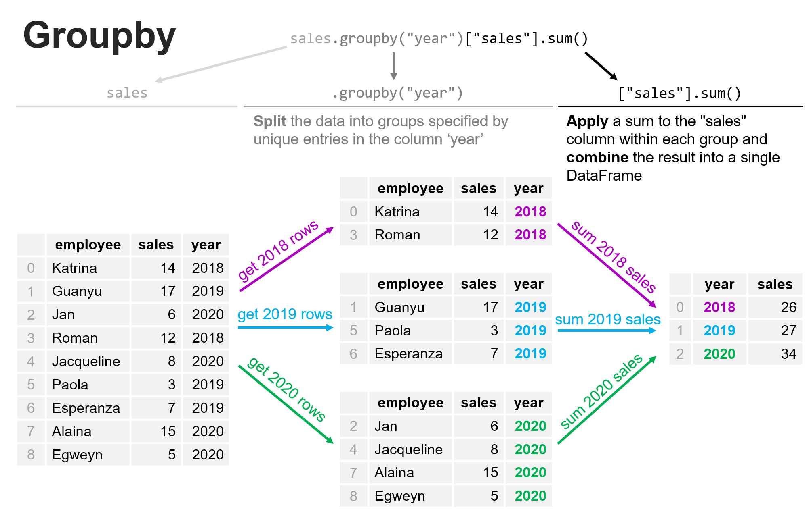

Slide 404
sales_by_year = sales.groupby('year')['sales'].sum()
sales_by_year
Out[39]:
year
2018 26
2019 27
2020 34

Slide 405
Let’s think through Question 2, above: which year was the best for the number of sales per employee?
We need some additional data here.
We need the data from Question 1 on the number of sales per year, but we also need to count how many employees there were each year:
employees_by_year = sales.groupby('year')['employee'].count()
employees_by_year
Out[40]:
year
2018 2
2019 3
2020 4

Slide 406
Now let’s combine these into a single DataFrame.
question_2_data = pd.merge(sales_by_year, employees_by_year, on = 'year', how='left')
question_2_data
Out[41]:
sales employee
year
2018 26 2
2019 27 3
2020 34 4

Slide 407
Now let’s compute the number of sales by employee
question_2_data['sales_per_employee'] = (
question_2_data['sales'] / question_2_data['employee']
)
question_2_data
Out[42]:
sales employee sales_per_employee
year
2018 26 2 13.0
2019 27 3 9.0
2020 34 4 8.5

Slide 408
Asking data questions
Let’s see how we can programmatically ask questions of our datasets using queries.
We have seen this before when we discussed subsetting our data and filtering based on different logical expressions.
Here we will introduce a compact way to execute such queries to add another tool into your programmatic toolbox for working with data.
This is similar to structured query language (SQL) in databases.

Slide 409
sales = pd.read_csv('dealership.csv')
Out[44]:
employee sales year
0 Katrina 14 2018
1 Guanyu 17 2019
2 Jan 6 2020
3 Roman 12 2018
4 Jacqueline 8 2020
5 Paola 3 2019
6 Esperanza 7 2019
7 Alaina 15 2020
8 Egweyn 5 2020

Slide 410
Nature of queries
To query a pandas DataFrame, we need to use the query method which takes a query string.
This string allows you to ask a world of questions of your data.
For example, see the table below for a set of examples of queries and their corresponding query strings for our sales dataset:

Slide 411
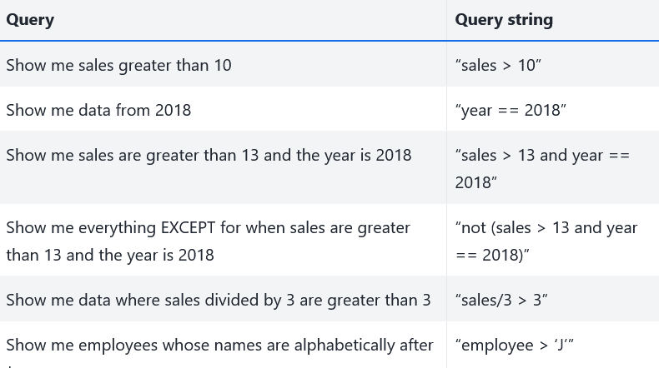

Slide 412
Let’s show each of these queries in action below:
sales.query('sales > 10')
Out[45]:
employee sales year
0 Katrina 14 2018
1 Guanyu 17 2019
3 Roman 12 2018
7 Alaina 15 2020

Slide 413
sales.query('year == 2018')
Out[46]:
employee sales year
0 Katrina 14 2018
3 Roman 12 2018
sales.query('sales > 13 and year == 2018')
Out[47]:
employee sales year
0 Katrina 14 2018

Slide 414
sales.query('not(sales > 13 and year == 2018)')
Out[48]:
employee sales year
1 Guanyu 17 2019
2 Jan 6 2020
3 Roman 12 2018
4 Jacqueline 8 2020
5 Paola 3 2019
6 Esperanza 7 2019
7 Alaina 15 2020
8 Egweyn 5 2020

Slide 415
sales.query('sales/3 > 3')
Out[49]:
employee sales year
0 Katrina 14 2018
1 Guanyu 17 2019
3 Roman 12 2018
7 Alaina 15 2020

Slide 416
sales.query('employee > "J"')
Out[50]:
employee sales year
0 Katrina 14 2018
2 Jan 6 2020
3 Roman 12 2018
4 Jacqueline 8 2020
5 Paola 3 2019

Slide 417
Another way. . .
Now, these same queries can be accomplished using selection and filtering but it requires more sytax.
The query method is often more computationally efficient and less prone to error.
Let’s try rewriting sales.query('sales > 13 and year == 2018') using these techniques:
sales[(sales['sales'] > 13) & (sales['year'] == 2018)]
Out[51]:
employee sales year
0 Katrina 14 2018

Slide 418
Another nice feature of query is that we can bring in variables from our local workspace, but outside of the DataFrame by prefixing the @ symbol to the variable name.
Let’s say we knew that each sale was worth $1,000.
Then we could query based on the total dollar amount of sales as follows:
revenue_per_sale = 1000
sales.query('sales * @revenue_per_sale > 10000')
Out[52]:
employee sales year
0 Katrina 14 2018
1 Guanyu 17 2019
3 Roman 12 2018
7 Alaina 15 2020

Slide 420
Computation with columns
pandas also has a faster, more readable method for performing a number of computations on columns.
Let’s create a DataFrame with some data to demonstrate:
rand_matrix = np.random.rand(5, 4)
data = pd.DataFrame(rand_matrix, columns=['speed_initial', 'speed_final', 'time_initial', 'time_final'])
data_copy = data.copy() # Make a copy to use later
data

Slide 421
Out[53]:
speed_initial speed_final time_initial time_final
0 0.517930 0.497419 0.609459 0.620051
1 0.126974 0.054085 0.414578 0.567567
2 0.039720 0.601753 0.578390 0.653008
3 0.102974 0.008130 0.370052 0.089282
4 0.073707 0.341360 0.941587 0.769856

Slide 422
In physics, we calculate acceleration of an object by it’s change in velocity divided by the time it took to change that velocity.
Let’s calculate that using the tools we’ve discussed already:
data['acceleration'] = (data['speed_final'] - data['speed_initial']) /
(data['time_final'] - data['time_initial'])
data

Slide 423
Out[54]:
speed_initial speed_final time_initial time_final acceleration
0 0.517930 0.497419 0.609459 0.620051 -1.936597
1 0.126974 0.054085 0.414578 0.567567 -0.476436
2 0.039720 0.601753 0.578390 0.653008 7.532178
3 0.102974 0.008130 0.370052 0.089282 0.337800
4 0.073707 0.341360 0.941587 0.769856 -1.558558

Slide 424
We can instead use the eval function, with a syntax similar to that of query.
It lets us do a number of common computations more clearly (and more quickly, since the code will run more quickly as well):
data_copy.eval('acceleration = (speed_final - speed_initial) / (time_final - time_initial)', inplace = True)
data_copy

Slide 425
Out[55]:
speed_initial speed_final time_initial time_final acceleration
0 0.517930 0.497419 0.609459 0.620051 -1.936597
1 0.126974 0.054085 0.414578 0.567567 -0.476436
2 0.039720 0.601753 0.578390 0.653008 7.532178
3 0.102974 0.008130 0.370052 0.089282 0.337800
4 0.073707 0.341360 0.941587 0.769856 -1.558558

Slide 426
Models
A statistical model is a mathematical model that embodies a set of statistical assumptions concerning the generation of sample data.
A statistical model represents, often in considerably idealized form, the data-generating process.
It is a representation of reality; it is not reality itself eg. map
Models can be linear and non-linear.
“All models are wrong but some are useful” – George E. P. Box

Slide 427
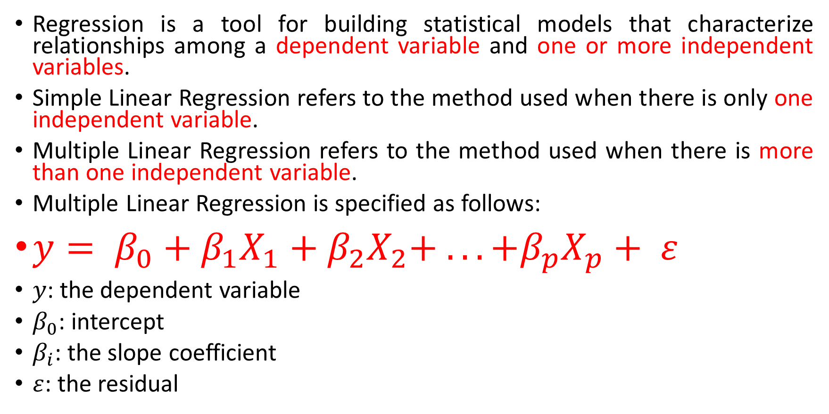
Linear Regression using Python
Regression is a tool for building statistical models that characterize relationships among a dependent variable and one or more independent variables.
Simple Linear Regression refers to the method used when there is only one independent variable.
Multiple Linear Regression refers to the method used when there is more than one independent variable.
Multiple Linear Regression is specified as follows:
$y= β_{0}+β_{1}X_{1}+β_{2}X_{2}+ . . . +β_{p}X_{p}+ ε$
$y$: the dependent variable
$β_{0}$: intercept
$β_{i}$: the slope coefficient
$ε$: the residual

Slide 428
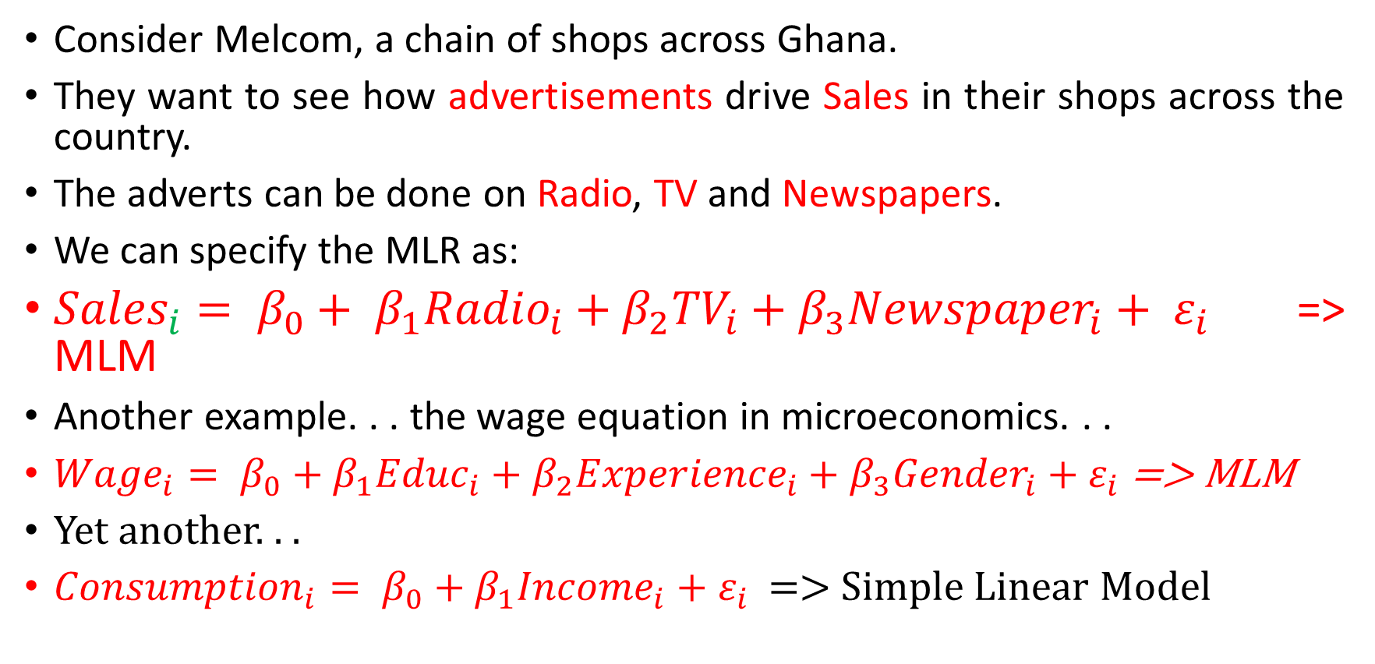
Example
Consider Melcom, a chain of shops across Ghana.
They want to see how advertisements drive Sales in their shops across the country.
The adverts can be done on Radio, TV and Newspapers.
We can specify the MLR as:
${Sales}_{i}= β_{0}+ β_{1}{Radio}_{i}+β_{2}{TV}_{i}+β_{3}{Newspaper}_{i}+ ε_{i}$ => MLM
Another example. . . the wage equation in microeconomics. . .
${Wage}_{i}= β_{0}+β_{1}{Educ}_{i}+β_{2}{Experience}_{i}+β_{3}{Gender}_{i}+ε_{i}$ => MLM
Yet another. . .
${Consumption}_{i}= β_{0}+β_{1}{Income}_{i}+ε_{i}$ => Simple Linear Model

Slide 429
Assumptions
Linearity
Normality
Multicollinearity
Autocorrelation
Homoscedasticity

Slide 430
Linearity
This assumes that there is a linear relationship between the independent variables and the dependent variable.
Since we have multiple independent variables, we can do this by using a scatter plot to see our predicted values versus the actual values.

Slide 431
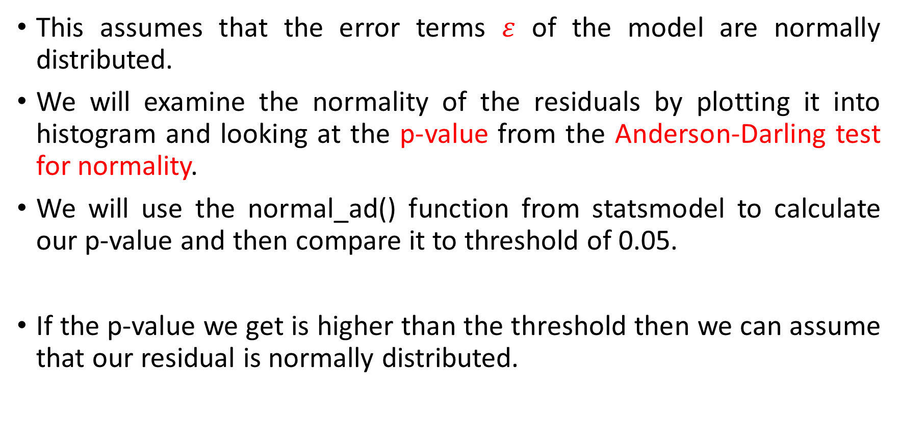
Normality
This assumes that the error terms $ε$ of the model are normally distributed.
We will examine the normality of the residuals by plotting it into histogram and looking at the p-value from the Anderson-Darling test for normality.
We will use the normal_ad() function from statsmodel to calculate our p-value and then compare it to threshold of 0.05.
If the p-value we get is higher than the threshold then we can assume that our residual is normally distributed.

Slide 432
Multicollinearity
This assumes that the predictors used in the regression are not correlated with each other.
To identify if there are any correlation between our predictors we can calculate the Pearson correlation coefficient between each column in our data using the corr() function from Pandas dataframe.
Then we can display it as a heatmap using heatmap() function from Seaborn.

Slide 433
Autocorrelation
Autocorrelation is correlation of the errors (residuals) over time.
Autocorrelation exists if residuals in one time period are related to residuals in another period.
We can detect autocorrelation by performing Durbin-Watson test to determine if either positive or negative correlation is present.
In this step we will use the durbin_watson () function from statsmodel to calculate our Durbin-Watson score and then assess the value with the following condition:
If the Durbin-Watson score is less than 1.5 then there is a positive autocorrelation and the assumption is not satisfied
If the Durbin-Watson score is between 1.5 and 2.5 then there is no autocorrelation and the assumption is satisfied
If the Durbin-Watson score is more than 2.5 then there is a negative autocorrelation and the assumption is not satisfied

Slide 434
Homoscedasticity
This assumes homoscedasticity, which is the same variance within our error terms.
Heteroscedasticity, the violation of homoscedasticity, occurs when we don’t have an even variance across the error terms.
To detect homoscedasticity, we can plot our residual and see if the variance appears to be uniform.

Slide 435
Code
import pandas as pd
import numpy as np
import warnings

Slide 436
## Building Model
from sklearn import linear_model
from scipy import stats
import statsmodels
import statsmodels.api as sm
import statsmodels.formula.api as smf
import statsmodels.stats.api as sms
from statsmodels.compat import lzip

Slide 437
## Data Visualization
import seaborn as sns
import matplotlib.pyplot as plt
from mpl_toolkits.mplot3d import Axes3D
%matplotlib
warnings.filterwarnings('ignore')
plt.rcParams['figure.figsize'] = (7, 7)
plt.style.use('ggplot')

Slide 438
Load advert data
advert = pd.read_csv('advertising.csv')
advert.head()
Out[121]:
TV Radio Newspaper Sales
0 230.1 37.8 69.2 22.1
1 44.5 39.3 45.1 10.4
2 17.2 45.9 69.3 12.0
3 151.5 41.3 58.5 16.5
4 180.8 10.8 58.4 17.9

Slide 439
advert.shape
Out[122]: (200, 4)

Slide 440
Descriptive Analysis (EDA)
We start with the description of the data.
First, we use the pairplot() function from the Seaborn library.
The function will output a figure containing histogram and scatter plot between each variable.
sns.set_palette('colorblind')
sns.pairplot(data = advert, height=2)

Slide 441


Slide 442
Building Regression Model
In the diagram above we see that there might be relations between our independent and dependent variable

Slide 443

Ordinary Least Squares Methods
Building the linear regression involves finding the value of $β_{i}$ in the regression equation:
$y= β_{0}+β_{1}X_{1}+β_{2}X_{2}+ . . . +β_{p}X_{p}+ ε$
We use the method of least squares which involves the minimization of the sum of squared errors between an observed and a predicted value.

Slide 444


Illustration

Slide 445

Some Math
Remember that we can rewrite
$y= β_{0}+β_{1}X_{1}+β_{2}X_{2}+ . . . +β_{p}X_{p}+ ε$
as
$y=Xβ+ ε$ (Matrix form)
And therefore
$ε= y−Xβ⇒ε=y − \hat{y}$
which when squared becomes
$ε^{2}= {(y − \hat{y})}^{2}$ ie for an individual error.
For the sum of squared errors, we have:
$\sum{ε^{2}= \sum{{(y − \hat{y})}^{2}}}⇒this is minimised to get the β$s.

Slide 446
So, let's continue to building our regression model.
We will use the LinearRegression() function from the sklearn library to build our models.
advert.columns
Out[129]: Index(['TV', 'Radio', 'Newspaper', 'Sales'], dtype='object')
# Set independent and dependent variables
X = advert[['Radio', 'TV', 'Newspaper’]]
y = advert['Sales']
type(X)
Out[131]: pandas.core.frame.DataFrame
type(y)
Out[132]: pandas.core.series.Series

Slide 447

# Initialize model from sklearn and fit it into our data
regr = linear_model.LinearRegression()
model = regr.fit(X, y)
print('Intercept:', model.intercept_)
print('Coefficients:', model.coef_)
Intercept: 4.625124078808657
Coefficients: [0.10700123 0.05444578 0.00033566]
Those values are the intercept and coefficients values of the models which can be put in mathematics equation as below:
$\hat{Sales}=4.6251+0.107Radio+0.0544TV+0.0003Newspaper$

Slide 448

Let's breakdown what each of those number means:
The intercept value is the estimated average value of our dependent variable when all of our independent variables values is 0.
In our case this means that in the case where there are not adverts on TV, on Radio and in Newspapers, the shops will generate an average of 4.6251 units in Sales.
For the coefficients we have 3 values for Radio, TV, and Newspaper respectively.
This value represents the relation of our independent variable to the dependent variable, where a change of exactly 1 at the independent variable will change the value of our dependent variable the same amount as the coefficient.
For example, if we increase our Radio ads by 1 unit, we will also increase our Sales by $0.107$ units.

Slide 449

Model Validation
After building the model it is important for us to validate it's performance.
We can evaluate a model by looking at it's coefficient of determination ($R^{2}$), F-test, t-test, and also residuals.
Before we continue we will rebuild our model using the statsmodel library with the OLS() function.
Then we will print the model summary using the summary() function on the model.
The model summary contains lots of important value we can use to evaluate our model.

Slide 450
fit = smf.ols(formula = 'Sales ~ Radio + TV + Newspaper', data = advert).fit()
fit.summary()

Slide 451
OLS Regression Results
_____________________________________________________
Dep. Variable: Sales R-squared: 0.903
Model: OLS Adj. R-squared: 0.901
Method: Least Squares F-statistic: 605.4
Date: Fri, 24 Oct 2025 Prob (F-statistic): 8.13e-99
Time: 16:00:59 Log-Likelihood: -383.34
No. Observations: 200 AIC: 774.7
Df Residuals: 196 BIC: 787.9
Df Model: 3
Covariance Type: nonrobust

Slide 452
coef std err t P>|t| [0.025 0.975]
-----------------------------------------------------------------------------------------
Intercept 4.6251 0.308 15.041 0.000 4.019 5.232
Radio 0.1070 0.008 12.604 0.000 0.090 0.124
TV 0.0544 0.001 39.592 0.000 0.052 0.057
Newspaper 0.0003 0.006 0.058 0.954 -0.011 0.012

Slide 453
Omnibus: 16.081 Durbin-Watson: 2.251
Prob(Omnibus): 0.000 Jarque-Bera (JB): 27.655
Skew: -0.431 Prob(JB): 9.88e-07
Kurtosis: 4.605 Cond. No. 454.

Slide 454

Coefficient of Determination ($R^{2}$)
Coefficient of determination is the portion of the total variation in the dependent variable that is explained by variation in the independent variable.
$R^{2}= \frac{\sum{{({\hat{y}}_{i}−\overline{y})}^{2}}}{\sum{{(y_{i}−\overline{y})}^{2}}}$
In the estimated MLR, $R^{2}$ = 90.3%
$R^{2}$ range between 0 and 1, where $R^{2}$= 0 means there are no linear relationship between the variables and $R^{2}$ = 1 shows a perfect linear relationship.
In our case, we got $R^{2}$ score about 0.903 which means 90.3% of our dependent variable can be explained using our independent variables.

Slide 455

F-test (ANOVA)
F-test answers the question: Has the model been correctly specified?
It test the hypothesis:
$H_{0}: β_{i}=0$ . . . . . . . . . . . . . . . . . . . 1
$H_{A}: {at least one β}_{i}≠0$ . . . . . . . . .2
In 1, we have
Sales = 0! => Sales = NULL, Sales is a purely random thing!
In 2, there is some influence of ads whether from Radio, TV or Newspaper on Sales.
How do we know which option holds?

Slide 456
The p-value
We may have to listen carefully. . .
0 α 1
Probability span [0, 1]
An event with a probability of 0 => Impossible
An event with a probability of 1 => Certain
Between 0 and 1 are varying degrees of likelihood of occurring.
Sounds confusing, isn’t it?
Let’s cut a region α to denote the level of significance.
The region [0, α) is impossible; [α, 1] is certain.

Slide 457

Suppose α = 0.05 (ie. 5%)
0 α=0.05 1
If we have a probability of 0.001, we say it is impossible.
A probability of 0.6945 will be . . . .
The probability we are referring to is the p-value.
In hypothesis testing, the p-value is always tied to the NULL hypothesis.
$H_{0}: β_{i}=0$ <= p-value
$H_{A}: {at least one β}_{i}≠0$

Slide 458

$H_{0}: β_{i}=0$ <= p-value
$H_{A}: {at least one β}_{i}≠0$
If you have a p-value = 0.0001, that would be in the Impossible region.
Who is impossible? The term p-value is tied to! So, we reject $H_{0}$.
If you have a p-value = 0.6947, that would be in the Certain region.
Who is Certain? The term p-value is tied to! So, we cannot reject $H_{0}$.

Slide 459
Back to the results. . .
OLS Regression Results
-------------------------------------------------------------------------------------------
Dep. Variable: Sales R-squared: 0.903
Model: OLS Adj. R-squared: 0.901
Method: Least Squares F-statistic: 605.4
Date: Sat, 25 Oct 2025 Prob (F-statistic): 8.13e-99
Time: 05:29:12 Log-Likelihood: -383.34
No. Observations: 200 AIC: 774.7
Df Residuals: 196 BIC: 787.9
Df Model: 3

Slide 460

T-test
The t-statistic is the coefficient divided by its standard error.
The standard error is an estimate of the standard deviation of the coefficient, the amount it varies across cases.
It can be thought of as a measure of the precision with which the regression coefficient is measured.
Same as the F-test, the test hypothesis is:
$H_{0}: β_{Radio}=0$ <= p-value = 0.0000 (actually 4.602097e-27)
$H_{A}: β_{Radio}≠0$

Slide 461
fit.pvalues
Out[179]:
Intercept 1.682677e-34
Radio 4.602097e-27
TV 1.892945e-95
Newspaper 9.538145e-01
dtype: float64
From the p-values, we see that Intercept, Radio and TV ads are significant; Newspaper is not.

Slide 462
95%
5%
2.5% 97.5%
0.025 0.975

Slide 463
Testing of Assumptions
First, let’s expand the dataset advert.
advert['Predicted_Sales'] = fit.predict(X)
advert['Residuals'] = fit.resid
advert.head()
Out[184]:
TV Radio Newspaper Sales Predicted_Sales Residuals
0 230.1 37.8 69.2 22.1 21.220972 0.879028
1 44.5 39.3 45.1 10.4 11.268248 -0.868248
2 17.2 45.9 69.3 12.0 10.496209 1.503791
3 151.5 41.3 58.5 16.5 17.312447 -0.812447
4 180.8 10.8 58.4 17.9 15.644137 2.255863

Slide 464
Linearity
Let’s plotting the observed vs predicted values. . .
sns.lmplot(x ='Sales', y = 'Predicted_Sales', data = advert, fit_reg = True)
The scatter plots show residual point evenly spread around the diagonal line, so we can assume that there is linear relationship between our independent and dependent variables.

Slide 465


Slide 466

Normality
This assumes that the error terms of the model are normally distributed.
$H_{0}:$Population from which the sample is drawn is normally distributed.
$H_{A}:$Population from which the sample is drawn is not normally distributed.
from statsmodels.stats.diagnostic import normal_ad
Performing the test on the residuals
p_value = normal_ad(advert['Residuals'])[1]
p_value
Out[191]: 0.028710104443456536

Slide 467
Plot the histogram
plt.subplots(figsize=(6, 4))
plt.title('Distribution of Residuals', fontsize=18)
sns.distplot(advert['Residuals’])
Let’s calculate the mean:
np.mean(advert['Residuals'])
Out[193]: 6.226130722097878e-15

Slide 468


Slide 469
Multicollinearity
corr = advert[['Radio', 'TV', 'Newspaper']].corr()
corr
Out[195]:
Radio TV Newspaper
Radio 1.000000 0.054809 0.354104
TV 0.054809 1.000000 0.056648
Newspaper 0.354104 0.056648 1.000000
Correlation in all cases is below 0.5.
This means our independent variable are not affecting each other and that there is no multicollinearity in our data.

Slide 470

Heatmap
sns.heatmap(corr)

Slide 471
Autocorrelation
Autocorrelation is correlation of the errors (residuals) over time.
Used when data are collected over time to detect if autocorrelation is present.
Autocorrelation exists if residuals in one time period are related to residuals in another period.
We can detect autocorrelation by performing Durbin-Watson test to determine if either positive or negative correlation is present.

Slide 472
Decision
If the Durbin-Watson score is less than 1.5 then there is a positive autocorrelation and the assumption is not satisfied
If the Durbin-Watson score is between 1.5 and 2.5 then there is no autocorrelation and the assumption is satisfied
If the Durbin-Watson score is more than 2.5 then there is a negative autocorrelation and the assumption is not satisfied

Slide 473
from statsmodels.stats.stattools import durbin_watson
durbinWatson = durbin_watson(advert['Residuals'])
print('Durbin-Watson:', durbinWatson)
Durbin-Watson: 2.2505518360793566

Slide 474
Homoscedasticity
Homoscedasticity assumes same variance within our error terms.
Heteroscedasticity is the violation of homoscedasticity and it occurs when we don’t have an even variance across the error terms.
To detect homoscedasticity, we can plot our residual and see if the variance appears to be uniform.

Slide 475
plt.subplots(figsize=(6, 4))
plt.scatter(x = advert.index, y = advert.Residuals, alpha=0.8)
plt.plot(np.repeat(0, len(advert.index)), color = 'darkorange', linestyle = '--’)
plt.ylabel('Residual', fontsize = 14)
plt.xlabel('Index', fontsize=14)
plt.title('Homescedasticity Assumption', fontsize=16)

Slide 476


Slide 477
NumPy and built-in function support
.shape
.size
.describe()
.sample()
.value_counts()
.unique()
.sort_values()

Slide 478
NumPy
pandas is designed to work well with NumPy, the framework for array computations.
Just about any NumPy function can be applied to pandas DataFrames and Series.
# Pull out the number of babies named Bella each year
bella_counts = babynames[babynames[‘Name’] == ‘Bella’][‘Count’]
# Average number of babies named Bella each year
np.mean(bella_counts)
# Max number of babies named Bella born in any one year
np.max(bella_counts)

Slide 479
.shape and .size
.shape and .size are attributes of Series and DataFrames that measure the “amount” of data stored in the structure.
Calling .shape returns a tuple containing the number of rows and columns present in the DataFrame or Series.
.size is used to find the total number of elements in a structure, equivalent to the number of rows times the number of columns.
Many functions strictly require the dimensions of the arguments along certain axes to match.
Calling these dimension-finding functions is much faster than counting all of the items by hand.

Slide 480
# Return the shape of the DataFrame, in the format (num_rows, num_columns)
babynames.shape
# Return the size of the DataFrame, equal to num_rows * num_columns
babynames.size

Slide 481
.describe()
If many statistics are required from a DataFrame (minimum value, maximum value, mean value, etc.), then .describe() can be used to compute all of them at once.
babynames.describe()
A different set of statistics will be reported if .describe() is called on a Series.
babynames[‘Sex’].describe()

Slide 482
.sample()
.sample() lets us quickly select random entries (a row if called from a DataFrame, or a value if called from a Series).
By default, .sample() selects entries without replacement.
Pass in the argument replace=True to sample with replacement.
# Sample a single row
babynames.sample()
# Sample 5 random rows
babynames.sample(5)
# Randomly sample 4 names from the year 2000, with replacement
babynames[babynames["Year"] == 2000].sample(4, replace = True)

Slide 483
.value_counts()
The Series.value_counts() methods counts the number of occurrence of each unique value in a Series.
In other words, it counts the number of times each unique value appears.
This is often useful for determining the most or least common entries in a Series.
In the example:
babynames["Name"].value_counts().head()

Slide 484
.unique()
If we have a Series with many repeated values, then .unique() can be used to identify only the unique values.
Here we return an array of all the names in babynames.
babynames["Name"].unique()

Slide 485
.sort_values()
Ordering a DataFrame can be useful for isolating extreme values.
For example, the first 5 entries of a row sorted in descending order (that is, from highest to lowest) are the largest 5 values.
.sort_values allows us to order a DataFrame or Series by a specified column.
We can choose to either receive the rows in ascending order (default) or descending order.
# Sort the "Count" column from highest to lowest
babynames.sort_values(by = ‘Count’, ascending=False).head()

Slide 486
Goals of Visualization
Visualizations are useful for a number of reasons.
To help your own understanding of the data
Key part of exploratory data analysis.
Summarize trends visually before in-depth analysis.
To communicate results/conclusions to others
Fine-tuned to achieve a communications goal.
Considerations: clarity, accessibility, providing necessary context.
Put together, these goals add more nuance to our visualization task.
Visualization is not simply a matter of making “pretty” pictures; rather, we will need to do a lot of thinking about what stylistic choices communicate ideas in the most effective way.

Slide 487
In short. . .
One of the most common applications of visualizations is in understanding a distribution of data.

Slide 488
Distributions
A distribution describes the frequency of unique values in a variable.
Distributions must satisfy two properties:
Each data point must belong to only one category.
The total frequency of all categories must sum to 100%.
In other words, their total count should equal the number of values in consideration.

Slide 489

Example

Slide 490
Variable Types

Slide 491
Different plot types are more or less suited for displaying particular types of variables.
Before creating a visualization, you should always ask yourself:
What types of variables am I presenting?
What plots are suitable to present this variable type?
A summary of the plots generally used to display different variable types is given on the next slide.

Slide 492
Distribution of a qualitative variable:
Bar plot
Distribution of a quantitative continuous variable:
Histogram
Box plot
Violin plot
KDE plot

Slide 493
Distribution of a continuous variable across qualitative categories:
Overlaid histograms
Side-by-side box plots
Side-by-side violin plots
Overlaid KDE plots
Relationship between quantitative continuous variables:
Scatter plot
Hex plot
Contour map

Slide 494
Examples
Let’s contextualize with examples using the World Bank dataset wb, which contains information about countries and social statistics.
import os
os.chdir(‘C:/. . . ')
import pandas as pd
wb = pd.read_csv('worldbank.csv', index_col = 0)
wb.head()

Slide 495
Let’s visualize the distribution of the "Continent" column using a bar plot.
There are a few ways to do this.

Slide 496
Plotting in Matplotlib
Matplotlib is a common library used for generating visualizations in Python.
Most Matplotlib plotting functions follow the same structure: we pass in a sequence (list, array, or Series) of values to be plotted on the x-axis, and a second sequence of values to be plotted on the y-axis.
In pseudocode, Matplotlib plotting calls typically have the form:

Slide 497
In pseudocode. ..
# plt is the typical alias for Matplotlib
import matplotlib.pyplot as plt
plt.plotting_function(x_values, y_values)
To add labels and a title to a plot, we call the functions plt.xlabel, plt.ylabel, and plt.title.
plt.xlabel(“x axis label”)
plt.ylabel(“y axis label”)
plt.title(“Title of the plot”);

Slide 498
The plotting function to create a bar plot in Matplotlib is plt.bar.
To generate a bar plot, we will need to create a set of x values and y values to pass in as arguments to plt.bar.
In the code, we call .value_counts() to obtain the distribution of the "Continent" column.
The index of the resulting Series contains our desired x values (the names of each unique continent), while the values contain our y data (the counts of countries in each continent).

Slide 499
#import matplotlib.pyplot as plt
continents = wb["Continent"].value_counts()
plt.bar(continents.index, continents)
plt.xlabel("Continent")
plt.ylabel("Count of countries")
plt.title("Distribution of countries across continents");
plt.show()

Slide 500


Slide 501
Plotting in Seaborn
Seaborn is another popular Python library for creating plots.
Seaborn plotting functions use a different structure to Matplotlib.
In Seaborn, we pass in an entire DataFrame as an argument, then specify what column(s) from the DataFrame to plot.

Slide 502
Pseudocode
# sns is the typical alias for Seaborn
import seaborn as sns
sns.plotting_function(data = df, x = "x_col", y = "y_col")
As before, we can add axis labels and a title:
plt.xlabel(“x axis label”)
plt.ylabel(“y axis label”)
plt.title(“Title of the plot”)

Slide 503
#import seaborn as sns
sns.countplot(data = wb, x = 'Continent');
plt.show()

Slide 504


Slide 505
sns.countplot both counts and visualizes the number of unique values in a given column, without the need for us to pre-process data using .value_counts().
The DataFrame containing our desired information is specified by the data argument, while the column to be plotted is specified by the x argument.

Slide 506
Visualize quantitative variables
To visualize the distribution of a quantitative variable, bar plots are no longer an appropriate choice of visualization.
To see why, consider what happens when we use sns.countplot to visualize the distribution of gross national income, a quantitative continuous variable.

Slide 507
sns.countplot(data = wb, x = 'Gross national income per capita, Atlas method: $: 2016');

Slide 508


Slide 509
Ooops! What happened?
A bar plot (either plt.bar or sns.countplot) will create a separate bar for each unique value of a variable.
With a continuous variable, we may not have a finite number of possible values, which can lead to situations where we would need many, many bars to display each unique value.
To visualize the distribution of a continuous variable, we use a different type of plot:
Box plot
Violin plot
Histogram

Slide 510
Box Plots
Box plots display distributions using information about quartiles.
A quartile represents a 25% portion of the data.
We say that: * The first quartile (Q1) represents the 25th percentile – 25% of the data lies below the first quartile
* The second quartile (Q2) represents the 50th percentile, also known as the median – 50% of the data lies below the second quartile
* The third quartile (Q3) represents the 75th percentile – 75% of the data lies below the third quartile.

Slide 511

In a box plot, the lower extent of the box lies at Q1, while the upper extent of the box lies at Q3.
The horizontal line in the middle of the box corresponds to Q2 (equivalently, the median).
The interquartile range measures the spread of the middle % of the distribution, calculated as the ( $3^{rd}$ Quartile - $1^{st}$Quartile).
The whiskers of a box-plot are the two points that lie at the [$1^{st}$Quartile - (1.5 * IQR)], and the [$3^{rd}$ Quartile + (1.5 * IQR)].
They are the lower and upper ranges of “normal” data (the points excluding outliers).
Subsequently, the outliers are the data points that fall beyond the whiskers, or further than ( IQR) from the extreme quartiles.

Slide 512


Slide 513
In Matplotlib, box plots are created using the function plt.boxplot.
wb = wb[~wb["Gross domestic product: % growth : 2016"].isna()]
plt.boxplot(wb['Gross domestic product: % growth : 2016’])
plt.ylabel("% GDP growth")
plt.title("Distribution of GDP growth across countries");

Slide 514


Slide 515
And in Seaborn, box plots are generated by sns.boxplot.
sns.boxplot(data = wb, y = "Gross domestic product: % growth : 2016")

Slide 516


Slide 517
Sometimes, we may wish to also incorporate a qualitatative variable.
For example, we may wish to compare the distribution of a quantitative variable across a set of categories.
To do so, we can plot side-by-side box plots.
In the example below, the continent of each county, a qualitative nominal variable, is plotted on the x-axis, while GDP growth, a quantiative continuous variable, is plotted on the y-axis.

Slide 518
sns.boxplot(data=wb, x= "Continent", y= "Gross domestic product: % growth : 2016")
plt.title("Distribution of GDP growth by continent");

Slide 519


Slide 520
Violin Plots
Violin plots, much like box plots, encode information about quantiles.
A violin plot also incorporates smoothed density curves to add an additional level of information – now, the width of the plot at each point also carries meaning.
The three quartiles and whiskers that we saw in box plots are still present in violin plots (look closely at the center)!

Slide 521
sns.violinplot(data = wb, y = 'Gross domestic product: % growth : 2016 ‘)
plt.title("Distribution of GDP growth across countries");

Slide 522


Slide 523
plt.violinplot(wb['Gross domestic product: % growth : 2016'])
plt.ylabel("% GDP growth")
plt.title("Distribution of GDP growth across countries");

Slide 524
Histograms
Histograms are an alternative method of visualizing quantitative continuous distributions.
In a histogram, datapoints with similar values are collected into a shared “bin”.
These bins are scaled such that the area of each bin is equal to the percentage of datapoints it contains.

Slide 525
gni = wb["Gross national income per capita, Atlas method: $: 2016"]
plt.hist(gni, density=True, edgecolor="white")
plt.xlabel("Gross national income per capita")
plt.ylabel("Density")
plt.title("Distribution of gross national income per capita");

Slide 526


Slide 527
sns.histplot(data = wb, x = "Gross national income per capita, Atlas method: $: 2016", stat="density")
plt.title("Distribution of gross national income per capita");

Slide 528


Slide 529
The hue parameter of sns.histplot specifies the column that should be used to determine the color of each category. hue can be used in many Seaborn plotting functions.
Notice that the resulting plot includes a legend describing which color corresponds to each hemisphere – a legend should always be included if color is used to encode information in a visualization!
This assists with our visualization goal of communicating our results to a broader audience.

Slide 530
north = ["Asia", "Europe", "N. America"]
south = ["Africa", "Oceania", "S. America"]
wb.loc[wb["Continent"].isin(north), "Hemisphere"] = "Northern"
wb.loc[wb["Continent"].isin(south), "Hemisphere"] = "Southern"

Slide 531
sns.histplot(data = wb, x = "Gross national income per capita, Atlas method: $: 2016", hue="Hemisphere", stat="density")
plt.title("Distribution of gross national income per capita");

Slide 532


Slide 533
Overlay histograms
You may have seen histograms drawn differently – perhaps with an overlaid density curve and normalized y-axis.
We can display both with a few tweaks to our code.
To visualize a density curve, we can set the the kde = True argument of the sns.histplot.
Setting the argument stat = 'density' normalizes our histogram and displays densities, instead of counts, on the y-axis.
You’ll notice that the area under the density curve is 1.

Slide 534
sns.histplot(data = wb, x = "Gross national income per capita, Atlas method: $: 2016", kde = True, stat = 'density');

Slide 535


Slide 536
Interpreting Histograms
Histograms allow us to assess a distribution by its shape.
In doing so, there are a few features that we typically consider.
The skew of a histogram describes the direction in which its “tail” extends.
If a distribution has a long right tail (such as gross national income per capita), it is skewed right.
In a right-skewed distribution, the few large outliers “pull” the mean to the right of the median.

Slide 537
If a distribution has a long left tail (such as water source access), it is skewed left.
In a left-skewed distribution, the few small outliers “pull” the mean to the left of the median.
In the case where a distribution has equal-sized right and left tails, it is symmetric.
The mean is approximately equal to the median.
Think of mean as the balancing point of the distribution

Slide 538
import numpy as np
sns.histplot(data = wb, x = "Gross national income per capita, Atlas method: $: 2016", stat = "density");
df_mean = np.mean(wb["Gross national income per capita, Atlas method: $: 2016"])
df_median = np.nanmedian(wb["Gross national income per capita, Atlas method: $: 2016"])
print(f"The mean, {df_mean}, is right of the median, {df_median}")
The mean, 12963.312101910828, is right of the median, 5280.0

Slide 539
sns.histplot(data = wb, x = 'Access to an improved water source: % of population: 2015', stat = "density");
df_mean = np.mean(wb['Access to an improved water source: % of population: 2015’])
df_median = np.nanmedian(wb['Access to an improved water source: % of population: 2015'])
print(f"The mean, {df_mean}, is left of the median, {df_median}")

Slide 540


Slide 541
A mode of a distribution is a local or global maximum.
A distribution with a single clear maximum is unimodal, distributions with two modes are bimodal, and those with 3 or more are multimodal.
You may need to distinguish between modes and random noise.
Often, it is difficult to discern noise from true modes when working with histograms – a histogram may contain too much detail to be able to identify general trends across the distribution.
One solution to this issue, is to construct a kernel density estimate.

Slide 542


Slide 543
Kernel Density Estimation
A kernel density estimate (KDE) is a smooth, continuous function that approximates a curve.
It allows us to represent general trends in a distribution without focusing on the details, which is useful to analyzing the broad structure of a dataset.
More formally, a KDE attempts to approximate the underlying probability distribution from which our dataset was drawn.
A KDE curve estimates the probability density function of a random variable.

Slide 544
sns.displot(data = wb, x = 'Antiretroviral therapy coverage: % of people living with HIV: 2015', kde = True, stat = "density")
plt.title("Distribution of HIV rates");

Slide 545


Slide 546
Visualizing Relationships
Now, let’s understand how to visualize the relationship between pairs of numerical variables.
Scatter Plots
Scatter plots are one of the most useful tools in representing the relationship between two quantitative variables.
They are particularly important in gauging the strength, or correlation, of the relationship between variables.
Knowledge of these relationships can then motivate decisions in our modeling process.

Slide 547
In Matplotlib, we use the function plt.scatter to generate a scatter plot.
Notice that unlike our examples of plotting single-variable distributions, now we specify sequences of values to be plotted along the x axis and the y axis.

Slide 548
plt.scatter(wb["per capita: % growth: 2016"], wb['Adult literacy rate: Female: % ages 15 and older: 2005-14'])
plt.xlabel("% growth per capita")
plt.ylabel("Female adult literacy rate")
plt.title("Female adult literacy against % growth");

Slide 549


Slide 550
In Seaborn, we call the function sns.scatterplot.
We use the x and y parameters to indicate the values to be plotted along the x and y axes, respectively.
By using the hue parameter, we can specify a third variable to be used for coloring each scatter point.
sns.scatterplot(data = wb, x = "per capita: % growth: 2016", y = "Adult literacy rate: Female: % ages 15 and older: 2005-14", hue = "Continent")
plt.title("Female adult literacy against % growth");

Slide 551


Slide 552
Overplotting
Although the plots above communicate the general relationship between the two plotted variables, they both suffer a major limitation – overplotting.
Overplotting occurs when scatter points with similar values are stacked on top of one another, making it difficult to see the number of scatter points actually plotted in the visualization.
Notice how in the upper righthand region of the plots, we cannot easily tell just how many points have been plotted.
This make our visualizations difficult to interpret.

Slide 553
Remedy
We have a few methods to help reduce overplotting:
Decreasing the size of the scatter point markers can improve readability. We do this by setting a new value to the size parameter, s, of plt.scatter or sns.scatterplot
Jittering is the process of adding a small amount of random noise to all x and y values to slightly shift the position of each datapoint. By randomly shifting all the data by some small distance, we can discern individual points more clearly without modifying the major trends of the original dataset.

Slide 554
Code
# This means we all get the same results
np.random.seed(150)
# We add these random numbers to the original x data to jitter it slightly
x_noise = np.random.uniform(-1, 1, len(wb))
jittered_x = wb["per capita: % growth: 2016"] + x_noise
# Repeat for y data
y_noise = np.random.uniform(-5, 5, len(wb))
jittered_y = wb["Adult literacy rate: Female: % ages 15 and older: 2005-14"] + y_noise

Slide 555
# Setting the size parameter ‘s’ changes the size of each point
plt.scatter(jittered_x, jittered_y, s=15)
plt.xlabel("% growth per capita (jittered)")
plt.ylabel("Female adult literacy rate (jittered)")
plt.title("Female adult literacy against % growth");

Slide 556


Slide 557
lmplot and jointplot
Seaborn also includes several built-in functions for creating more sophisticated scatter plots.
Two of the most commonly-used examples are sns.lmplot and sns.jointplot.
sns.lmplot plots both a scatter plot and a linear regression line, all in one function call.

Slide 558
sns.lmplot(data = wb, x = "per capita: % growth: 2016", y = "Adult literacy rate: Female: % ages 15 and older: 2005-14")
plt.title("Female adult literacy against % growth");

Slide 559


Slide 560
sns.jointplot creates a visualization with three components: a scatter plot, a histogram of the distribution of x values, and a histogram of the distribution of y values.
sns.jointplot(data = wb, x = "per capita: % growth: 2016", y = "Adult literacy rate: Female: % ages 15 and older: 2005-14")
# plt.suptitle allows us to shift the title up so it does not overlap with the histogram
plt.suptitle("Female adult literacy against % growth")
plt.subplots_adjust(top=0.9);

Slide 561


Slide 562
Transformations
A strong graphical correlation between two variables hints at an underlying relationship that we may want to study in greater detail.
However, relying on visual relationships alone is limiting - not all plots show association.
The presence of outliers and other statistical anomalies make it hard to interpret data.
Transformations are the process of manipulating data to find significant relationships between variables.
These are often found by applying mathematical functions to variables that “transform” their range of possible values and highlight some previously hidden associations between data.

Slide 563
Consider the following plot of adult literacy rates against gross national income.
df = pd.DataFrame(index=wb.index)
df['lit'] = wb['Adult literacy rate: Female: % ages 15 and older: 2005-14'] + wb["Adult literacy rate: Male: % ages 15 and older: 2005-14"]
df['inc'] = wb['Gross national income per capita, Atlas method: $: 2016']
df.dropna(inplace=True)
plt.scatter(df["inc"], df["lit"])
plt.xlabel("Gross national income per capita")
plt.ylabel("Adult literacy rate")
plt.title("Adult literacy rate against GNI per capita");

Slide 564


Slide 565
This plot is difficult to interpret for two reasons:
The data shown in the visualization appears almost “smushed” – it is heavily concentrated in the upper lefthand region of the plot. Even if we jittered the dataset, we likely would not be able to fully assess all datapoints in that area.
It is hard to generalize a clear relationship between the two plotted variables. While adult literacy rate appears to share some positive relationship with gross national income, we are not able to describe the specifics in this trend in much detail.

Slide 566
A transformation would allow us to visualize this data more clearly, which, in turn, would enable us to describe the underlying relationship between our variables of interest.
We will most commonly apply a transformation to linearize a relationship between variables.
If we find a transformation to make a scatter plot of two variables linear, we can “backtrack” to find the exact relationship between the variables.

Slide 567
This helps us in two major ways.
Firstly, linear relationships are particularly simple to interpret.
We have an intuitive sense of what the slope and intercept of a linear trend represent, and how they can help us understand the relationship between two variables.
Secondly, linear relationships are the backbone of linear models.
As we’ll soon see, linear models become much more effective when we are working with linearized data.

Slide 568

We will linearize a dataset to produce the result below.
Notice that the resulting plot displays a rough linear relationship between the values plotted on the x and y axes.

Slide 569
Applying Transformations
To linearize a relationship, begin by asking: what makes the data non-linear?
It is helpful to repeat this question for each variable in your visualization.
Let’s start by considering the gross national income variable in our plot above.
Looking at just the x values in the scatter plot, we notice that most datapoints are clustered at low values to the left of the plot.
The scale of the x axis is being distorted by the few outlying datapoints at extremely large values on the right.

Slide 570


Slide 571
If we decreased the size of these outliers relative to the bulk of the data, we could reduce the distortion of the horizontal axis.
How can we do this? We need a transformation that will:
Decrease the magnitude of large x values by a significant amount
Not drastically change the magnitude of small x values

Slide 572
One function that produces this result is the log transformation.
When we take the logarithm of a large number, the original number will decrease in magnitude dramatically.
Conversely, when we take the logarithm of a small number, the original number does not change its value by as significant of an amount.
To illustrate this, consider the difference between log(100) = 4.61 and log = 2.3.

Slide 573
plt.scatter(np.log(df["inc"]), df["lit"])
plt.xlabel("Log(gross national income per capita)")
plt.ylabel("Adult literacy rate")
plt.title("Adult literacy rate against Log(GNI per capita)");

Slide 574


Slide 575
After taking the logarithm of our x values, our plot appears much more balanced in its horizontal scale.
We no longer have many datapoints clumped on one end and a few outliers out at extreme values.
Let’s repeat this reasoning for the y values.
Considering only the vertical axis of the plot, notice how there are many datapoints concentrated at large y values.
Only a few datapoints lie at smaller values of y.

Slide 576


Slide 577
If we were to “spread out” these large values of y more, we would no longer see the dense concentration in one region of the y axis.
We need a transformation that will:
Increase the magnitude of large values of y so these datapoints are distributed more broadly on the vertical scale
Not substantially alter the scaling of small values of y (we do not want to drastically modify the lower end of the y axis, which is already distributed evenly on the vertical scale)

Slide 578

Here, we apply a power transformation – that is, raise our y values to a power.
Let’s try raising our adult literacy rate values to the power of 4.
Large values raised to the power of 4 will increase in magnitude proportionally much more than small values raised to the power of 4 (consider the difference $2^{4}=16$ between and ${200}^{4}=1600000000$).

Slide 579
plt.scatter(np.log(df["inc"]), df["lit"]**4)
plt.xlabel("Log(gross national income per capita)")
plt.ylabel("Adult literacy rate (4th power)")
plt.suptitle("Adult literacy rate (4th power) against Log(GNI per capita)")
plt.subplots_adjust(top=0.9);

Slide 580


Slide 581
Introduction to Modeling
Up until this point in our lectures, we’ve focused on understanding our datasets.
We’ve looked into the early stages of the data science lifecycle, focusing on the programming tools and visualization techniques needed for data analysis.
Let’s put this framework into practice by implementing various kinds of models.

Slide 582
What is a Model?
A model is an idealized representation of a system.
A system is a set of principles or procedures according to which something functions.
We live in a world full of systems: the procedure of turning on a light happens according to a specific set of rules dictating the flow of electricity.
The truth behind how any event occurs are usually complex, and many times the specifics are unknown.
The workings of the world can be viewed is its own giant procedure.
Models seek to simplify the world and distill them it into workable pieces.

Slide 583

Example
We model the fall of an object on Earth as subject to a constant acceleration of 9.81 $m/s^{2}$ due to gravity.
While this describes the behavior of our system, it is merely an approximation.
It doesn’t account for the effects of air resistance, local variations in gravity, etc.
In practice, it’s accurate enough to be useful!

Slide 584
Reasons for building models
Why do we want to build models?
As far as data scientists and statisticians are concerned, there are three reasons, and each implies a different focus on modeling.
To explain complex phenomena occurring in the world we live in.
How is the patients’ average height related to the children’s average height?
To make accurate predictions about unseen data.
Can we predict if an email is spam or not?
To measure the causal effects of one event on some other event.
Does smoking cause lung cancer?
Does a job training program cause increases in employment and wage?

Slide 585
Goal
Most of the times, we aim to strike a balance between building interpretable models and building accurate models.

Slide 586
Common Types of Models
In general, models can be split into two categories:
Deterministic physical (mechanistic) models: Laws that govern how the world works.
F = ma
Probabilistic models: models that attempt to understand how random processes evolve.
These are more general and can be used describe many phenomena in the real world. These models commonly make simplifying assumption about the nature of the world.
Poisson Process models: Used to model random events that happen with some probability at any point in time and are strictly increasing in count, such as the arrival of customers at a store.

Slide 587

Simple Linear Regression
The regression line is the unique straight line that minimizes the mean squared error of estimation among all straight lines.
As with any straight line, it can be defined by a slope and a y-intercept:
slope: $r= \frac{change in y}{change in x}$
y-intercept: $average of y −slope∗average of x$

Slide 588
import pandas as pd
import numpy as np
import matplotlib.pyplot as plt
import seaborn as sns
# Set random seed for consistency
np.random.seed(43)
plt.style.use('default')
#Generate random noise for plotting
x = np.linspace(-3, 3, 100)
y = x * 0.5 - 1 + np.random.randn(100) * 0.3
#plot regression line
sns.regplot(x=x,y=y);

Slide 589


Slide 590

Notations and Definitions
For a pair of variables x and y representing our data $𝒟=\{\left(x_{1},y_{1}\right), \left(x_{2}, y_{2}\right), . . . , (x_{n}, y_{n})\}$, we denote their means/averages as $\overline{x}$ and $\overline{y}$, standard deviations as $σ_{x}$ and $σ_{y}$.

Slide 591

Standard Units
A variable is represented in standard units if the following are true:
0 in standard units is the mean ($\overline{x}$) in the original variable’s units.
An increase of 1 standard unit is an increase of 1 standard deviation($σ_{x}$) in the original variable’s units
To convert a variable $x_{i}$ into standard units, we subtract from it its mean and divide by its standard deviation.
For example, $x_{i}$ in standard units is $\frac{x_{i} −\overline{x}}{σ_{x} }$

Slide 592


Correlation
The correlation (r) is the average of the product of $x$ and $y$, both measured in standard units.

Slide 593

Properties of Correlation
Correlation measures the strength of a linear association between two variables.
Correlations range between -1 and 1: $\left|r\right|≤1,$with $r=1$indicating perfect linear association, and $r=−1$indicating perfect negative association.
The closer is to $r$ is to 0, the weaker the linear association is.
Correlation says nothing about causation and non-linear association. Correlation does imply causation.
When $r=0$, the two variables are uncorrelated.
However, they could still be related through some non-linear relationship.

Slide 594
def plot_and_get_corr(ax, x, y, title):
ax.set_xlim(-3, 3)
ax.set_ylim(-3, 3)
ax.set_xticks([])
ax.set_yticks([])
ax.scatter(x, y, alpha = 0.73)
r = np.corrcoef(x, y)[0, 1]
ax.set_title(title + " (corr: {})".format(r.round(2)))
return r

Slide 595
fig, axs = plt.subplots(2, 2, figsize = (10, 10))
# Just noise
x1, y1 = np.random.randn(2, 100)
corr1 = plot_and_get_corr(axs[0, 0], x1, y1, title = "noise")
# Strong linear
x2 = np.linspace(-3, 3, 100)
y2 = x2 * 0.5 - 1 + np.random.randn(100) * 0.3
corr2 = plot_and_get_corr(axs[0, 1], x2, y2, title = "strong linear")

Slide 596
# Unequal spread
x3 = np.linspace(-3, 3, 100)
y3 = - x3/3 + np.random.randn(100)*(x3)/2.5
corr3 = plot_and_get_corr(axs[1, 0], x3, y3, title = "strong linear")
extent = axs[1,0].get_window_extent().transformed(fig.dpi_scale_trans.inverted())
# Strong non-linear
x4 = np.linspace(-3, 3, 100)
y4 = 2*np.sin(x3 - 1.5) + np.random.randn(100) * 0.3
corr4 = plot_and_get_corr(axs[1, 1], x4, y4, title = "strong non-linear")

Slide 597


Slide 598
Tukey-Mosteller Bulge Diagram
The Tukey-Mosteller Bulge Diagram is a good guide when determining possible transformations to achieve linearity.
It is a visual summary of the reasoning we just worked through above.
To use the diagram, find which of the four bulges resembles your dataset the most closely.
Then, look at the axes of the quadrant for this bulge.
The horizontal axis will list possible transformations that could be applied to your x data for linearization.

Slide 599

Diagram

Slide 600
Similarly, the vertical axis will list possible transformations that could be applied to your y data.
Note that each axis lists two possible transformations.
While either of these transformations has the potential to linearize your dataset, note that this is an iterative process.
It’s important to try out these transformations and look at the results to see whether you’ve actually achieved linearity.
If not, you’ll need to continue testing other possible transformations.

Slide 601

Summary of Tukey-Mosteller
Generally:
$√$ and $log$ will reduce the magnitude of large values.
Powers (${}^{2}$ and ${}^{3}$) will increase the spread in magnitude of large values.

Slide 602


Slide 603

The Modeling Process
At a high level, a model is some way of representing a system.
What variables are we modeling?
Typically, we use a subset of the variables in our sample of collected data to model another variable in this data.
To put this more formally, say we have the following dataset $𝒟$:
$𝒟=\{\left(x_{1},y_{1}\right), \left(x_{2}, y_{2}\right), . . . , (x_{n}, y_{n})\}$

Slide 604

Each pair of values $\left(x_{i},y_{i}\right)$represents a datapoint.
In a modeling setting, we call these observations.
$y_{i}$is the dependent variable we are trying to model, also called an output or response.
$x_{i}$is the independent variable inputted into the model to make predictions, also known as a feature.
Our goal in modeling is to use the observed data $𝒟$ to predict the output variable $y_{i}$.

Slide 605

We denote each prediction as ${\hat{y}}_{i}$ (read: “y hat sub i”).
How do we generate these predictions?

Slide 606

Examples of Models
Some examples of models we’ll encounter in the next few lectures are given below:
${\hat{y}}_{i}= θ$
${\hat{y}}_{i}= θ_{0}+ θ_{1}x_{i}$ (y = mx + c, slope = m, intercept = c)
The examples are known as parametric models.
They relate the collected data $x_{i}$, to the prediction we make, ${\hat{y}}_{i}$.
A few parameters ($θ$, $θ_{0}$, $θ_{1}$) are used to describe the relationship between $x_{i}$and ${\hat{y}}_{i}$.

Slide 607

Note
Notice that we don’t immediately know the values of these parameters.
While the features, $x_{i}$, are taken from our observed data, we need to decide what values to give $θ$, $θ_{0}$, and $θ_{1}$ourselves.
This is the heart of parametric modeling: what parameter values should we choose so our model makes the best possible predictions?

Slide 608
Modeling Process
To choose our model parameters, we’ll work through the modeling process.
Choose a model: how should we represent the world?
Choose a loss function: how do we quantify prediction error?
Fit the model: how do we choose the best parameters of our model given our data?
Evaluate model performance: how do we evaluate whether this process gave rise to a good model?

Slide 609

Choosing a Loss Function
We’ve talked about the idea of creating the “best” possible predictions.
This begs the question: how do we decide how “good” or “bad” our model’s predictions are?
A loss function characterizes the cost, error, or fit resulting from a particular choice of model or model parameters.
This function, $L(y, \hat{y})$, quantifies how “far off” a single prediction by our model is from a true, observed value in our collected data.

Slide 610

The choice of loss function for a particular model depends on the modeling task at hand.
2023 – 50 (Observation) Model (GDP 54, 2024 ie prediction)
54 – 50 = 4
Observed = 53
Regardless of the specific function used, a loss function should follow two basic principles:
If the prediction ${\hat{y}}_{i}$ is close to the actual value $y_{i}$, loss should be low.
If the prediction ${\hat{y}}_{i}$is far from the actual value $y_{i}$, loss should be high

Slide 611

Two common choices of loss function are squared loss and absolute loss.
Squared loss, also known as L2 loss, computes loss as the square of the difference between the observed $y_{i}$and predicted ${\hat{y}}_{i}$:
$L\left(y_{i},{\hat{y}}_{i}\right)= {(y_{i} − {\hat{y}}_{i})}^{2}$ = ${(observed −predicted)}^{2}$
Absolute loss, also known as L1 loss, computes loss as the absolute difference between the observed and predicted:
$L\left(y_{i},{\hat{y}}_{i}\right)=|y_{i} − {\hat{y}}_{i}|$ = |$observed −predicted$|

Slide 612

L1 and L2 loss give us a tool for quantifying our model’s performance on a single datapoint.
This is a good start, but ideally we want to understand how our model performs across our entire dataset.
A natural way to do this is to compute the average loss across all datapoints in the dataset.
This is known as the cost function, $\hat{R}(θ)$:
$\hat{R}\left(θ\right)= \frac{1}{n}\sum_{i=1}^{n}{L(y_{i},{\hat{y}}_{i})}$

Slide 613
The cost function has many names in statistics literature.
You may also encounter the terms:
Empirical risk (this is why we give the cost function the name )
Error function
Average loss

Slide 614

Let’s substitute our L1 and L2 loss into the cost function definition.
The Mean Squared Error (MSE) is the average squared loss across a dataset:
$MSE= \frac{1}{n}\sum_{i=1}^{n}{{(y_{i} − {\hat{y}}_{i})}^{2}}$
The Mean Absolute Error (MAE) is the average absolute loss across a dataset:
$MAE= \frac{1}{n}\sum_{i=1}^{n}{|y_{i} − {\hat{y}}_{i}|}$
RMAE = $\sqrt{MAE}= \sqrt{\frac{1}{n}\sum_{i=1}^{n}{|y_{i} − {\hat{y}}_{i}|}}$
RMSE = $\sqrt{MSE}= \sqrt{\frac{1}{n}\sum_{i=1}^{n}{{(y_{i} − {\hat{y}}_{i})}^{2}}}$

Slide 615
Evaluating Performance
At this stage, we’ve:
Defined our model(s)
Defined our loss function(s)
Fit the model to identify the best model parameters
Now, what are some ways to determine if our model was a good fit to our data?

Slide 616
There are three main ways for evaluating a model.
1. Statistics:
Plot original data
Compute column means
Compute standard deviations
If we want to fit a linear model, compute correlation (r)

Slide 617
Performance metrics:
Root Mean Square Error (RMSE). It is the square root of MSE, which is the average loss that we’ve been minimizing to determine optimal model parameters.
RMSE is in the same units as
.
A lower RMSE indicates more “accurate” predictions (lower “average loss” across data)

Slide 618

Visualization:
Look at a residual plot of to visualize the difference between actual and predicted values.
$y=Xβ+ ε$
$Consumption= β_{0}+ β_{1}Income+ ε$, $ε\sim N(μ, σ)$ Simple linear equation.
$Consumption= β_{0}+ β_{1}Income+ β_{2}Taste+ ε$ Multiple linear regression

Slide 619
Ordinary Least Squares
As data scientists, we usually have access to datasets containing many features.
To make the best models we can, it will be beneficial to consider all of the variables available to us as inputs to a model, rather than just one.
This lecture, back by the principle introduced in modeling will look at multiple Linear regression.
We will also learn how to accelerate the modeling process – specifically, we’ll see how linear algebra offers us a powerful set of tools for understanding model performance.

Slide 620


Slide 621


Slide 622


Slide 623

Linearity
An expression is linear in $θ$ (a set of parameters) if it is a linear combination of the elements of the set.
Checking if an expression can separate into a matrix product of two terms: a vector of $θ$s, and a matrix/vector not involving $θ$.
Example: $θ$ = [$θ_{1}, θ_{2}, . . . , θ_{n}$]
1. Linear in theta: $\hat{y}=1θ_{0}+2θ_{1}+3θ_{2}$
We transform into matrix for as $\hat{y}=[1 2 3]\left[\begin{matrix}θ_{0} \\ θ_{1} \\ θ_{2}\end{matrix}\right]$
Non-linear in theta: $\hat{y}= θ_{0}θ_{1}+2θ_{1}^{2}+3log⁡(θ_{2})$

Slide 624

Multiple Linear Regression
Multiple Linear regression is an extension of simple linear regression that adds additional features into the model.
For example, we may record the age, height, and weekly hours of sleep for a student in Data Science course.
This single observation now contains data for multiple features.
To accommodate for the fact that we now consider several feature variables, we’ll adjust our notation slightly.
Each observation can now be thought of as a row vector with an entry for each of $p$ features.

Slide 625


The multiple Linear regression model takes the form:
${\hat{y}}_{i}= θ_{0}+ θ_{1}x_{i1}+θ_{2}x_{i2}+. . . +θ_{p}x_{ip}$
Our th prediction,
The $i$th prediction, ${\hat{y}}_{i}$, is a linear combination of the parameters, $θ_{i}$.

Slide 626

Because we are now dealing with many parameter values, we’ll collect them all into a parameter vector with dimensions (p + 1) x 1 to keep things tidy.
$θ= \left[\begin{matrix}θ_{0} \\ θ_{1} \\ \begin{aligned}. \\ . \\ . \\ θ_{p}\end{aligned}\end{matrix}\right]$

Slide 627

The parametric equation now involves two vectors: a row vector representing the observed data, and a column vector containing the model parameters.
$\left[1, x_{i1}, x_{i2}, x_{i3}, . . ., x_{ip}\right]θ=\left[1, x_{i1}, x_{i2}, x_{i3}, . . ., x_{ip}\right]\left[\begin{matrix}θ_{0} \\ θ_{1} \\ \begin{aligned}. \\ . \\ . \\ θ_{p}\end{aligned}\end{matrix}\right]$ = $θ_{0}+ θ_{1}x_{i1}+θ_{2}x_{i2}+. . . +θ_{p}x_{ip}$
Note that we have inserted 1 as the first value in the observation vector.
We call this 1 entry the intercept or bias term.

Slide 628
Linear Algebra Approach
We now know how to generate a single prediction from multiple observed features.
Data scientists usually work at scale – that is, they want to build models that can produce many predictions, all at once.
The vector notation we introduced above gives us a hint on how we can expedite Multiple Linear regression.
We want to use the tools of linear algebra.

Slide 629
Think carefully about what we did to generate the single prediction above.
To make a prediction from the first observation in the data, we took the dot product of the parameter vector and first observation vector.
To make a prediction from the second observation, we would repeat this process to find the dot product of the parameter vector and the second observation vector.

Slide 630


If we wanted to find the model predictions for each observation in the dataset, we’d repeat this process for all $n$ observations in the data.
Our observed data is represented by $n$ row vectors, each with dimension (p + 1).

Slide 631

We can collect them all into a single matrix, which we call $𝕏$.

Slide 632

The matrix $𝕏$is known as the design matrix.
It contains all observed data for each of our features.
It often (but not always) contains an additional column of all ones to represent the intercept or bias column.
Let’s transfer this linear algebra perspective to real data.

Slide 633


Slide 634


Formally. . .
The multiple linear regression model can then be restated in terms of matrices:
Here, $\hat{𝕐}$ is the prediction vector with dimensions (n x 1).
It contains the prediction made by the model for each of $n$ input observations.

Slide 635

Loss Function of MLE
We now have a new approach to understanding models in terms of vectors and matrices.
To accompany this new convention, we should update our understanding of risk functions and model fitting.
Recall our definition of MSE:

Slide 636


Fundamentally, the MSE is a measure of distance – it gives an indication of how “far away” the predictions are from the true values, on average.
When working with vectors, this idea of “distance” is represented by the norm.
More precisely, the distance between two vectors $\vec{a}$ and $\vec{b}$ can be expressed as:

Slide 637


The double bars are mathematical notation for the norm.
The subscript 2 indicates that we are computing the L2, or squared norm.
Looks pretty familiar!
We can rewrite the MSE to express it as a squared L2 norm in terms of the prediction vector,$\hat{𝕐}$, and true target vector, $𝕐$:

Slide 638


The superscript 2 outside of the norm double bars means that we are squaring the norm.
If we plug in our linear model $\hat{𝕐}= 𝕏θ$, we find the MSE cost function in vector notation:

Slide 639

Evaluating Model Performance
Now, we want to understand how well our fitted model performs.
One measure of model performance is the Root Mean Squared Error, or RMSE.
The RMSE is simply the square root of MSE.
Taking the square root converts the value back into the original, non-squared units of $y_{i}$, which is useful for understanding the model’s performance.

Slide 640

A low RMSE indicates more “accurate” predictions – that there is lower average loss across the dataset.

Slide 641


Multiple $R^{2}$
In a multiple linear model setting, we will need a performance metric that can account for multiple features at once.
Multiple $R^{2}$, also called the coefficient of determination, is the ratio of the variance of the predicted values ${\hat{y}}_{i}$ to the variance of the true values $y_{i}$.
It can be interpreted as the proportion of variance in the observations that is explained by the model.
As we add more features, our fitted values tend to become closer and closer to our actual values. Thus, $R^{2}$increases.

Slide 642
Extended Example
import pandas as pd
import numpy as np
import matplotlib.pyplot as plt
%matplotlib
Using matplotlib backend: QtAgg
import statsmodels.formula.api as sm

Slide 643
from statsmodels.iolib.summary2 import summary_col
from linearmodels.iv import IV2SLS
import seaborn as sns
sns.set_theme()

Slide 644
df = pd.read_csv('Advertising.csv')
df.head()
Out[20]:
TV Radio Newspaper Sales
0 230.1 37.8 69.2 22.1
1 44.5 39.3 45.1 10.4
2 17.2 45.9 69.3 12.0
3 151.5 41.3 58.5 16.5
4 180.8 10.8 58.4 17.9

Slide 645
df.corr()
Out[21]:
TV Radio Newspaper Sales
TV 1.000000 0.054809 0.056648 0.901208
Radio 0.054809 1.000000 0.354104 0.349631
Newspaper 0.056648 0.354104 1.000000 0.157960
Sales 0.901208 0.349631 0.157960 1.000000

Slide 646
fig, ax = plt.subplots(2, 2, figsize = (10, 8))
ax[0, 0].scatter(df.Radio, df.Sales)
ax[0, 0].set_xlabel('Radio')
ax[0, 0].set_ylabel(‘Sales’)
ax[0, 1].scatter(df.TV, df.Sales)
ax[0, 1].set_xlabel('TV')

Slide 647
ax[1, 0].scatter(df.Newspaper, df.Sales)
ax[1, 0].set_xlabel('Newspaper’)
ax[1, 0].set_ylabel('Sales')
ax[1, 1].scatter(df.Sales, df.Sales)
ax[1, 1].set_xlabel('Sales')

Slide 648


Slide 649
Fit Model
fitmodel = sm.ols('Sales ~ TV + Radio + Newspaper', data = df).fit()
fitmodel.summary()

Slide 650
Results
OLS Regression Results
=============================================================
Dep. Variable: Sales R-squared: 0.903
Model: OLS Adj. R-squared: 0.901
Method: Least Squares F-statistic: 605.4
Date: Wed, 16 Oct 2024 Prob (F-statistic): 8.13e-99
Time: 18:08:21 Log-Likelihood: -383.34
No. Observations: 200 AIC: 774.7
Df Residuals: 196 BIC: 787.9
Df Model: 3
Covariance Type: nonrobust

Slide 651
coef std err t P>|t| [0.025 0.975]
-----------------------------------------------------------------------------------------------
Intercept 4.6251 0.308 15.041 0.000 4.019 5.232
TV 0.0544 0.001 39.592 0.000 0.052 0.057
Radio 0.1070 0.008 12.604 0.000 0.090 0.124
Newspaper 0.0003 0.006 0.058 0.954 -0.011 0.012
=============================================================
Omnibus: 16.081 Durbin-Watson: 2.251
Prob(Omnibus): 0.000 Jarque-Bera (JB): 27.655
Skew: -0.431 Prob(JB): 9.88e-07
Kurtosis: 4.605 Cond. No. 454.
=============================================================

Slide 652
Use of sklearn
Another way of modeling our data is through the use of the sklearn Python library.
sklearn is a robust library of machine learning tools used extensively in research and industry.
It gives us a wide variety of in-built modeling frameworks and methods.
Regardless of the specific type of model being implemented, sklearn follows a standard set of steps for creating a model.

Slide 653
1. Create a model object. This generates a new instance of the model class. You can think of it as making a new copy of a standard “template” for a model. In pseudocode, this looks like:
my_model = ModelClass()
2. Fit the model to the X design matrix and Y target vector. This calculates the optimal model parameters “behind the scenes” without us explicitly working through the calculations ourselves. The fitted parameters are then stored within the model for use in future predictions:
my_model.fit(X, Y)
my_model.coef_
my_model.intercept_
3. Use the fitted model to make predictions on the X input data using .predict.
my_model.predict(X)
Let’s put this into action with our multiple regression task.

Slide 654
Code
import pandas as pd
import seaborn as sns
import numpy as np
penguins = sns.load_dataset("penguins")
penguins = penguins[penguins["species"] == "Adelie"].dropna()
penguins.head()

Slide 655
species island bill_length_mm bill_depth_mm flipper_length_mm body_mass_g sex
0 Adelie Torgersen 39.1 18.7 181.0 3750.0 Male
1 Adelie Torgersen 39.5 17.4 186.0 3800.0 Female
2 Adelie Torgersen 40.3 18.0 195.0 3250.0 Female
4 Adelie Torgersen 36.7 19.3 193.0 3450.0 Female
5 Adelie Torgersen 39.3 20.6 190.0 3650.0 Male

Slide 656
Import sklearn
import sklearn.linear_model as lm
my_model = lm.LinearRegression()
# .fit expects a 2D data design matrix, so we use double brackets to extract a DataFrame
X = penguins[["flipper_length_mm"]]
y = penguins["bill_depth_mm"]
my_model.fit(X, y)

Slide 657
Note
Notice that we use double brackets to extract this column. Why double brackets instead of just single brackets?
The .fit method, by default, expects to receive 2-dimensional data – some kind of data that includes both rows and columns.
Writing penguins["flipper_length_mm"] would return a 1D Series, causing sklearn to error.
We avoid this by writing penguins[["flipper_length_mm"]] to produce a 2D DataFrame.

Slide 658
And in just three lines of code, our model has run gradient descent to determine the optimal model parameters!
Our single-feature model takes the form:
Note that LinearRegression will automatically include an intercept term.
The fitted model parameters are stored as attributes of the model instance. my_model.intercept_ will return the value of as a scalar.
my_model.coef_ will return all values in an array.
Because our model only contains one feature, we see just the value of in the cell below.

Slide 659
# The intercept term, theta_0
my_model.intercept_
# All parameters theta_1, ..., theta_p
my_model.coef_

Slide 660
Use the fitted model to make predictions
Now that the model has been trained, we can use it to make predictions!
To do so, we use the .predict method.
.predict takes in one argument, the design matrix that should be used to generate predictions.
To understand how the model performs on the training set, we would pass in the training data.
Alternatively, to make predictions on unseen data, we would pass in a new dataset that wasn’t used to train the model.

Slide 661
.predict to generate model predictions on the original training data.
As before, we use double brackets to ensure that we extract 2-dimensional data.
y_hat = my_model.predict(penguins[["flipper_length_mm"]])
print(f"The RMSE of the model is {np.sqrt(np.mean((y-y_hat)**2))}")
The RMSE of the model is 1.1549363099239012

Slide 662
What if we wanted a model with two features? Say. . .

Slide 663
two_feature_model = lm.LinearRegression()
# Step 2: fit the model
X_two_features = penguins[["flipper_length_mm", "body_mass_g"]]
y = penguins["bill_depth_mm"]
two_feature_model.fit(X_two_features, y)
# Step 3: make predictions
y_hat_two_features = two_feature_model.predict(X_two_features)
print(f"The RMSE of the model is {np.sqrt(np.mean((y-y_hat_two_features)**2))}")
The RMSE of the model is 0.9881331104079044

Slide 665
Feature Engineering
At this point in the course, we’ve equipped ourselves with some powerful techniques to build and optimize models.
We’ve explored how to develop models of multiple variables, as well as how to fit these models to maximize their performance.
All of this was done with one major caveat: the regression models we’ve worked with so far are all linear in the input variables.
We’ve assumed that our predictions should be some combination of linear variables.

Slide 666

While this works well in some cases, the real world isn’t always so straightforward.
Let’s address this issue – and consider some new problems that can arise when we do so.
Feature engineering is the process of transforming the raw variables into more informative features that can be used in modeling or EDA tasks.
Wage = f(educ, exp, gender) + other things
$Wage= β0+ β1educ+β2\exp{+ β3}gender+ ε$ (1)
$Wage= β0+ β1educ+β2{educ}^{2}+ β3\exp{+ β4}gender+ ε$ (2)

Slide 667
What exactly?
Feature engineering allows you to:
Capture domain knowledge
Express non-linear relationships using linear models.
Use non-numeric features in models
Consumption = f(Income) + other

Slide 669

Feature Functions
A feature function describes the transformations we apply to raw features in a dataset to create a design matrix of transformed features.
We typically denote the feature function as $Φ$ (think to yourself: “phi”-ture function).
When we apply the feature function to our original dataset $𝕏$, the result, $Φ(𝕏)$, is a transformed design matrix ready to be used in modeling.

Slide 670

For example, we might design a feature function that computes the square of an existing feature and adds it to the design matrix.
In this case, our existing matrix is $\left[x\right]$ transformed to $\left[x, x^{2}\right]$.
Its dimension increases from 1 to 2.

Slide 671


Slide 672

The new features introduced by the feature function can then be used in modeling.
Often, we use the symbol $φ_{i}$ to represent transformed features after feature engineering.
$\hat{y}= θ_{1}x+θ_{2}x^{2}$ Non-linear
$\hat{y}= θ_{1}φ_{1}+θ_{2}φ_{2}$ Linear
In matrix notation, the symbol $Φ$is sometimes used to denote the design matrix after feature engineering has been performed.
Note that in the usage below, $Φ$is now a feature-engineered matrix, rather than a function.
$$\hat{𝕐}=Φθ$$

Slide 673

Formally. . .
More formally, we describe a feature function as transforming the original $ℝ^{nxp}$ dataset $𝕩$ to a featurized $ℝ^{nxp′}$dataset, $Φ$where $p′$ is typically greater than $p$.
$𝕏$ ${∈ℝ}^{nxp}$ $→Φ$($𝕏$) $∈ℝ^{nxp′}$

Slide 674
One Hot Encoding
Feature engineering opens up a whole new set of possibilities for designing better performing models.
So, feature engineering is one of the most important parts of the entire modeling process.
A particularly powerful use of feature engineering is to allow us to perform regression on non-numeric features.
One hot encoding is a feature engineering technique that generates numeric features from categorical data, allowing us to use our usual methods to fit a regression model on the data.

Slide 675
To illustrate how this works, consider the "day" column of the dataset:
import numpy as np
np.random.seed(1234)
tips = sns.load_dataset("tips").sample(100)
tips.head(5)

Slide 676
tips.head(5)
Out[42]:
total_bill tip sex smoker day time size
54 25.56 4.34 Male No Sun Dinner 4
46 22.23 5.00 Male No Sun Dinner 2
86 13.03 2.00 Male No Thur Lunch 2
199 13.51 2.00 Male Yes Thur Lunch 2
106 20.49 4.06 Male Yes Sat Dinner 2

Slide 677
At first glance, it doesn’t seem possible to fit a regression model to this data – we can’t directly perform any mathematical operations on the entry “Sun”.
To resolve this, we instead create a new table with a feature for each unique value in the original "day" column.
We then iterate through the "day" column.
For each entry in "day" we fill the corresponding feature in the new table with 1.
All other features are set to 0.

Slide 678


Slide 679
The OneHotEncoder class of sklearn offers a quick way to perform one-hot encoding.
Let’s recognize that we follow a very similar workflow to when we were working with the LinearRegression class:
we initialize a OneHotEncoder object
fit it to our data
then use .transform to apply the fitted encoder.

Slide 680
Code
from sklearn.preprocessing import OneHotEncoder
# Initialize a OneHotEncoder object
ohe = OneHotEncoder()
# Fit the encoder
ohe.fit(tips[["day"]])
# Use the encoder to transform the raw "day" feature
encoded_day = ohe.transform(tips[["day"]]).toarray()
encoded_day_df = pd.DataFrame(encoded_day, columns=ohe.get_feature_names_out())

Slide 681
encoded_day_df.head()
Out[51]:
day_Fri day_Sat day_Sun day_Thur
0 0.0 0.0 1.0 0.0
1 0.0 0.0 1.0 0.0
2 0.0 0.0 0.0 1.0
3 0.0 0.0 0.0 1.0
4 0.0 1.0 0.0 0.0
Now, the “day” feature (or rather, the four new boolean features that represent day) can be used to fit a model.

Slide 682
Polynomial Features
You will encounter a few cases now where models with linear features have performed poorly on datasets that show clear non-linear curvature.
As an example, consider the vehicles dataset, which contains information about cars.
Suppose we want to use the "hp" (horsepower) of a car to predict its "mpg" (gas mileage in miles per gallon).
If we visualize the relationship between these two variables, we see a non-linear curvature.
Fitting a linear model to these variables results in a high (poor) value of RMSE.

Slide 683
import matplotlib.pyplot as plt
import sklearn.linear_model as lm

Slide 684
#pd.options.mode.chained_assignment = None
vehicles = sns.load_dataset("mpg").dropna().rename(columns = {"horsepower": "hp"}).sort_values("hp")
X = vehicles[["hp"]]
y = vehicles["mpg"]
hp_model = lm.LinearRegression()
hp_model.fit(X, y)
hp_model_predictions = hp_model.predict(X)
sns.scatterplot(data=vehicles, x="hp", y="mpg")
plt.plot(vehicles["hp"], hp_model_predictions, c="tab:red");
print(f"MSE of model with (hp) feature: {np.mean((y-hp_model_predictions)**2)}")
MSE of model with (hp) feature: 23.943662938603108

Slide 685


Slide 686

To capture non-linearity in a dataset, it makes sense to incorporate non-linear features.
Let’s introduce a polynomial term, ${hp}^{2}$, into our regression model.
The model now takes the form:
$$\hat{y}= θ_{0}+θ_{1}\left(hp\right)+θ_{2}({hp}^{2})$$
$$\hat{y}= θ_{0}+θ_{1}φ_{1}+θ_{2}φ_{2}$$

Slide 687
How can we fit a model with non-linear features?
We can use the exact same techniques as before: ordinary least squares or sklearn.
This is because our new model is still a linear model.
Although it contains non-linear features, it is linear with respect to the model parameters.
All of our previous work on fitting models was done under the assumption that we were working with linear models.
Because our new model is still linear, we can apply our existing methods to determine the optimal parameters.

Slide 688
Code
# Add a hp^2 feature to the design matrix
X = vehicles[["hp"]]
X["hp^2"] = vehicles["hp"]**2
# Use sklearn to fit the model
hp2_model = lm.LinearRegression()
hp2_model.fit(X, y)
hp2_model_predictions = hp2_model.predict(X)
sns.scatterplot(data=vehicles, x="hp", y="mpg")
plt.plot(vehicles["hp"], hp2_model_predictions, c="tab:red");
print(f"MSE of model with (hp^2) feature: {np.mean((y-hp2_model_predictions)**2)}")

Slide 689

MSE of model with (hp^2) feature: 18.984768907617216

Slide 690
Complexity and Overfitting
We’ve seen now that feature engineering allows us to build all sorts of features to improve the performance of the model.
In particular, we saw that designing a more complex feature (squaring "hp" in the vehicles data previously) substantially improved the model’s ability to capture non-linear relationships.
To take full advantage of this, we might be inclined to design increasingly complex features.
Consider the following three models, each of different order (the maximum exponent power of each model).

Slide 691


Slide 692

Models

Slide 693
When we use our model to make predictions on the same data that was used to fit the model, we find that the MSE decreases with increasingly complex models.
The training error is the model’s error when generating predictions from the same data that was used for training purposes.
We can conclude that the training error goes down as the complexity of the model increases.

Slide 694


Slide 695
Seems like a good deal ie. when working on the training data, we can improve model performance by designing increasingly complex models.
However, high model complexity comes with its own set of issues.
When a model has many complicated features, it becomes increasingly sensitive to the data used to fit it.
Even a small variation in the data points used to train the model may result in wildly different results for the fitted model.
The plots below illustrate this idea. In each case, we’ve fit a model to two very similar sets of data (in fact, they only differ by two data points!).

Slide 696
Notice that the model with order 2 appears roughly the same across the two sets of data; in contrast, the model with order 4 changes erratically across the two datasets.

Slide 697


Slide 698
The sensitivity of the model to the data used to train it is called the model variance.
A model with high variance tends to vary more dramatically when trained on different datasets.
As we saw above, model variance tends to increase with model complexity.

Slide 699


Slide 700
We can see that there is a clear “trade-off” that comes from the complexity of our model.
As model complexity increases, the model’s error on the training data decreases. At the same time, the model’s variance tends to increase.
Why does this matter?
To answer this question, let’s take a moment to review our modeling workflow when making predictions on new data.
Sample a dataset of training data from the real world
Use this training data to fit a model
Apply this fitted model to generate predictions on unseen data

Slide 701
This first step – sampling training data – is important to remember in our analysis.
As we saw above, a highly complex model may produce results that vary wildly across different samples of training data.
If we happen to sample a set of training data that is a poor representation of the population we are trying to model, our model may perform poorly on any new set of data it has not “seen” before during training.

Slide 702

To see why, consider a model fit using the training data shown on the left.
Because the model is so complex, it achieves zero error on the training set – it perfectly predicts each value in the training data!

Slide 703
When we go to use this model to make predictions on a new sample of data, however, things aren’t so good.
The model now has enormous error on the unseen data.
The phenomenon above is called overfitting.
The model effectively just memorized the training data it encountered when it was fitted, leaving it unable to handle new situations.

Slide 704
Takeaway
We have to strike a balance in the complexity of our models.
A model that is too simple won’t be able to capture the key relationships between our variables of interest; a model that is too complex runs the risk of overfitting.
How do we do it?
We turn to Regularization.

Slide 705
Cross Validation and Regularization
In our feature engineering lectures, we arrived at the issue of fine-tuning model complexity.
We identified that too complex of a model can lead to overfitting, while too simple of a model can lead to underfitting.
This brings us to a natural question: how do we control model complexity to avoid under- and overfitting?

Slide 706
To answer this question, we will need to address two things.
First, we need to understand when our model begins to overfit by assessing its performance on unseen data.
We can achieve this through cross-validation.
Secondly, we need to introduce a technique to adjust the complexity of our models ourselves – to do so, we will apply regularization.

Slide 707
Training, Test, and Validation Sets
We know that increasing model complexity decreased our model’s training error but increased its variance.
This makes intuitive sense: adding more features causes our model to fit more closely to data it encountered during training, but generalize worse to new data it hasn’t seen before.
For this reason, a low training error is not always representative of our model’s underlying performance - we need to also assess how well it performs on unseen data to ensure that it is not overfitting.

Slide 708
Truly, the only way to know when our model overfits is by evaluating it on unseen data.
Unfortunately, that means we need to wait for more data.
This may be very expensive and time-consuming.

Slide 709
Test Sets
The simplest approach to avoid overfitting is to keep some of our data “secret” from ourselves.
We can set aside a random portion of our full dataset to use only for testing purposes.
The datapoints in this test set will NOT be used in the model fitting process.

Slide 710
Instead, we will:
Use the remaining portion of our dataset – now called the training set – to run ordinary least squares, gradient descent, or some other technique to fit model parameters
Take the fitted model and use it to make predictions on datapoints in the test set.
The model’s performance on the test set (expressed as the MSE, RMSE, etc.) is now indicative of how well it can make predictions on unseen data

Slide 711
Important
The optimal model parameters are found by only considering the data in the training set.
After the model has been fitted to the training data, we do not change any parameters before making predictions on the test set.
Importantly, we only ever make predictions on the test set once, after all model design has been completely finalized.
We treat the test set performance as the final test of how well a model does.

Slide 712

The process of sub-dividing our dataset into training and test sets is known as a train-test split.
Typically, between 10 and 20% of the data is allocated to the test set.

Slide 713
Back to sklearn
In sklearn, the train_test_split function of the model_selection module allows us to automatically generate train-test splits.
We will work with the vehicles dataset from previous lectures.
As before, we will attempt to predict the mpg of a vehicle from transformations of its hp.
We allocate 20% of the full dataset to testing, and the remaining 80% to training.

Slide 714
Code
import pandas as pd
import numpy as np
import seaborn as sns
import warnings
warnings.filterwarnings('ignore')

Slide 715
# Load the dataset and construct the design matrix
vehicles = sns.load_dataset("mpg").rename(columns={"horsepower":"hp"}).dropna()
X = vehicles[["hp"]]
X["hp^2"] = vehicles["hp"]**2
X["hp^3"] = vehicles["hp"]**3
X["hp^4"] = vehicles["hp"]**4
Y = vehicles["mpg"]

Slide 716
from sklearn.model_selection import train_test_split
# `test_size` specifies the proportion of the full dataset that should be allocated to testing
# `random_state` makes our results reproducible for educational purposes
X_train, X_test, Y_train, Y_test = train_test_split(X, Y, test_size=0.2, random_state=220)
print(f"Size of full dataset: {X.shape[0]} points")
print(f"Size of training set: {X_train.shape[0]} points")
print(f"Size of test set: {X_test.shape[0]} points")

Slide 717
After performing our train-test split, we fit a model to the training set and assess its performance on the test set.

Slide 718
import sklearn.linear_model as lm
from sklearn.metrics import mean_squared_error
model = lm.LinearRegression()
# Fit to the training set
model.fit(X_train, Y_train)
# Make predictions on the test set
test_predictions = model.predict(X_test)
# Let's also consider the training MSE for practice
print(f"Train MSE: {mean_squared_error(Y_train, model.predict(X_train))}")
print(f"Test MSE: {mean_squared_error(Y_test, test_predictions)}")

Slide 719
Train MSE: 17.858516841012094
Test MSE: 23.192405628470613
Notice that the MSE on the test set is substantially higher than the MSE on the training set.
This may be a sign that the model is overfitting to the training data.
It also illustrates the importance of test sets – they give us a preview of how well the model generalizes to unseen data.

Slide 720
Validation Sets
We may have felt dissatisfied with the previous example.
We found that our model is likely overfitting, as evidenced by the high test MSE, but we seem to be “stuck”.
As outlined previously, assessing model performance on the test set is the final stage of the model design process.
We can’t go back and adjust our model based on the new discovery that it is overfitting – if we did, then we would be factoring the unseen test data into the design of the model.

Slide 721
The test error would no longer be a true representation of the model’s performance on unseen data!
What options do we have?

Slide 722
Well, our solution is to introduce a validation set.
A validation set is a random portion of the training set that is set aside for assessing model performance while the model is still being developed.
The process for using a validation set is:
- Perform a train-test split. Set the test set aside; we will not touch it until the very end of the model design process
- Set aside a portion of the training set to be used for validation
- Fit the model parameters to the datapoints contained in the remaining portion of the training set

Slide 723
Assess the model’s performance on the validation set. Adjust the model as needed, re-fit it to the remaining portion of the training set, then re-evaluate it on the validation set. Repeat as necessary until you are satisfied.
Assess the model’s performance on the test set. This is the final test of how well the model performs on unseen data. No further modifications should be made to the model

Slide 724

The process of creating a validation set is called a validation split.

Slide 725
Let’s use a validation set to help us with our model design task – we want to find which degree of polynomial led to the best-performing model.
We use train_test_split to sub-divide the training set into a validation set and a “mini” training set.
X_train_mini, X_val, Y_train_mini, Y_val = train_test_split(X_train, Y_train, test_size=0.2, random_state=100)
print(f"Size of original training set: {X_train.shape[0]} points")
print(f"Size of mini training set: {X_train_mini.shape[0]} points")
print(f"Size of validation set: {X_val.shape[0]} points")

Slide 726

We can then fit models of increasing polynomial degree and compute their validation errors.

Slide 727
We note that the validation error behaves quite differently to the training error explored previously.
Recall that the training error decreased monotonically with increasing model degree – as the model became more complex, it made better and better predictions on the training data.
The validation error, in contrast, decreases then increases as we increase model complexity.
This reflects the transition from under- to overfitting.
At low model complexity, the model underfits because it is not complex enough to capture the main trends in the data.
At high model complexity, the model overfits because it “memorizes” the training data too closely.

Slide 728

Bias-Variance Trade-off
We can update our understanding of the relationships between error, complexity, and model variance:

Slide 729
The Goal
Our goal is to train a model with complexity near the black dotted line – this is where our model achieves minimum error on the validation set.

Slide 730
Cross-Validation
Introducing a validation set gave us an “extra” chance to assess model performance on one other set of unseen data.
We are able to finetune the model design based on its performance on this one set of validation data.
But what if, by random chance, our validation set just happened to contain many outliers?
It is possible that the validation datapoints we set aside do not actually represent other unseen data that the model might encounter.
Ideally, we would like to validate our model’s performance on several different unseen datasets.
This would give us greater confidence in our understanding of how the model behaves on new data.

Slide 731

Think about how our validation framework worked.
Earlier, we set aside some portion of our training data (say, 20%) to use for validation.
In this example, we set aside the first 20% of training datapoints for the validation set.
This was an arbitrary choice.

Slide 732
We could have set aside any 20% portion of the training data for validation.
In fact, there are 5 non-overlapping “chunks” of training points that we could have designated as the validation set.
The common term for one of these chunks is a fold.
In this example, we had 5 folds, each containing 20% of the training data.
This gives us a new perspective: we really have 5 validation sets “hidden” in our training set.

Slide 733

In cross-validation, we perform validation splits for each fold in the training set.
For a dataset with folds, we:
Pick one fold to be the validation fold
Fit the model to training data from every fold other than the validation fold
Compute the model’s error on the validation fold and record it
Repeat for all $k$ folds

Slide 734


The cross-validation error is then the average error across all $k$ validation folds.

Slide 735
Model Selection Workflow
At this stage, we have refined our model selection workflow.
We begin by performing a train-test split to set aside a test set for the final evaluation of model performance.
Then, we alternate between adjusting our design matrix and computing the cross-validation error to finetune the model’s design.
For example below, we illustrate the use of 3-fold cross-validation to help inform model design.

Slide 736


Slide 737
Logistic Regression
To this point , we’ve focused on regression tasks - that is, predicting a numerical quantity from a given dataset.
We looked at how to explain outcomes that have continuous scale, such as quantity, money, height or weight.
While these are a number of typical outcomes data science, they are not the most common form of outcomes that are typically modeled.
Much more common are situations where the outcome of interest takes the form of a limited set of classes.
Binary (two class) problems are very common.
Now that we have some understanding of the modeling process, let’s expand our knowledge of other possible modeling tasks.

Slide 738
Examples
Hiring, promotion and attrition are often modeled as binary outcomes.
For example ‘Promoted’ or ‘Not promoted’.
Multi-class outcomes like performance ratings on an ordinal scale, or survey responses on a Likert scale are often converted to binary outcomes by dividing the ratings into two groups.
For example ‘High’ and ‘Not High’.
These are in the realm of classification problems.

Slide 739
Classification
A classification problem aims to classify data into categories.
Unlike in regression, where we predicted a quantitative output, classification involves predicting some categorical variable.
Examples of classification tasks include:
Predicting the species of penguin from its flipper length
Predicting the day of the week of a meal from the total restaurant bill
Predicting the model of car from its horsepower

Slide 740
We will mostly deal with binary classification, where we are attempting to classify data into one of two classes.
To build a classification model, we need to modify our modeling workflow slightly.
Recall that in regression we:
Created a design matrix of numeric features
Defined our model as a linear combination of these numeric features
Used the model to output numeric predictions

Slide 741
In classification, we no longer want to output numeric predictions; instead, we want to predict the class to which a datapoint belongs.
This means that we need to update our workflow.

Slide 742
Workflow
To build a classification model, we will:
Create a design matrix of numeric features
Define our model as a linear combination of these numeric features, transformed by a non-linear sigmoid function.
This outputs a numeric quantity.
Apply a decision rule to interpret the outputted quantity and decide a classification
Output a predicted class

Slide 743

There are two key differences: we need to incorporate a non-linear transformation to capture non-linear relationships hidden in our data.
We do so by applying the sigmoid function to a linear combination of the features.
Secondly, we must apply a decision rule to convert the numeric quantities computed by our model into an actual class prediction.
This can be as simple as saying that any datapoint with a feature greater than some number $x$ belongs to Class 1.

Slide 744


Slide 745

Sigmoid or Logistic Function
The sigmoid or logistic function is given by:
$$σ\left(x\right)= \frac{1}{1+ e^{−x}}$$
It is an important function that usually transforms a non-linear relation into a linear relation for analysis.
It functions by mapping input values to a value between 0 and 1, making it useful for binary classification and logistic regression problems.

Slide 746

Graph of sigmoid function

Slide 747
Code
import numpy as np
import matplotlib.pyplot as plt
%matplotlib

Slide 748
Function
def sig(x):
return 1/(1 + np.exp(-x))
Let’s substitute give values of x and see what the function gives us.

Slide 749
x = 1.0
(x, sig(x))
x = -10.0
(x, sig(x))
x = 0
(x, sig(x))
x = 15
(x, sig(x))

Slide 750
Plot sigmoid activation
x = np.linspace(-10, 10, 50)
y = sig(x)
plt.ylabel(r'$Sigmoid(x)$')
plt.xlabel(r'$x$')
plt.plot(x, y)

Slide 751

Graph

Slide 752
Use cases for binomial logistic regression
Binomial logistic regression can be used when the outcome of interest is binary or dichotomous in nature.
That is, it takes one of two values.
For example, one or zero, true or false, yes or no.
These classes are commonly described as ‘positive’ and ‘negative’ classes.

Slide 753
Given a set of data about sales managers in an organization, including performance against targets, team size, tenure in the organization and other factors, what influence do these factors have on the likelihood of the individual receiving a high performance rating?
Given a set of demographic, income and location data, what influence does each have on the likelihood of an individual voting in an election?
Given a set of statistics about the in-game activity of soccer players, what relationship does each statistic have with the likelihood of a player scoring a goal?

Slide 754
The Logistic Regression
Imagine that you have an outcome event which either occurs or does not occur.
The probability of y occurring, or P(y=1), obviously takes a value between 0 and 1.
Now imagine that some input variable x has a positive effect on the probability of the event occurring.
Then you would naturally expect P(y=1) to increase as x increases.

Slide 755

For example, a manager’s promotion is more likely with higher sales levels.
We will try to model this probability using our logistic function:
$P\left(y=1\right)= \frac{1}{1+ e^{−k(x − x_{0})}}$
where $x_{0}$ is the mean of the input and $k$ some maximum gradient value.

Slide 756

Deriving the concept of log odds
Let $−k\left(x−x_{0}\right)=−\left(kx −kx_{0}\right)=−(−kx_{0}+kx) =−(β_{0}+β_{1}x)$ where
$β_{0}=−kx_{0}$ and $β_{1}=k$. 5 + 6 = 6 + 5, -2 + 8 = 8 + -2 = 8 - 2
Therefore,
$P\left(y=1\right)= \frac{1}{1+e^{−(β_{0}+β_{1}x)}}$.
We see in this equation that as the value of x increases, the value $e^{−(β_{0}+β_{1}x)}$gets smaller and smaller towards zero, and thus P(y=1) approaches its theoretical maximum value of 1.

Slide 757

As the value of x decreases towards zero, we see that the value of P(y=1) approaches a minimum value of $\frac{1}{1+e^{−(β_{0}+β_{1}x)}}$.

Slide 758


Let’s formalize the role of $β_{0}$ and $β_{1}$in the likelihood of a positive outcome. P(A) + P(A’) = 1 => P(A’) = 1 – P(A)
We know that for any binary event y, P(y=0) is equal to 1−P(y=1), ie. P(y=0) + P(y=1) = 1 (In probability P(A) + P(A’) = 1)
P(y = 0) = 1 – P(y = 1)
So

Slide 759

Putting these together, we find that
Odds ratio. . . 1:4 => 1/5, 4/5
If we take the natural logarithm to both sides, we get. . .

Slide 760

P(y=1) is the probability that the event will occur, while P(y=0) is the probability that the event will not occur.
You may be familiar from sports like soccer betting or other gambling situations that the ratio of these two represents the odds of an event.
For example, if a given match has odds of 1:4, this means that there is a 20% probability they will win and an 80% probability they will not.

Slide 761


Multivariate Binomial Logistic
The derivations in the previous section extend to multivariate data.
Let y be a dichotomous outcome, and let $x_{1}, x_{2}, . . . ,x_{p}$ be our input variables. Then
for coefficients $β_{0}, β_{1}, . . ., β_{p}$.

Slide 762
Code
We will build binary logistic regression models with that will predict whether a breast cancer tumor is malignant or benign.
Malignant or Benign will be our response variable.
We will use the Breast Cancer Wisconsin (Diagnostic) Data Set available from sklearn.datasets.

Slide 763


Slide 764
import numpy as np
from sklearn.datasets import load_breast_cancer
from sklearn.model_selection import train_test_split
cancer1 = load_breast_cancer()
We can take a look at the predictors (independent variables) using the feature_names attribute and the response variable (dependent variable) using the target_names attribute.

Slide 765
cancer1.feature_names
Out[7]:
array(['mean radius', 'mean texture', 'mean perimeter', 'mean area',
'mean smoothness', 'mean compactness', 'mean concavity',
'mean concave points', 'mean symmetry', 'mean fractal dimension',
'radius error', 'texture error', 'perimeter error', 'area error',
'smoothness error', 'compactness error', 'concavity error',
'concave points error', 'symmetry error',
'fractal dimension error', 'worst radius', 'worst texture',
'worst perimeter', 'worst area', 'worst smoothness',
'worst compactness', 'worst concavity', 'worst concave points',
'worst symmetry', 'worst fractal dimension'], dtype='<U23')

Slide 766
cancer1.target_names
Out[8]: array(['malignant', 'benign'], dtype='<U9’)

Slide 767
cancer = pd.DataFrame(cancer1.data, columns = cancer1.feature_names)
cancer.head()
Out[14]:
mean radius mean texture ... worst symmetry worst fractal dimension
0 17.99 10.38 ... 0.4601 0.11890
1 20.57 17.77 ... 0.2750 0.08902
2 19.69 21.25 ... 0.3613 0.08758
3 11.42 20.38 ... 0.6638 0.17300
4 20.29 14.34 ... 0.2364 0.07678

Slide 768
cancer.columns = cancer.columns.str.replace(' ','_')
In [16]: cancer.head()
Out[16]:
mean_radius mean_texture ... worst_symmetry worst_fractal_dimension
0 17.99 10.38 ... 0.4601 0.11890
1 20.57 17.77 ... 0.2750 0.08902
2 19.69 21.25 ... 0.3613 0.08758
3 11.42 20.38 ... 0.6638 0.17300
4 20.29 14.34 ... 0.2364 0.07678
cancer.shape
Out[17]: (569, 30)

Slide 769
Each tumor, or each row, contains those same 30 predictors we saw above as columns.
It is important to note that the current DataFrame does not contain the response variable information, it only contains the predictors!
We want our dataset to contain input-output pairs so that we can train our logistic regression model to know which predictor values will likely result in either a malignant or benign tumor.
We have the inputs (predictors), so we just need to add a column onto the DataFrame containing the output (responses).

Slide 770
cancer['Target'] = cancer1.target
cancer.shape
Out[21]: (569, 31)
cancer.head()

Slide 771
Splitting the Data
Next, we will split up our predictor and response data into training datasets and testing datasets.
We will use the training dataset to train our logistic regression models and then use the testing dataset to test the accuracy of model predictions.
There is a nice function from sklearn.model_selection called train_test_split that splits a given dataset into 75% training and 25% testing data.
Setting random_state=123 allows you to generate the same random train and test subsets.
It’s not strictly necessary to split data into training and testing sets when performing logistic regression.
In fact if you have limited data it’s not wise to do.

Slide 772
For the logistic regression examples, we will model malignant or benign as a function of the first 10 predictors (columns) in our dataset.
These first 10 correspond to mean measurements of each tumor; mean radius, mean texture, mean perimeter, mean area, etc.
We selected these 10 columns purely for convenience to limit output.

Slide 773
X = cancer.iloc[:,:10]
y = cancer.Target
# Split these data into training and testing datasets
x_train, x_test, y_train, y_test = train_test_split(X,y, random_state=123)
Now we are ready to build our logistic regression models!

Slide 774
Determining Model Accuracy
We will need to assess how well the models work at correctly classifying the test data.
We will use two tools to assess the accuracy of the models: the confusion matrix and the accuracy score.

Slide 775
Confusion Matrix
The confusion matrix is a matrix/table layout that provides a visualization of how well a certain algorithm (usually a supervised learning algorithm) performed.

Slide 776
For a binary classification model like logistic regression, the confusion matrix will be a 2×2 matrix.
Each row representing the counts of actual conditions and each column representing the counts of predicted conditions.
Essentially, a confusion matrix is a contingency table with two dimensions: predicted and actual.
Let’s call the confusion matrix itself C.

Slide 777

$C_{00}$(the 00th element or the top left matrix element) will show the count of true positives.
$C_{11}$(the bottom right element) will show the count of true negatives.
$C_{01}$ (the top right element) will show the count of false negatives.
$C_{10}$(the bottom left element) will show the count of false positives.

Slide 778


Slide 779

Model Criteria

Slide 780
Note that logistic regression returns predicted probabilities, not classifications.
In order to make a classification we have to set a threshold.
The most common threshold is 0.5. If a prediction is 0.5 or below, the classification is a 0. If it’s higher than 0.5, the classification is a 1.
Of course. . .
Clearly a confusion matrix is not a perfect measure of model accuracy, especially when dealing with probabilities close to 0.5.

Slide 781
If the model performed perfectly, there would be no off-diagonal elements in the confusion matrix — it would only contain true negatives and true positives.
The model is likely imperfect, so there will be off-diagonal elements in the confusion matrix.
Having the majority of counts (larger numbers) in the true negative and true positive (diagonal) elements is a good indication that the model is working well.

Slide 782

Accuracy Score
The accuracy score is a metric given as the fraction of correct predictions generated by the given model.
To calculate the accuracy score of our logistic regression models, we will use the sklearn.metrics.accuracy_score function.
It computes the accuracy score as follows:
$accuracy= \frac{1}{n_{samples}}\sum_{i=0}^{n_{samples}−1}{𝕀({\hat{y}}_{i}= y_{i})}$ or $\frac{TP+TN}{TP+TN+FP+FN}$
where 1(…) is the indicator function.

Slide 783
If the model performed perfectly and was able to correctly classify every sample in the test dataset, the accuracy score would return a 1.0 (100%).
So the closer to 1.0 or 100% the better the model performance.
Now we are ready to build our logistic regression models.

Slide 784
import statsmodels.formula.api as smf
all_columns = ' + '.join(cancer.columns[:10])
formula = "Target ~ " + all_columns
print("Formula: ", formula, "\n")
Formula: Target ~ mean_radius + mean_texture + mean_perimeter + mean_area + mean_smoothness + mean_compactness + mean_concavity + mean_concave_points + mean_symmetry + mean_fractal_dimension

Slide 785
trainingdata = pd.concat([x_train,y_train], axis = 1)
# Build the model
log_reg = smf.logit(formula, data = trainingdata).fit()
log_reg.summary()

Slide 786
Now we can test our model on the testing data using the predict() method.
We can also determine the accuracy of the model by looking at the accuracy score and confusion matrix from the sklearn.metric package.
from sklearn.metrics import confusion_matrix, accuracy_score

Slide 787
# Predict responses
prediction = log_reg.predict(x_test)
#round() rounds to nearest integer;
# 0.5 rounds to 0; 0.501 rounds to 1
prediction = list(map(round, prediction))
# Accuracy score
print('\nTest accuracy = ', accuracy_score(y_test, prediction))
Test accuracy = 0.958041958041958

Slide 788
cm = confusion_matrix(y_test, prediction)
print ("\nConfusion Matrix : \n", cm)
Confusion Matrix :
[[49 5]
[ 1 88]]

Slide 789
Quick Summary of the Logistic Regression Process
We worked through four ways to carry out a logistic regression with Python.
While these methods were all done with different packages, they all followed the same general steps:
Organize the dataset such that it contains both predictors and responses (input-output pairs)
Split the dataset into training and testing datasets
Fit the logistic regression model to the training dataset
Use the testing dataset with the model to predict testing dataset outcomes
Determine the accuracy of the model from these predictions
Again, it’s not always necessary to split your data into training and test sets, but it can be an effective way to compare the performance of different models

Slide 790
Regularization
We’ve now addressed the first of our two goals in modeling:
Creating a framework to assess model performance on unseen data.
Now, let’s discuss our second objective:
developing a technique to adjust model complexity.
This will allow us to directly tackle the issues of under- and overfitting.

Slide 791
We’ve seen the complexity of the model increases such that the training error reduces but the testing error doesn’t.
We can restrict model complexity by limiting the total number of features present in the model.
We only include a limited number of polynomial features at a time; all other polynomials were excluded from the model.
This is the process of regularization.

Slide 792
Regularization defined
Regularization is a technique which makes slight modifications to the learning algorithm such that the model generalizes better.
This in turn improves the model’s performance on the unseen data as well.

Slide 793
Approach
Instead of fully removing particular features, we will all features and used each one only a “little bit”.
If we put a limit on how much each feature can contribute to the predictions, we can still control the model’s complexity without the need to manually determine how many features should be removed.
But what do we mean by a “little bit”?

Slide 794

Consider the case where some parameter $θ_{i}$ is close to or equal to 0.
Then, feature $φ_{i}$ barely impacts the prediction – the feature is weighted by such a small value that its presence doesn’t significantly change the value of $\hat{𝕐}$.
If we restrict how large each parameter $θ_{i}$can be, we restrict how much feature $φ_{i}$contributes to the model.
This has the effect of reducing model complexity.

Slide 795
Underfitting and Overfitting (Again)
Before diving further let’s revise this terms again.
Bias – Assumptions made by a model to make a function easier to learn.
Variance – If you train your data on training data and obtain a very low error, upon changing the data and then training the same previous model you experience high error, this is variance.

Slide 796
Underfitting
A data science or statistical model is said to have underfitting when it cannot capture the underlying trend of the data.
Underfitting destroys the accuracy of our model.
Its occurrence simply means that our model or the algorithm does not fit the data well enough.
It usually happens when we have less data to build an accurate model and also when we try to build a linear model with a non-linear data.
Underfitting can be avoided by using more data and also reducing the features by feature selection.

Slide 797
Summary . . . underfitting
Underfitting – High bias and low variance
Techniques to reduce underfitting :
Increase model complexity
Increase number of features, performing feature engineering
Remove noise from the data.
Increase the number of epochs or increase the duration of training to get better results.

Slide 798
Overfitting
A data science model is said to be overfitted, when we train it with a lot of data.
When a model gets trained with so much of data, it starts learning from the noise and inaccurate data entries in our data set.
Then the model does not categorize the data correctly, because of too many details and noise.
A solution to avoid overfitting is using a linear algorithm if we have linear data or using the parameters like the maximal depth if we are using decision trees.

Slide 799
Summary. . .overfitting
Overfitting – High variance and low bias
Techniques to reduce overfitting :
Increase training data.
Reduce model complexity.
Early stopping during the training phase (as soon as loss begins to increase stop training).
Ridge Regularization and Lasso Regularization
Use dropout for neural networks to tackle overfitting.

Slide 800

(small) Math. . .
Suppose we specify that the sum of all absolute parameter values can be no greater than some number $ℚ$.
In other words:
$$\sum_{i=1}^{p}{\left|θ_{i}\right| ≤ℚ}$$
Where $p$ is the total number of parameters in the model.
You can think of this as us giving our model a “budget” for how it distributes the magnitudes of each parameter.

Slide 801

If the model assigns a large value to some $θ_{i}$, it may have to assign a small value to some $θ_{k}$.
This has the effect of increasing feature $φ_{i}$’s influence on the predictions, while decreasing the influence of feature $φ_{k}$.
The model will need to be strategic about how the parameter weights are distributed – ideally, more “important” features will receive greater weighting.
Notice that the intercept term, $θ_{0}$, is excluded from this constraint.
We typically do not regularize the intercept term.

Slide 802

Summary

Slide 803

L1 (Lasso) Regularization
How do we actually apply our constraint:
$\sum_{i=1}^{p}{\left|θ_{i}\right| ≤ℚ}$?
We will do so by modifying the objective function that we seek to minimize when fitting a model.
Recall our ordinary least squares objective function: our goal was to find parameters that minimize the model’s mean squared error.
$\frac{1}{n}\sum_{i=1}^{n}{{({y_{i}−\hat{y}}_{i})}^{2}}$such that $\sum_{i=1}^{p}{\left|θ_{i}\right| ≤ℚ}$.

Slide 804

To cut a long story short, we would minimize the following augmented objective function is equivalent to our minimization goal above.
$$\frac{1}{n}\sum_{i=1}^{n}{{({y_{i}−\hat{y}}_{i})}^{2}}+λ\sum_{i=1}^{p}{\left|θ_{i}\right|}$$
We call $λ$the regularization penalty hyperparameter. We select its value via cross-validation.
The process of finding the optimal $\hat{θ}$ to minimize our new objective function is called L1 regularization.
It is also sometimes known by the acronym “LASSO”, which stands for “least absolute shrinkage and selection operator.”

Slide 805
Code
We revist our previous problem to do with hp vrs mpg. . .
import pandas as pd
import numpy as np
import seaborn as sns
vehicles = sns.load_dataset("mpg").rename(columns={"horsepower":"hp"}).dropna()
X = vehicles[["hp"]]
X["hp^2"] = vehicles["hp"]**2
X["hp^3"] = vehicles["hp"]**3
X["hp^4"] = vehicles["hp"]**4
Y = vehicles["mpg"]

Slide 806
from sklearn.model_selection import train_test_split
X_train, X_test, Y_train, Y_test = train_test_split(X, y, test_size=0.2, random_state=220)
print(f"Size of full dataset: {X.shape[0]} points")
print(f"Size of training set: {X_train.shape[0]} points")
print(f"Size of test set: {X_test.shape[0]} points")
Size of full dataset: 392 points
Size of training set: 313 points
Size of test set: 79 points

Slide 807
After performing our train-test split, we fit a model to the training set and assess its performance on the test set.

Slide 808
import sklearn.linear_model as lm
from sklearn.metrics import mean_squared_error
model = lm.LinearRegression()
model.fit(X_train, Y_train)
test_predictions = model.predict(X_test)
print(f"Train MSE: {mean_squared_error(Y_train, model.predict(X_train))}")
print(f"Test MSE: {mean_squared_error(Y_test, test_predictions)}")
Train MSE: 17.858516841012094
Test MSE: 23.192405628470613

Slide 809
model.coef_
Out[37]: array([ 5.96521442e-02, -6.43379725e-03, 4.44957013e-05, -8.84882455e-08])
model.intercept_
Out[38]: 45.03003536863686

Slide 810
Lasso Model
# The alpha parameter represents our lambda term
lasso_model = lm.Lasso(alpha=2)
lasso_model.fit(X_train, Y_train)
lasso_model.coef_
Out[39]: array([-2.54932056e-01, -9.48597165e-04, 8.91976284e-06, -1.22872290e-08])
lasso_model.intercept_
Out[40]: 50.11697816706449

Slide 811
Note
All the model coefficients are very small in magnitude.
In fact, some of them are so small that they are essentially 0.
An important characteristic of L1 regularization is that many model parameters are set to 0.
When a model parameter is set to 0 or close to 0, its corresponding feature is essentially removed from the model.
We say that L1 regularization performs feature selection because, by setting the parameters of unimportant features to 0, LASSO “selects” which features are more useful for modeling.

Slide 812
Scaling Features for Regularization
The regularization procedure we just performed had one subtle issue.
To see what it is, let’s take a look at the design matrix for our lasso_model.
X_train.head()
Out[41]:
hp hp^2 hp^3 hp^4
259 85.0 7225.0 614125.0 52200625.0
129 67.0 4489.0 300763.0 20151121.0
207 102.0 10404.0 1061208.0 108243216.0
302 70.0 4900.0 343000.0 24010000.0
71 97.0 9409.0 912673.0 88529281.0

Slide 813
Our features – hp, hp^2, hp^3, and hp^4 – are on drastically different numeric scales!
The values contained in hp^4 are orders of magnitude larger than those contained in hp.
This can be a problem because the value of hp^4 will naturally contribute more to each predicted because it is so much greater than the values of the other features.
For hp to have much of an impact at all on the prediction, it must be scaled by a large model parameter.
By inspecting the fitted parameters of our model, we see that this is the case – the parameter for hp is much larger in magnitude than the parameter for hp^4.

Slide 814
pd.DataFrame({"Feature":X_train.columns, "Parameter": lasso_model.coef_})
Out[42]:
Feature Parameter
0 hp -2.549321e-01
1 hp^2 -9.485972e-04
2 hp^3 8.919763e-06
3 hp^4 -1.228723e-08

Slide 815
Recall that by applying regularization, we give our a model a “budget” for how it can allocate the values of model parameters.
For hp to have much of an impact on each prediction, LASSO is forced to “spend” more of this budget on the parameter for hp.

Slide 816

Scaling
We can avoid the above issue by scaling the data before regularizing.
This is a process where we convert all features to the same numeric scale.
A common way to scale data is to perform standardization such that all features have mean 0 and standard deviation 1.
$$x_{standardized}= \frac{x_{unscaled} − μ}{σ}$$

Slide 817

L2 (Ridge) Regularization
In all of our work on L1, we considered the constraint $\sum_{i=1}^{p}{\left|θ_{i}\right| ≤ℚ}$to limit the complexity of the model.
What if we had applied a different constraint?
In L2 regularization, also known as ridge regression, we constrain the model such that the sum of the squared parameters must be less than some number .
This constraint takes the form:
$$\sum_{i=1}^{p}{θ_{i}^{2} ≤ℚ}$$
As before, we typically do not regularize the intercept term.

Slide 818

Here, our new goal is to minimize the function:
$\frac{1}{n}\sum_{i=1}^{n}{{({y_{i}−\hat{y}}_{i})}^{2}}$such that $\sum_{i=1}^{p}{θ_{i}^{2} ≤ℚ}$
which we rewrite as:
$$\frac{1}{n}\sum_{i=1}^{n}{{({y_{i}−\hat{y}}_{i})}^{2}}+λ\sum_{i=1}^{p}{θ_{i}^{2}}$$
When applying L2 regularization, our goal is to minimize this updated objective function.
This solution to the above exists even if there is linear dependence in the columns of the design matrix.
This is a major reason why L2 regularization is often used – it can produce a solution even when there is colinearity in the features.

Slide 819
Code
In sklearn, we perform L2 regularization using the Ridge class.
Let’s scale the data before regularizing.
X_train_scaled = (X_train - X_train.mean())/X_train.std()
ridge_model = lm.Ridge(alpha=2)
ridge_model.fit(X_train_scaled, Y_train)
ridge_model.coef_
Out[43]: array([-10.2648041 , -0.74315078, 3.18273699, 2.28075222])

Slide 821
Extended Example
from sklearn import linear_model
from sklearn.model_selection import train_test_split
from sklearn.datasets import make_regression
from sklearn.metrics import mean_squared_error
from sklearn.preprocessing import StandardScaler
import matplotlib.pyplot as plt
import pandas as pd
import numpy as np
import folium

Slide 822
dwd = pd.read_table("https://userpage.fu-berlin.de/soga/data/raw-data/DWD.csv",index_col=0, sep=',')
dwd.head()
dwd.columns

Slide 823
df = dwd.drop(['DWD_ID', 'RECORD_LENGTH', 'STATION_NAME', 'FEDERAL_STATE', 'PERIOD'], axis=1).dropna()
df.head()

Slide 824
Let’s get the features X and response y
X = df.drop('MEAN_ANNUAL_RAINFALL', axis=1)
y = df['MEAN_ANNUAL_RAINFALL’]
scaler = StandardScaler()
X_train, X_test, y_train, y_test = train_test_split(X, y, test_size=0.2, random_state=42)
X_train = scaler.fit_transform(X_train)
X_test = scaler.transform(X_test)

Slide 825

Ridge regression
We calculate coefficients for $α ε [{10}^{−1}, {10}^{5}]$ with the ridge regression and plot the results.
n_alphas = 100
alphas = np.logspace(-1, 5, n_alphas)
coefs = []
for a in alphas:
ridge = linear_model.Ridge(alpha=a)
results = ridge.fit(X_train, y_train)
coefs.append(ridge.coef_)

Slide 826
ax = plt.gca()
ax.plot(alphas, coefs)
plt.xlabel("$\lambda$")
ax.set_xscale("log")
plt.ylabel("Coefficients")
plt.title("Ridge coefficients as a function of the regularization")
plt.axis("tight")
plt.grid()

Slide 827


Slide 828

Notes on graph
From the plot, as $α$ increases the coefficients convert to smaller values of their original.
That is the power of ridge regression, making the coefficients smaller (techspeak: shrink) to limit the collinearity between predictors.
Remember:
$\frac{1}{n}\sum_{i=1}^{n}{{({y_{i}−\hat{y}}_{i})}^{2}}+α\sum_{i=1}^{p}{β_{i}^{2}}$
From the above equation, we see:
$α=0$, the model default to the OLS regression.
$α$ = increasing result in stronger regularization, shrinking coefficients more.
$α≪small$, smaller values allow coefficients to vary more freely.

Slide 829
Analysis. . .
Let us have a look at the coefficient difference to the linear regressions for each parameter.
To this end, we calculate linear regression reg_LL and compute the mean squared error and plot it.

Slide 830
reg_LL = linear_model.LinearRegression().fit(X_train, y_train)
errors = []
for a in alphas:
ridge = linear_model.Ridge(alpha=a)
results = ridge.fit(X_train, y_train)
errors.append(mean_squared_error(ridge.coef_, reg_LL.coef_))

Slide 831
Plot
ax = plt.gca()
ax.plot(alphas, errors)
ax.set_xscale("log")
plt.xlabel("log($\lambda$)")
plt.ylabel("error")
plt.title("Coefficient deviation as a function of the regularization")
plt.axis("tight")
plt.grid()

Slide 832

Plot

Slide 833
Interpretation of Graph
The plot shows for a sequence of values of α the values for the Ridge model coefficients.
For large values of α the coefficients correspond to the least square solution.
By decreasing α, the coefficients are penalized and converge to 0.

Slide 834
Finding the minimum MSE
In the next step we want to find a model configuration, and thus the value of α that minimizes the residuals (difference between observations and prediction).
We use cross-validation) function.
The class RidgeCV() performs a leave-one-out cross-validation on the data set and stores the MSE values in .cv_values_ if the argument store_cv_values is active.
We can evaluate the model performance by calculating the mean-squared error (MSE).
By visualizing, we can demonstrate the relation between MSE and α.

Slide 835
Code
reg = linear_model.RidgeCV(alphas=alphas, store_cv_values=True)
reg = reg.fit(X_train, y_train)
ax = plt.gca()
ax.plot(alphas, np.mean(reg.cv_values_, axis=0))
ax.set_xscale("log")
plt.xlabel("alpha")
plt.ylabel("mean-squared error")
plt.title("MSE as a function of the regularization")
plt.axis("tight")
plt.grid()

Slide 836


Slide 837
The plot shows that the MSE increases with α.
We can assess these values of α by the object attributes .alpha_

Slide 838
print("Best score:", reg.best_score_)
print("Estimated regularization parameter alpha:", reg.alpha_)
print("Training score:", reg.score(X_train, y_train))
print("Test score:", reg.score(X_test, y_test))
Best score: -6440.03613499149
Estimated regularization parameter alpha: 1.6297508346206444
Training score: 0.9081942915442082
Test score: 0.862578849457066

Slide 839
Finally we may use the best α to predict the response vector y_train and y_test, respectively.
Once again we calculate the RMSE, for both the training data and the test data, and store the model together with the corresponding RMSE in our list object called model_outcome.

Slide 840
Training Model
# prediction for the training set
m_ridge_cv_pred_train = reg.predict(X_train)
# calculate RMSE on training set
rmse_test = mean_squared_error(m_ridge_cv_pred_train, y_train, squared=False)
print("RMSE on training set:", rmse_test)
RMSE on training set: 71.84011342174763

Slide 841
Test
# prediction for the test set
m_ridge_cv_pred_test = reg.predict(X_test)
# calculate RMSE for the test data set
rmse_train = mean_squared_error(m_ridge_cv_pred_test, y_test, squared=False)
print("RMSE on training set:", rmse_train)
RMSE on training set: 77.40882425619203

Slide 842
LASSO regression
The mechanics for the LASSO regression in Python are very similar to those for the ridge regression.
Let us build the model and plot it.

Slide 843
Data
We illustrate the use of lasso regression on a data frame called “Hitters” with 20 variables and 322 observations of major league players.
We want to predict a baseball player’s salary on the basis of various statistics associated with performance in the previous year.
import pandas as pd
df = pd.read_csv("https://raw.githubusercontent.com/kirenz/datasets/master/Hitters.csv")
df.head()

Slide 844
df.columns
Out[56]:
Index(['AtBat', 'Hits', 'HmRun', 'Runs', 'RBI', 'Walks', 'Years', 'CAtBat',
'CHits', 'CHmRun', 'CRuns', 'CRBI', 'CWalks', 'League', 'Division',
'PutOuts', 'Assists', 'Errors', 'Salary', 'NewLeague'],
dtype='object’)
df.columns

Slide 845
Missing values
Note that the salary is missing for some of the players:
print(df.isnull().sum())
# drop missing cases
df = df.dropna()

Slide 846
Create labels and features
We need to encode our categorical features as one-hot numeric features (dummy variables):
dummies = pd.get_dummies(df[['League', 'Division','NewLeague']])
dummies.info()
# Column Non-Null Count Dtype
--- ------ -------------- -----
0 League_A 263 non-null bool
1 League_N 263 non-null bool
2 Division_E 263 non-null bool
3 Division_W 263 non-null bool
4 NewLeague_A 263 non-null bool
5 NewLeague_N 263 non-null bool

Slide 847
print(dummies.head())
League_A League_N Division_E Division_W NewLeague_A NewLeague_N
1 False True False True False True
2 True False False True True False
3 False True True False False True
4 False True True False False True
5 True False False True True False

Slide 848
Next, we create our label y:
y = df['Salary’]
To get our design matrix, X, we drop the column with the outcome variable (Salary), and categorical columns for which we already created dummy variables:
X_numerical = df.drop(['Salary', 'League', 'Division', 'NewLeague'], axis=1).astype('float64’)

Slide 849
Make a list of all numerical features (we need them later):
list_numerical = X_numerical.columns
list_numerical
...:
Out[69]:
Index(['AtBat', 'Hits', 'HmRun', 'Runs', 'RBI', 'Walks', 'Years', 'CAtBat',
'CHits', 'CHmRun', 'CRuns', 'CRBI', 'CWalks', 'PutOuts', 'Assists',
'Errors'],
dtype='object')

Slide 850
# Create all features
X = pd.concat([X_numerical, dummies[['League_N', 'Division_W', 'NewLeague_N']]], axis=1)
X.info()

Slide 851
Split data
Split the data set into train and test set with the first 70% of the data for training and the remaining 30% for testing.
from sklearn.model_selection import train_test_split
X_train, X_test, y_train, y_test = train_test_split(X, y, test_size=0.3, random_state=10)

Slide 852
X_train.head()
Out[73]:
AtBat Hits HmRun Runs RBI Walks Years ... CWalks PutOuts Assists Errors League_N Division_W NewLeague_N
260 496.0 119.0 8.0 57.0 33.0 21.0 7.0 ... 165.0 155.0 371.0 29.0 True True True
92 317.0 78.0 7.0 35.0 35.0 32.0 1.0 ... 32.0 45.0 122.0 26.0 False False False
137 343.0 103.0 6.0 48.0 36.0 40.0 15.0 ... 325.0 211.0 56.0 13.0 False False False
90 314.0 83.0 13.0 39.0 46.0 16.0 5.0 ... 76.0 533.0 40.0 4.0 False True False
100 495.0 151.0 17.0 61.0 84.0 78.0 10.0 ... 709.0 1045.0 88.0 13.0 False

Slide 853
Standardization
from sklearn.preprocessing import StandardScaler
scaler = StandardScaler().fit(X_train[list_numerical])
X_train[list_numerical] = scaler.transform(X_train[list_numerical])
X_test[list_numerical] = scaler.transform(X_test[list_numerical])
X_train

Slide 854

Lasso regression
First, we apply lasso regression on the training set with an arbitrarily regularization parameter $α$ of 1.
from sklearn.linear_model import Lasso
reg = Lasso(alpha=1)
reg.fit(X_train, y_train)

Slide 855

Model evaluation
We print the $R^{2}$-score for the training and test set.
print('R squared training set', round(reg.score(X_train, y_train)*100, 2))
print('R squared test set', round(reg.score(X_test, y_test)*100, 2))
R squared training set 60.43
R squared test set 33.01

Slide 856
MSE for the training and test set
from sklearn.metrics import mean_squared_error
# Training data
pred_train = reg.predict(X_train)
mse_train = mean_squared_error(y_train, pred_train)
print('MSE training set', round(mse_train, 2))
# Test data
pred = reg.predict(X_test)
mse_test =mean_squared_error(y_test, pred)
print('MSE test set', round(mse_test, 2))

Slide 857
MSE training set 80571.73
MSE test set 134426.33

Slide 858
Role of alpha
To better understand the role of alpha, we plot the lasso coefficients as a function of alpha (max_iter are the maximum number of iterations):

Slide 859
import numpy as np
import matplotlib.pyplot as plt
alphas = np.linspace(0.01,500,100)
lasso = Lasso(max_iter=10000)
coefs = []
for a in alphas:
lasso.set_params(alpha=a)
lasso.fit(X_train, y_train)
coefs.append(lasso.coef_)

Slide 860
ax = plt.gca()
ax.plot(alphas, coefs)
ax.set_xscale('log')
plt.axis('tight')
plt.xlabel('alpha')
plt.ylabel('Standardized Coefficients')
plt.title('Lasso coefficients as a function of alpha');

Slide 861


Slide 862

Remember that if $α$ = 0, then the lasso gives the least squares fit, and when $α$becomes very large, the lasso gives the null model in which all coefficient estimates equal zero.
Moving from left to right in our plot, we observe that at first the lasso models contains many predictors with high magnitudes of coefficient estimates. With increasing $α$, the coefficient estimates approximate towards zero.

Slide 863


Lasso with optimal $α$
To find the optimal value of $α$, we use scikit learns lasso linear model with iterative fitting along a regularization path (LassoCV).
The best model is selected by cross-validation.

Slide 864
k-fold CV
from sklearn.linear_model import LassoCV
# Lasso with 5 fold cross-validation
model = LassoCV(cv=5, random_state=0, max_iter=10000)
# Fit model
model.fit(X_train, y_train)

Slide 865
Show best value of penalization chosen by cross validation:
model.alpha_
2.3441244939374593

Slide 866
Best model
Use best value for our final model:
# Set best alpha
lasso_best = Lasso(alpha=model.alpha_)
lasso_best.fit(X_train, y_train)
Out[82]: Lasso(alpha=2.3441244939374593)
Show model coefficients and names:
print(list(zip(lasso_best.coef_, X)))

Slide 867
Model evaluation
print('R squared training set', round(lasso_best.score(X_train, y_train)*100, 2))
print('R squared test set', round(lasso_best.score(X_test, y_test)*100, 2))
mean_squared_error(y_test, lasso_best.predict(X_test))
Out[84]: 129468.59746480997

Slide 868
Lasso path: plot results of cross-validation with mean squared errors (for more information about the plot visit the scikit-learn documentation)

Slide 869
plt.semilogx(model.alphas_, model.mse_path_, ":")
plt.plot( model.alphas_ , model.mse_path_.mean(axis=-1), "k", label="Average across the folds", linewidth = 2 )
plt.axvline(model.alpha_, linestyle="--", color="k", label="alpha: CV estimate")
plt.legend()
plt.xlabel("alphas")
plt.ylabel("Mean square error")
plt.title("Mean square error on each fold")
plt.axis("tight")
ymin, ymax = 50000, 250000
plt.ylim(ymin, ymax);

Slide 870


Slide 871
Multi-class Classification
In our lecture on logistic regression, we mainly focused on the task of “binary classification” where we try to distinguish between two classes of labels (e.g., “spam” or “ham”).
In real life though, we often have multi-class labels.
Such multi-class classification models turn out to be (arguably) better models.
Let’s delve further into the territory of non-linear models.
There are many non-linear models, decision tree is one of them.

Slide 872
Decision Trees
A decision tree is simply a tree of questions that must be answered in a sequence to yield a predicted classification.
For example, below is a classifier for animals.
It starts by asking how many legs the animal has.

Slide 873


Slide 874
If the answer is no, we immediately say snake.
If the answer is four, the model is not quite sure, so we must ask an additional question: does it purr?
If the answer is yes, the animal is a cat; and if the answer is no, the animal is a dog.
The other possibility is that the number of legs was two, in that case we have up to two additional questions we may need to ask before eventually deciding if it is a kangaroo, human, or parrot.
Obviously this decision tree does not cover all animals.
In principle, with the right sequence of questions, we could build a giant decision tree that could differentiate a vast number of animals.

Slide 875
Formally. . .
A decision tree is a non-parametric supervised learning algorithm, which is utilized for both classification and regression tasks.
It has a hierarchical, tree structure, which consists of a root node, branches, internal nodes and leaf nodes.

Slide 876

Structure

Slide 877
How it works. . .
Decision tree learning employs a divide and conquer strategy by conducting a greedy search to identify the optimal split points within a tree.
This process of splitting is then repeated in a top-down, recursive manner until all, or the majority of records have been classified under specific class labels.
Each internal node denotes a test on an attribute, each branch denotes the outcome of a test, and each leaf node holds a class label. The topmost node in the tree is the root node.
Whether or not all data points are classified as homogenous sets is largely dependent on the complexity of the decision tree.

Slide 878
Smaller trees are more easily able to attain pure leaf nodes—i.e. data points in a single class.
However, as a tree grows in size, it becomes increasingly difficult to maintain this purity, and it usually results in too little data falling within a given subtree.
When this occurs, it is known as data fragmentation, and it can often lead to overfitting.

Slide 879
Types of Decision Trees
ID3: Ross Quinlan is credited within the development of ID3, which is shorthand for “Iterative Dichotomiser 3.”
This algorithm leverages entropy and information gain as metrics to evaluate candidate splits.

Slide 880
C4.5: This algorithm is considered a later iteration of ID3, which was also developed by Quinlan.
It can use information gain or gain ratios to evaluate split points within the decision trees.

Slide 881
CART: The term, CART, is an abbreviation for “classification and regression trees” and was introduced by Leo Breiman.
This algorithm typically utilizes Gini impurity to identify the ideal attribute to split on.
Gini impurity measures how often a randomly chosen attribute is misclassified. When evaluating using Gini impurity, a lower value is more ideal.

Slide 882
Assumptions for Classification
We make the following assumptions while implementing the Decision-Tree algorithm.
These are listed as:
At the beginning, the whole training set is considered as the root.
Feature values need to be categorical. If the values are continuous then they are discretized prior to building the model.
Records are distributed recursively on the basis of attribute values.
Order to placing attributes as root or internal node of the tree is done by using some statistical approach.

Slide 883
Attribute selection measures
The primary challenge in the Decision Tree implementation is to identify the attributes which we consider as the root node and each level.
This process is known as the attributes selection.
There are different attributes selection measure to identify the attribute which can be considered as the root node at each level.

Slide 884
There are 2 popular attribute selection measures.
They are as follows:-
Information gain
Gini index
While using Information gain as a criterion, we assume attributes to be categorical and for Gini index attributes are assumed to be continuous.

Slide 885
Information gain
Using information gain as a criterion, we try to estimate the information contained by each attribute.
To understand the concept of information gain, we need to know another concept called entropy.

Slide 886
Entropy
Entropy measures the impurity in the given dataset.
In the physical sciences, entropy is referred to as the randomness or uncertainty of a random variable X.
This is called the impurity in a group of examples.
Information gain is the decrease in entropy.
Information gain computes the difference between entropy before split and average entropy after split of the dataset based on given attribute values.

Slide 887

Entropy is represented by the following formula:
$Entropy=− \sum_{i=1}^{C}{p\left(i\right)\log_{2}p(i)}$where C is the number of classes and $p(i)$ is the probability associated with the $i$th class.
The ID3 (Iterative Dichotomiser) Decision Tree algorithm uses entropy to calculate information gain.
So, by calculating decrease in entropy measure of each attribute we can calculate their information gain.
The attribute with the highest information gain is chosen as the splitting attribute at the node.

Slide 888

Gini index
Another attribute selection measure that CART (Categorical and Regression Trees) uses is the Gini index.
It uses the Gini method to create split points.
Gini index is given by:
$Gini index=1 − \sum_{i=1}^{C}{{(p(i))}^{2}}$

Slide 889
Overfitting in Decision Tree algorithm
Overfitting is a practical problem while building a decision-tree model.
The problem of overfitting is considered when the algorithm continues to go deeper and deeper to reduce the training-set error but results with an increased test-set error.
So, accuracy of prediction for our model goes down.
It generally happens when we build many branches due to outliers and irregularities in data.

Slide 890
Avoiding overfitting
There are two approaches to avoiding overfitting:
Pre-Pruning
Pre-pruning involves stopping the tree construction a bit early.
We prefer not to split a node if its goodness measure is below a threshold value.
But it is difficult to choose an appropriate stopping point.
Post-Pruning
Post-pruning involves the construction of a complete tree.
If the tree shows the overfitting problem then pruning is done as a post-pruning step.
We use the cross-validation data to check the effect of our pruning.
Using cross-validation data, we test whether expanding a node will result in improve or not.

Slide 891
Code
import numpy as np
import pandas as pd
import matplotlib.pyplot as plt
import seaborn as sns

Slide 892
import os
os.chdir('C:/PythonProjects')
df = pd.read_csv('car_evaluation.csv', header = None)
df.head(3)
Out[9]:
0 1 2 3 4 5 6
0 vhigh vhigh 2 2 small low unacc
1 vhigh vhigh 2 2 small med unacc
2 vhigh vhigh 2 2 small high unacc
df.shape
Out[10]: (1728, 7)

Slide 893
Rename column names
We can see that the dataset does not have proper column names.
The columns are merely labelled as 0,1,2.... and so on.
We should give proper names to the columns.

Slide 894
col_names = ['buying', 'maint', 'doors', 'persons', 'lug_boot', 'safety', 'class']
df.columns = col_names
col_names
Out[11]: ['buying', 'maint', 'doors', 'persons', 'lug_boot', 'safety', 'class']

Slide 895
df.head()
Out[12]:
buying maint doors persons lug_boot safety class
0 vhigh vhigh 2 2 small low unacc
1 vhigh vhigh 2 2 small med unacc
2 vhigh vhigh 2 2 small high unacc
3 vhigh vhigh 2 2 med low unacc
4 vhigh vhigh 2 2 med med unacc

Slide 896
df.info()
--- ------ -------------- -----
0 buying 1728 non-null object
1 maint 1728 non-null object
2 doors 1728 non-null object
3 persons 1728 non-null object
4 lug_boot 1728 non-null object
5 safety 1728 non-null object
6 class 1728 non-null object

Slide 897
Summary of variables
There are 7 variables in the dataset. All the variables are of categorical data type.
These are given by buying, maint, doors, persons, lug_boot, safety and class.
class is the target variable.

Slide 898
Explore class variable
df['class'].value_counts()
Out[18]:
class
unacc 1210
acc 384
good 69
vgood 65
The class target variable is ordinal in nature.

Slide 899
Missing values
df.isnull().sum()
Out[19]:
buying 0
maint 0
doors 0
persons 0
lug_boot 0
safety 0
class 0

Slide 900
Feature vector and target variable
X = df.drop(['class'], axis = 1)
y = df['class’]
y.head()
X.head()

Slide 901
Split data
from sklearn.model_selection import train_test_split
X_train, X_test, y_train, y_test = train_test_split(X, y, test_size = 0.33, random_state = 42)

Slide 902
Feature Engineering
Let’s look at the types of variables. . .
import category_encoders as ce
# encode variables with ordinal encoding
encoder = ce.OrdinalEncoder(cols=['buying', 'maint', 'doors', 'persons', 'lug_boot', 'safety'])
X_train = encoder.fit_transform(X_train)
X_test = encoder.transform(X_test)

Slide 903
X_train.head()
Out[21]:
buying maint doors persons lug_boot safety
48 1 1 1 1 1 1
468 2 1 1 2 2 1
155 1 2 1 1 2 2
1721 3 3 2 1 2 2
1208 4 3 3 1 2 2
In [22]: X_test.head()

Slide 904
X_test.head()
Out[22]:
buying maint doors persons lug_boot safety
599 2 2 4 3 1 2
1201 4 3 3 2 1 3
628 2 2 2 3 3 3
1498 3 2 2 2 1 3
1263 4 3 4 1 1 1

Slide 905
Import Decision Tree Classifier (gini index)
from sklearn.tree import DecisionTreeClassifier
clf_gini = DecisionTreeClassifier(criterion='gini', max_depth=3, random_state = 0)
# fit the model
clf_gini.fit(X_train, y_train)
Out[25]: DecisionTreeClassifier(max_depth=3, random_state=0)

Slide 906
Import Decision Tree Classifier (gini index)
from sklearn.tree import DecisionTreeClassifier
clf_gini = DecisionTreeClassifier(criterion='gini', max_depth=3, random_state = 0)
# fit the model
clf_gini.fit(X_train, y_train)
Out[25]: DecisionTreeClassifier(max_depth=3, random_state=0)

Slide 907
Predict the Test set results with criterion gini index
y_pred_gini = clf_gini.predict(X_test)

